Slide 1
Phase-II Improvement Process PFD
Previous Process PFD
Proposed Process PFD
OP-10 CNC Process
Grooving and its spot Face Machining
OP-10 VMC Process
Grooving and its spot Face Machining, Threading and its Bottom Face, Drilling and Reaming Process
OP-20 CNC Process
Threading and its Bottom Face Machining
OP-20 Pin pressing process
OP-30 Drilling process
Dia 3.9 mm Drilling operation
Pin Pressing process
OP-40 Reaming process
Dia 4.1 mm Reaming operation
OP-30 Leak testing
OP-50 Pin Pressing
OP-60 Leak testing
Schedule Date:06-07-2022
Proprietary information of Hi –Tech ARAI Private Limited

Slide 2
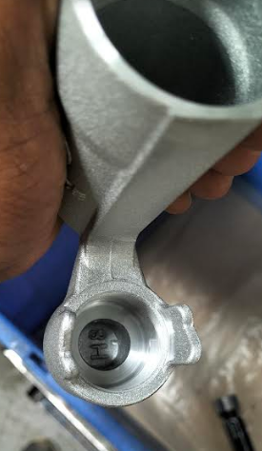
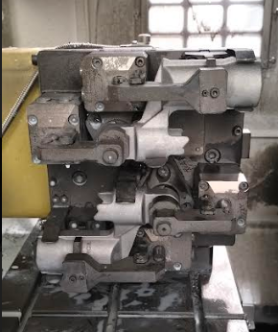
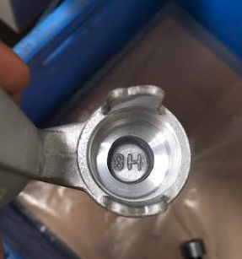
Phase-II Improvement Process PFD
IDENTIFICATION MARK
OP-10 VMC PROCESS MACHINING FIXTURE
With dot marking top side station
Without dot marking down side station

