Slide 1
TOPIC : Chamundi – Green Belt Photos
DATE : 07th June,2021

Slide 2
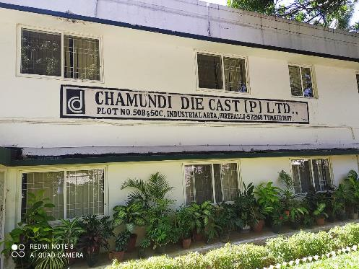
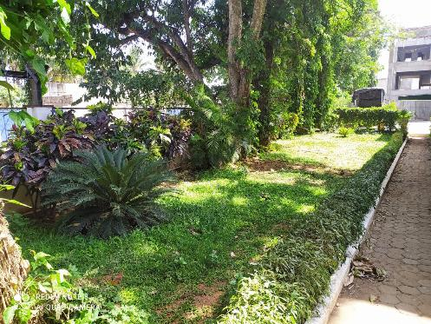
Green Belt Areas Inside Plant – Photos

Slide 3
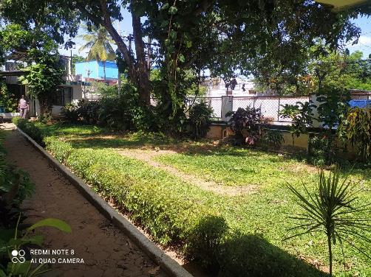
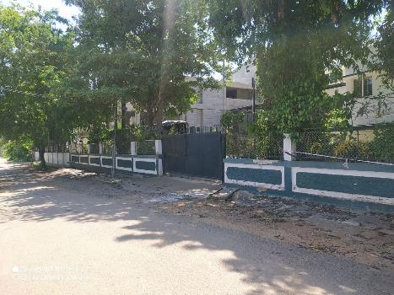
Green Belt Areas Inside Plant – Photos

Slide 4
THANK YOU

