Slide 1
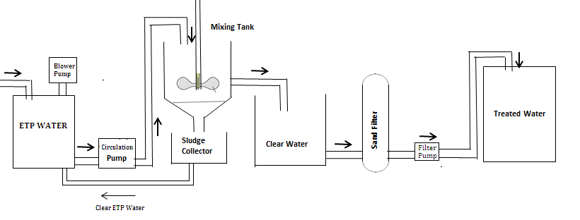
ETP PROCESS FLOW DIAGRAM

