Slide 1
Technowise Industrial Services Pvt Ltd
All types of Maintenance & production service
Electrical & Mechanical work
Specialist in Paint shop cleaning & deep cleaning
Oven cleaning
Air supply cleaning
House keeping all type shop
Skilled – unskilled labour suppliers
Material supplier Etc.

Slide 2
Work scope
We provide all the services required to run the facilities under one roof according to company needs.
Our services includes all types of maintenance Electrical, Mechanical work, Deep cleaning. we are specialist in Paint shop cleaning, Oven cleaning, Paint mix room cleaning Housekeeping & cleaning services , Security services Etc.
We can provide a more efficient solution translating into reduced costs and increased productivity.
We are very much Client-Focused, Safety Oriented, And Quality-Driven according to company’s standard operating procedures.
.Production in paint shop

Slide 3
Solution & services :
Paint booth-
Grating cleaning
Pit cleaning
Side walls cleaning
Ventury cleaning
Gun pipe cleaning
Hanger Skid cleaning
Mat filter changing
Bloater inside cleaning
Conveyor cleaning
Top to bottom system cleaning etc.

Slide 4
Solution & services :
Oven-
Oven interior cleaning
Heat box inside chamber cleaning and filter change
System cleaning etc.
PT/ CED-
All tank cleaning and water filling
Nozzle cleaning and fitting
Heat exchanger cleaning
Pipe line cleaning etc.

Slide 5
Solution & services :
Air supply unit -
Filter cleaning/ Filter changing
Water tank cleaning
Inside blower room cleaning
System cleaning etc.
Paint mix room (PMR)-
Tank cleaning
Paint mix room inside cleaning etc.

Slide 6
Solution & services :
Industrial Housekeeping by skilled personals
Deep cleaning services for building , paint shops etc.
Technical Maintenance (Mech. /Elect)Management.
Skilled/Unskilled Manpower Supply specialist in painter/ITI/Diploma/Fitter etc.
High Pressure Water Jet Cleaning up to 1000 bar.
ETP & Waste Management .
AMC specialist in Automobile Process. Mampower Availability-1 to 1000

Slide 7
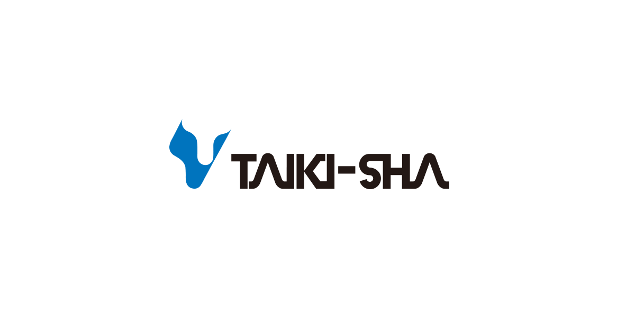
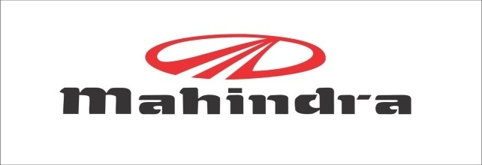
Our Clients :
Pune chakan
Pune chakan
Haryana bus plant
Chakan pune
JBMI haryana

Slide 8
We are Different :
Our almost 20 years of keen experience with multi national companies makes us superior in terms of quality hence we are different than others.
Single window Solution for all your Technical & Non technical Services in Automobile industry
Specialist in Paint shop technical & Deep Cleaning.
Well-Groomed & Trained Manpower for ensure Quality and safety in work shop floor.
Mechanized Services – wide range of High-end Machines to take care of Plant equipment health & life.
We exercises man to man ratio concept in rendering the services thereby ensuring optimal output from each manpower.
Professionally delivered services as working in state of art plant.
Creating Win-Win situation by providing optimal cost solution.

Slide 9
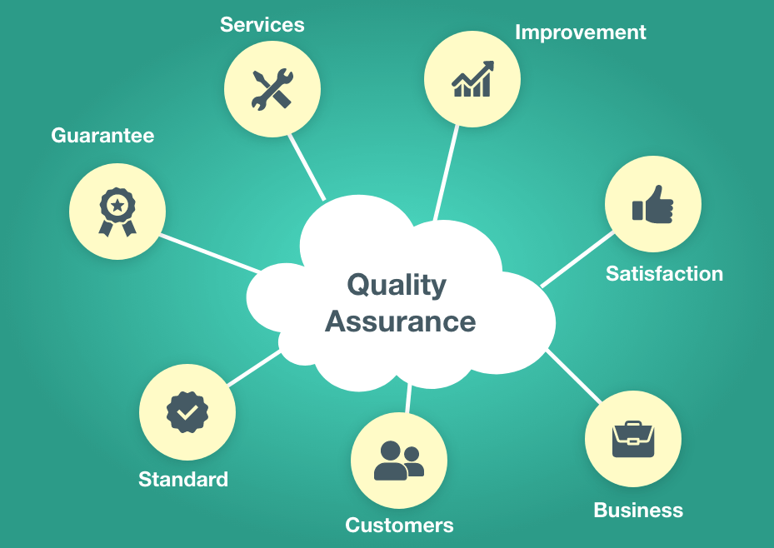
Quality Assurance
Quality is the foremost priority of our organization. The technical knowledge and profound experience of our team members helps us in offering quality range of Survey Services to the wide based clients.
Further, the active process supervision of our management team also enables us in offering high quality of facility management based services that meet with industry standards and norms. Apart from this, we also ensure the equipment and tools used in survey are of latest technology and must be able to yield accurate results.

Slide 10
Contact Details:
Mailing Address:
servicetechnowise@gmail.com
Technowise Industrial services
Pvt. Ltd.
68,Annapurna Colony
Mhow Gaon, Indore
M.P. - 453441
Contact Person:
Mr. A.K Singh
+91 8770990447
Mr. Roshan Singh
+917294093845
Notes:
nbcn

Slide 11
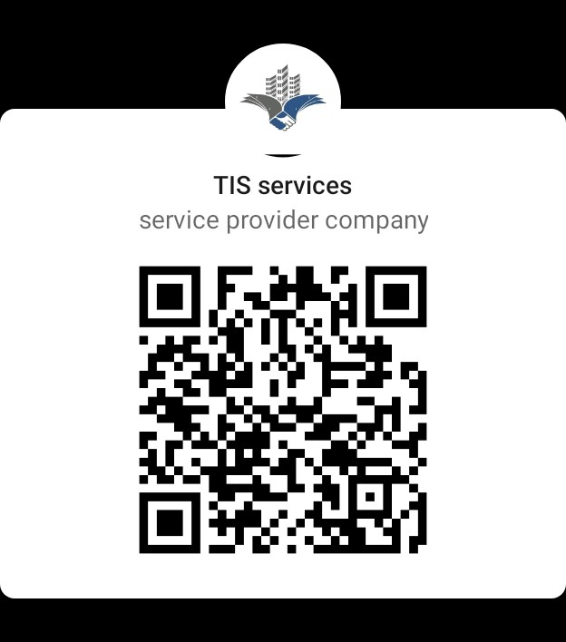
TECHNOWISE INDUSTRIAL SERVICES
Thank you

