Slide 1
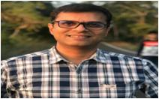
ORGANIZATIONAL STRUCTURE
Mr. Atul Bhandari CEO
Mr. Prashant Rajput Plant Head
Mr. Sharad Jadhav Purchase Head
Mr. Anil Chavan Quality Head
Production Head
Deepak Yadav
Maintenance Head
c.Sharma
Mrs. Manisha Tekale HR
1.Vishwanath Panchal
2.Bhagwan Khetre Quality Inspector
1)Gaurav Khandalkar
2)Govind Gupta
3) Manoj Gawai Shift Supervisors
Operators

