Slide 1
Entolabs India Private Limited
One stop solution for your pest control needs

Slide 2
INTRODUCTION
Entolabs was created and managed by a team of experts (HACCP Certified) who are in the pest control Industry for more than two decades.
Incorporated in the year 2015 with its registered office at Chennai.
Turnover is around Rs.600 Lakhs per year
Indepth understanding of the science of the pests and rodents, their origin and behaviour, the root cause analysis of the issues and the professional, scientific and customer centric approach to pest control have helped establish the reputation of Entolabs as one of the most trusted companies in the industry.
Entolabs takes pride in providing the highest standard of pest control services through a team of well trained and groomed technicians, service excellence experts, customer experience experts & entomologists.
Efficient and cost-effective pest control services with focused customer centric approach gives our clients assurance of quality and value for money.
Entolabs use the eco friendly, human friendly, odorless and colorless chemicals from reputed brands with focus on safety and health of all stakeholders and environment at large.

Slide 3
QUALITY DELIVERANCE
ISO 9001:2015 certified for Services
Specialization with individual HACCP certification
Use of eco friendly and human friendly broad band chemicals
Sensitive to the aesthetics of the structures and common areas
Adherence to compliance and HSE systems
Use of state-of-the-art machinery with AMC
Use of required PPE for technicians

Slide 4
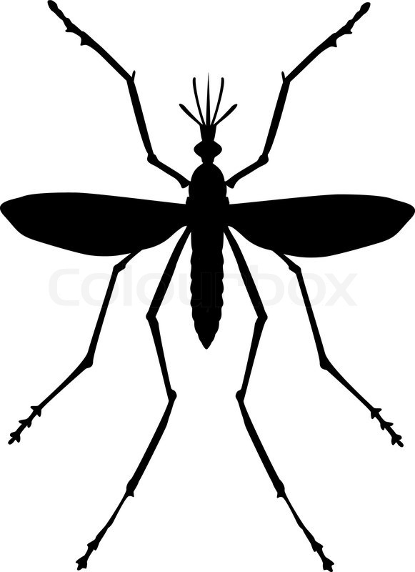
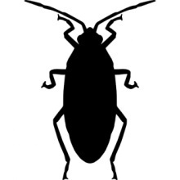
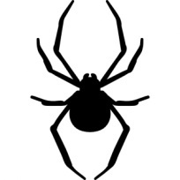
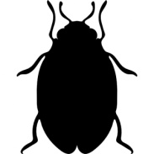
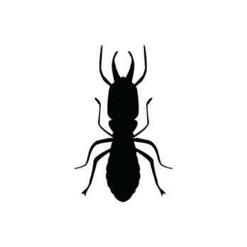
SERVICES OFFERED
Mosquito
control
Cockroach control
Spider control
Bed Bugs
Control
Rodent
Control
Termite
control
Bird
control
Snake
Control
Wasp
control
Fly
Control

Slide 5
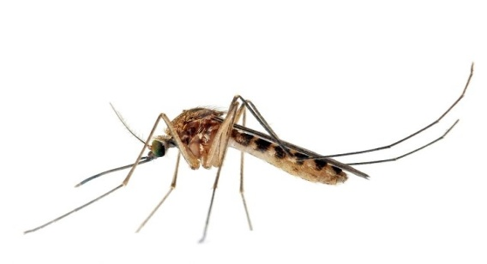
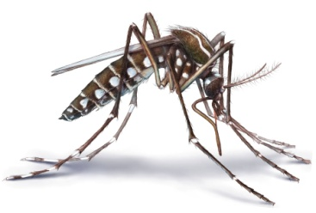
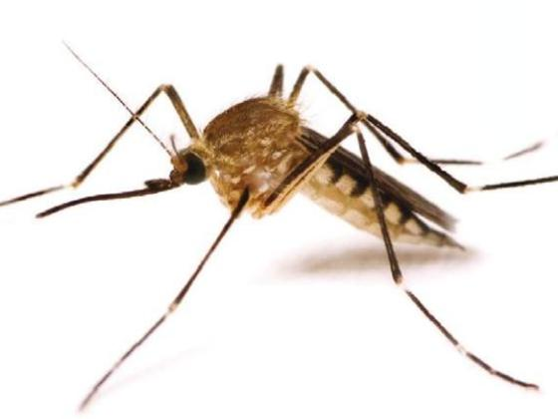
PROCESS FOR MOSQUITO CONTROL
Larviciding : Use of specialized larvicidal chemicals to control larva in mosquito breeding grounds
IRS (Indoor Residual Spraying) : Colorless and odorless Synthetic pyrethroids (Contact poison) sprayed on the walls which has a residual effect
Cold Misting : Specialized chemical emission in indoor areas for maximum penetration
Fogging : To eliminate adult mosquitoes that refuge in the external areas of the premises
Culex
Aedes
Anopheles

Slide 6
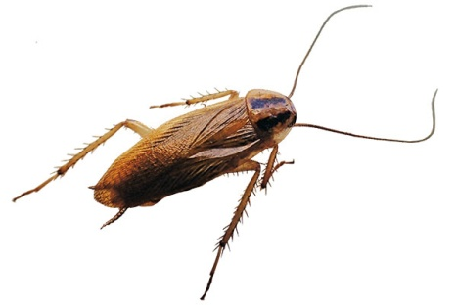
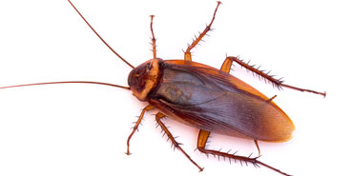
PROCESS FOR COCKROACH CONTROL
Clean - out & Baiting methods
Residual Chemical Spraying : Strategic Chemical spraying in infected area
Cracks & Crevices Work : Using aerosols to inject pesticides into the tiny areas where target pests are hiding
Gel Baiting Treatment : Gel spots are placed in strategic locations to exploit the cannibalistic tendency of cockroaches
German Cockroach
American Cockroach

Slide 7
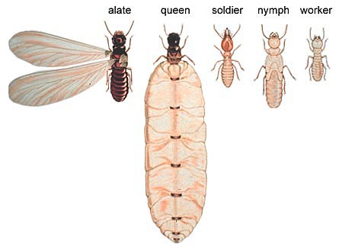
PROCESS FOR POST CONSTRUCTION ANTI-TERMITE TREATMENT
Drill Fill And Seal Treatment :
Drill: Drilling at tile level on the walls with a foot distance at 45°angle.
Fill: Filling and injecting the diluted termicide with domino effect inside the drilled holes repeating the process thrice with 2 hour gap.
Seal: Sealing or closing the holes with Chalk and pasting with white cement.
Spot Foaming :
Injecting / spraying the diluted oil based chemical on wooden fixtures and furniture

Slide 8
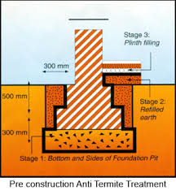
PROCESS FOR PRE CONSTRUCTION ANTI-TERMITE TREATMENT
Soil treatment at excavation level of construction
Chemical drenching at 3 stages
Stage1 : Drenching the bottom and sides of foundation pit with specialized chemical
Stage2 : Chemical injection during earth refilling
Stage3 : Uniform chemical spray at plinth level

Slide 9
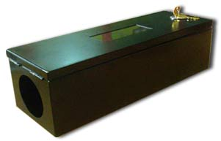
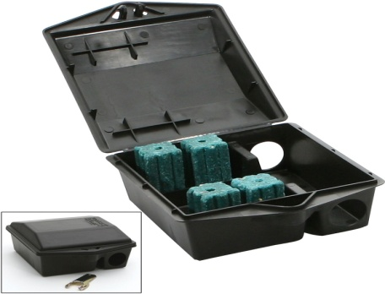
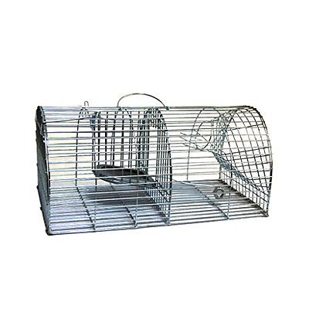
PROCESS FOR RODENT CONTROL
Three Line Defense
First Line Defense : External bait station is a see through device placed at the perimeter level of the premises to control rodent entry from external area.
Second Line Defense : Tamper Resistant Bait stations have single entry point and are placed close to the building to control rodents entering indoors.
Third Line Defense : Combination of mechanical traps and manual traps used to trap rodents inside the building (Glue Board Traps are being banned)
External Bait Station
Tamper resistant Bait Station
Mechanical Trap

Slide 10
THREE LINE DEFENCE MECHANISM LAYOUT
External Bait Station
Tamper resistant bait station
Building interior/Shop floor
Manual and mechanical traps
Compound Level
Fencing Level

Slide 11
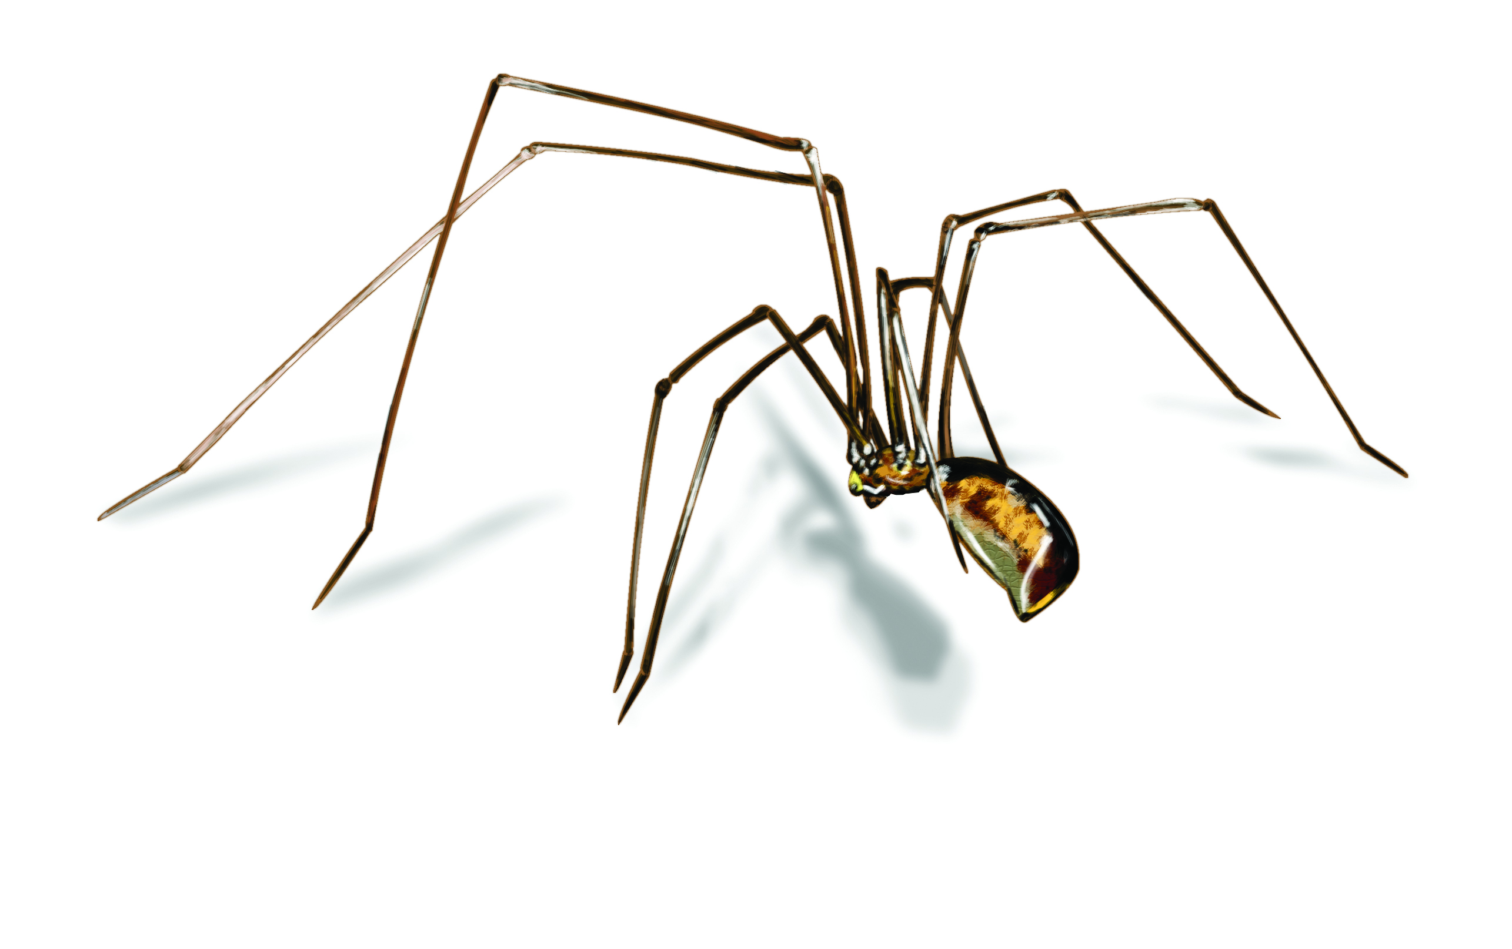
SPIDER CONTROL
If spiders are coming indoors, hunting for their prey, a residual insecticide spray treatment around all entry points and the perimeter of the premises is done
Chemical spray is done anywhere they are webbing - on decks, under eaves, on porches and other areas of the buildings and installations.

Slide 12
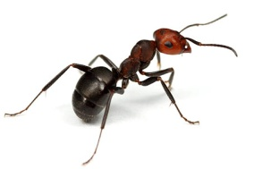
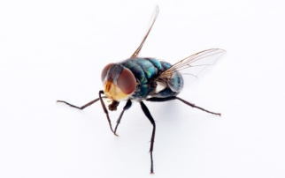
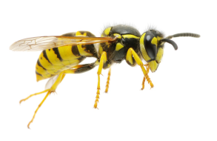
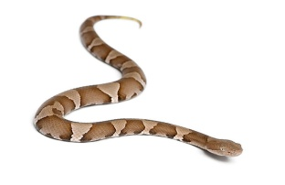
OTHER PEST CONTROL AND GENERAL DISINFESTATION TREATMENTS
Strategic use of sugar based granules and chemical spraying
Ants & Flies
Chemical Spraying to eliminate bees and wasps
Wasp & Bee
Sealing the entry points and construction of a chemical barrier
Snake

Slide 13
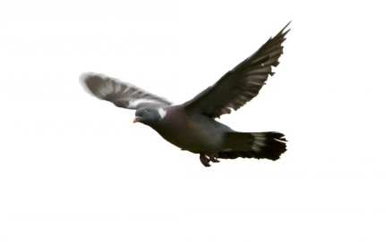
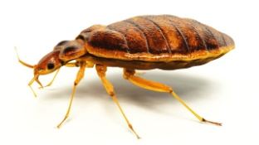
OTHER SPECIAL SERVICES
Bird netting and installation of spikes
Birds
Chemical spraying and cold misting
Bed Bugs
General Disinfestation Treatment : Ultra low volume sprayer IS used to spray tiny droplets of broad band chemical which can reach cracks and crevices of the building / premises

Slide 14
SUPERIOR SERVICE DELIVERY
2 / 24 complaint response/ resolution system
Quarterly Audit report and presentation
Pest proofing guidance
Sharing knowledge on latest methods and process
Use of human safe and environmental friendly chemicals
Escalation matrix for faster and total response
Use of state of the art techniques like Pest Risk Matrix

Slide 15
PEST RISK MATRIX
Science-based process that provides rationale for implementing Pest control measures for a specified area
Systematic approach to decide how a pest should be managed
Pest Risk Matrix
 | CONSEQUENCE
LIKELIHOOD | Level – 1 No | Level - 2 Rare | Level – 3 Visible
Pest seen during day | M | H | H
Pest droppings and other visible marks | M | S | H
Pest entry points and hygiene | M | S | H
H | HIGH RISK
S | SIGNIFICANT RISK
M | MEDIUM RISK

Slide 16
ENTOLABS ENTOMOLOGY EXTENSION PROGRAM
Reducing the environmental impact of insect management.
Focus on scientific control of insects/pests and proper dosage / usage of pesticide
Dedicated Field Biologists who support our Service Technicians by carrying out regular inspections on customer premises
In–depth examinations and analysis of production / operation processes and pest risks.
Extensive in–company training in various aspects of pest control, Safety and usage of relevant PPEs
Root Cause Analysis of any pest issues the Client may be experiencing and making highly practical recommendations to deal with the situation

Slide 17
OUR CLIENTS

Slide 18
OUR CLIENTS

Slide 19
OUR CLIENTS

Slide 20
OUR CLIENTS

Slide 21
OUR CLIENTS

Slide 22
OUR CLIENTS

Slide 23
OUR CLIENTS

Slide 24
OUR CLIENTS

Slide 25
OUR CLIENTS

Slide 26
CONTACT
Email: Consult@entolabs.in
Website : www.entolabs.in
Contact : 044 48522555 / 7823955520/ 7823955521
Address: #11, CLC Works Road Chrompet , Chennai - 600044

Slide 27
THANK YOU

