Slide 1
Welcome to the
Janai’ Group world
I
A
N
A
J
www.janai-group.com

Slide 2
ABOUT
Janai Industries Is A Firm Specializing In Engineering, Consulting, Manufacturing And Integration Of Automated Production Systems.
We Provide Innovative Technological Production Systems.
We Provide Innovate Solutions To A Wider Range Of Customers In The Fields Of Manufacturing And Industrial Processes.
With The Help Of Our Team Of Qualified Experts In Mechanics, Electricity, Automation, Robotics, Instrumentation And Information Systems. Our Talented Employees Focus Their Energy On Helping Business's Meet The Challenges Of Today’s New Economic Realities, Such As Globalization, Competitiveness And Ever Changing Commodity And Energy Prices.
www.janai-group.com

Slide 3
Know more about Janai Industries WE HAVE
Janai Industries AN ISO 9001: 2015 Total solution in process design & manufacturing Commodity And Energy Prices.
Janai Group was established in 2009 in Aurangabad, Maharashtra. We offer complete installation services and hardware and software support to our clients. We are recognized as a leading technical solution support and special purpose machine manufacturer and our group company Anom Technology is a trading company supplying pneumatic and electric panels to premium quality drive and speed control system suppliers.
www.janai-group.com

Slide 4
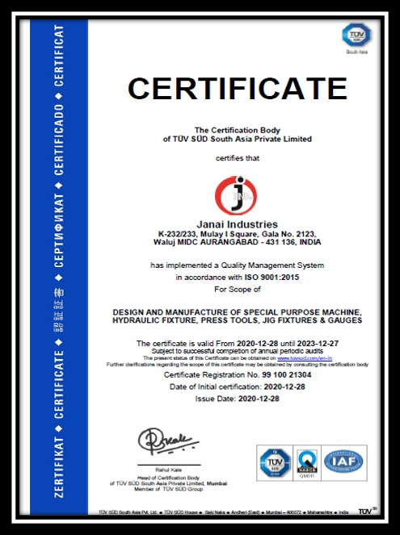
Know more about Janai Industries WE HAVE
Janai Industries AN ISO 9001: 2015 Total solution in process design & manufacturing Commodity And Energy Prices.
www.janai-group.com

Slide 5
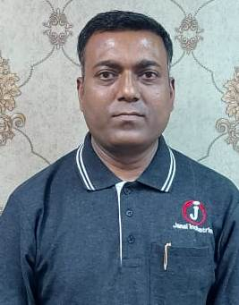
Let's meet our TEAM
Number of Employees 34
1) Marketing Manager
2) Marketing Executive
3) Sales Engineer
4) Quality Manager
5) Quality Executive
6) Production Manager
7) Production Assistant
8) Account Executive
9) Dispatch Manager
10) Dispatch Executive
1) DRO Operator 8
2) Lethe Machine operator 8
3) VMC Operator 2
4) Tig , mig & arc, welding machine
Operator 2
5) Bending Machine Operator 1
6) Operator Supporter 3
Mr. Ravikumar Vasate
(Managing Director)
www.janai-group.com

Slide 6
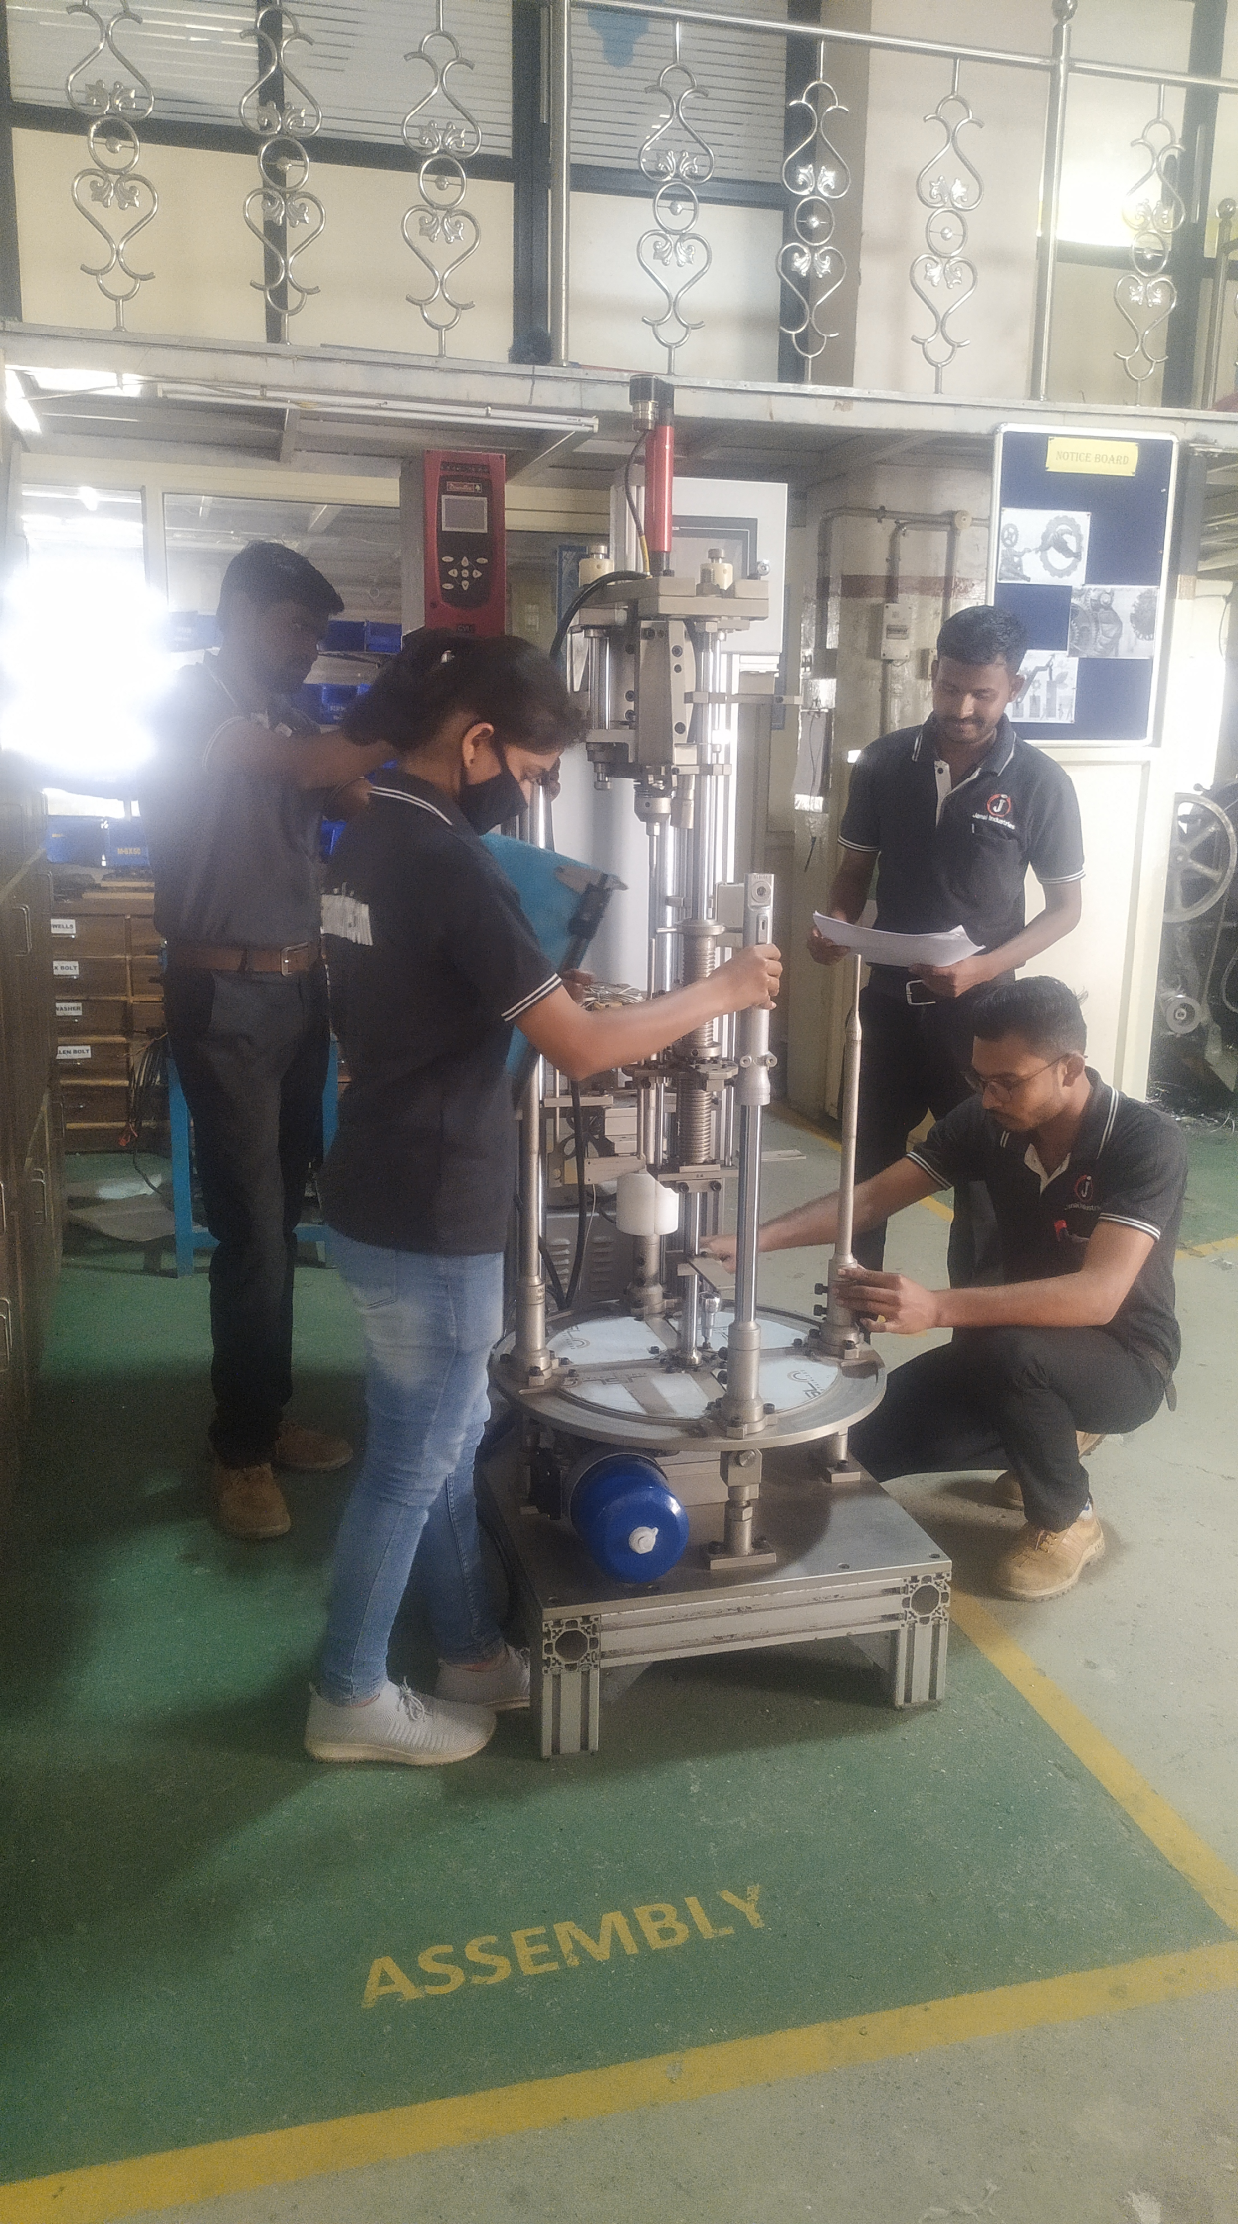
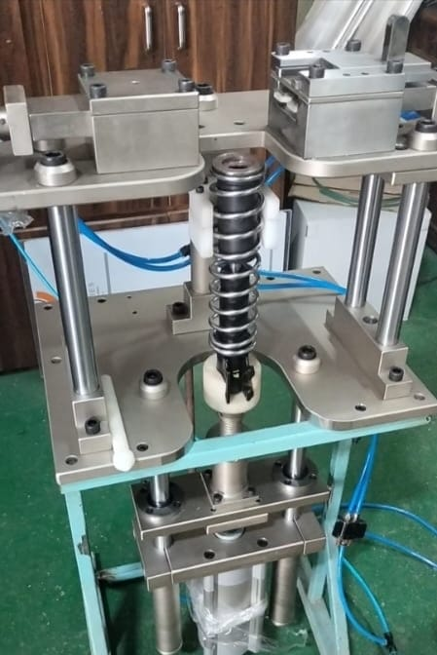
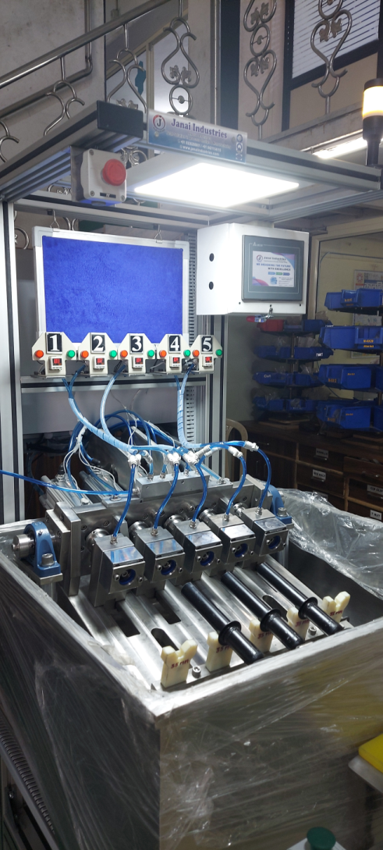
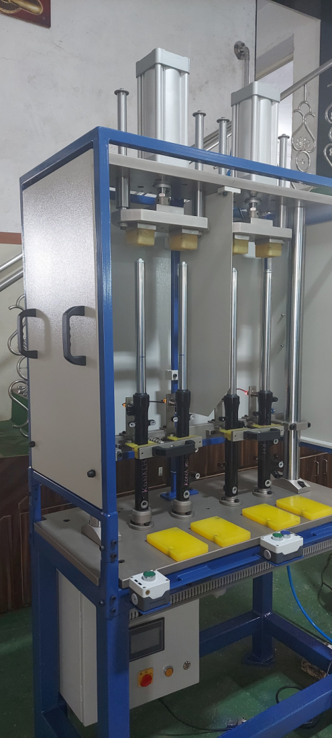
Our Developed machine
Let’s introduce to our Assembly Spring Fitting Machine….
Let’s introduce to our Assembly Leakage testing 7 to 10 Bar Machine….
Let’s introduce to our Assembly Stroking testing Machine….
Let’s introduce to our Assembly Central bolt Machine….
www.janai-group.com

Slide 7
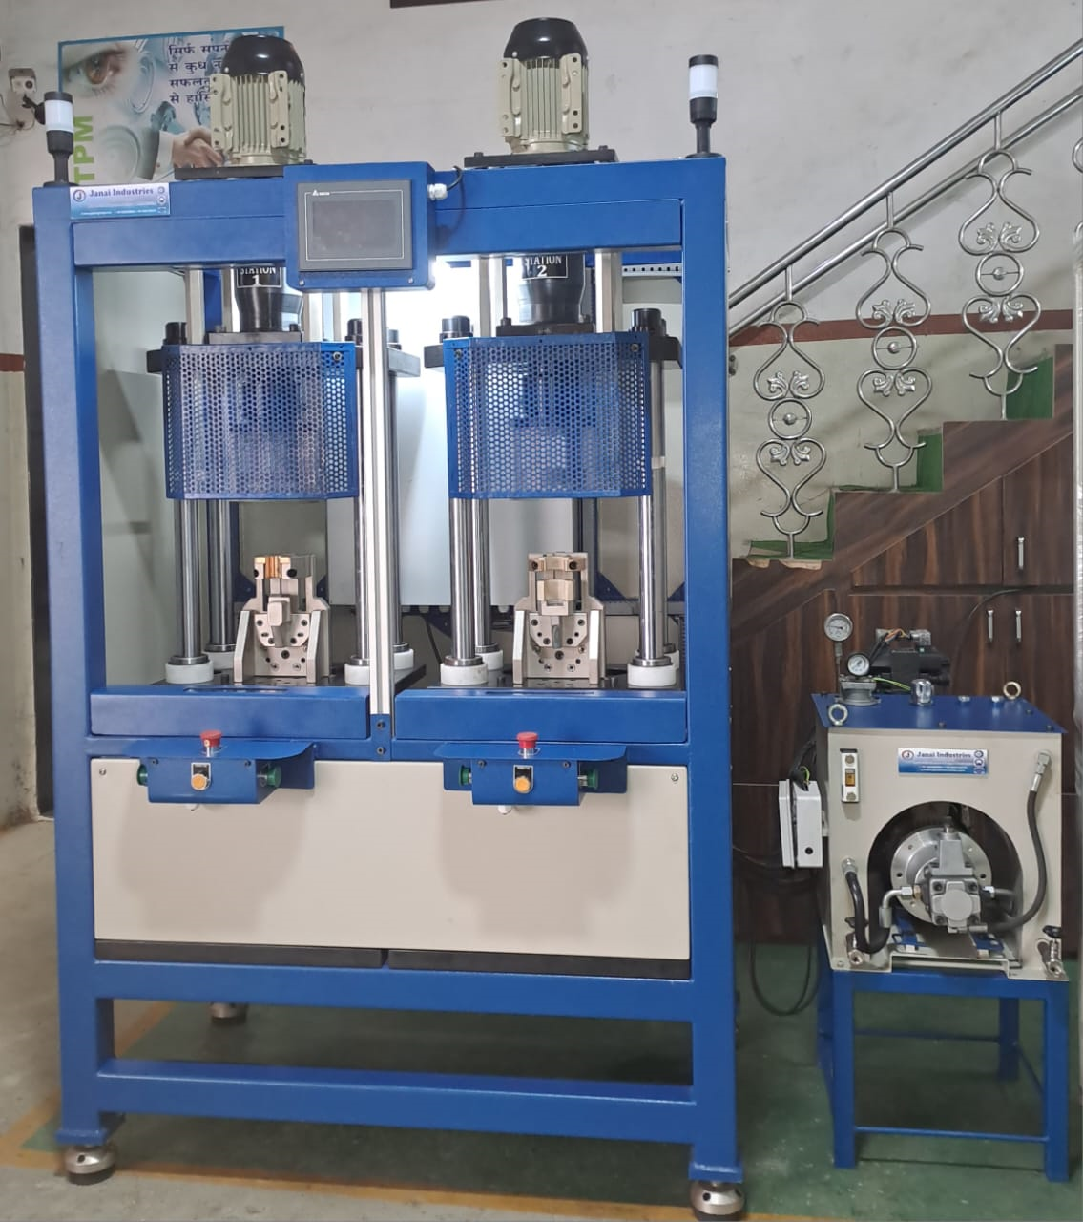
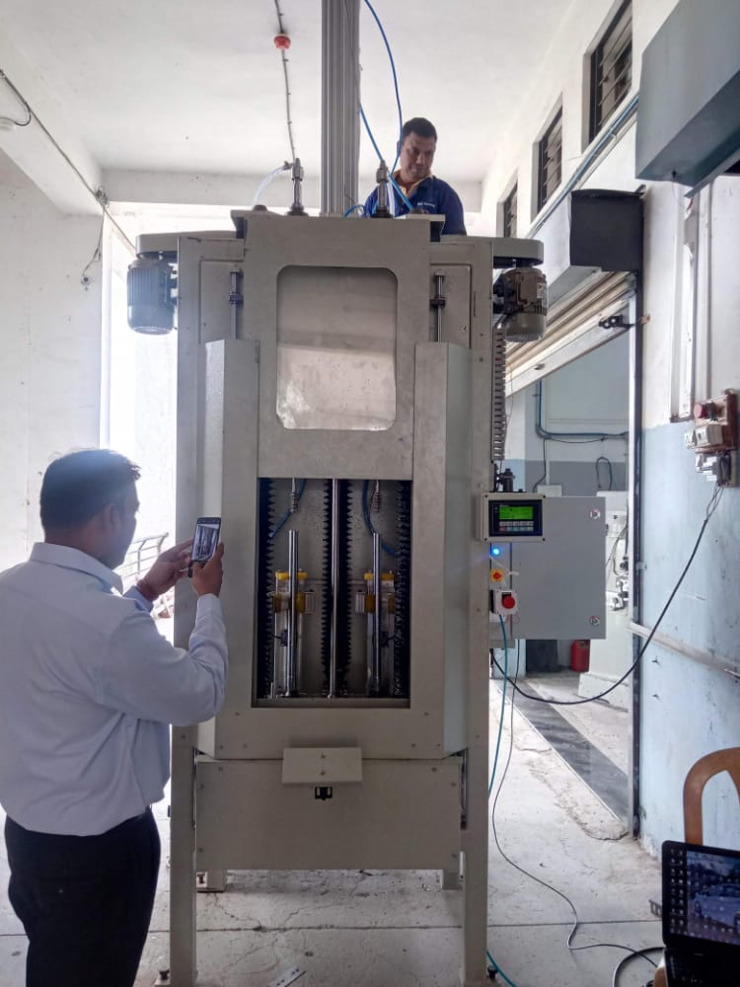
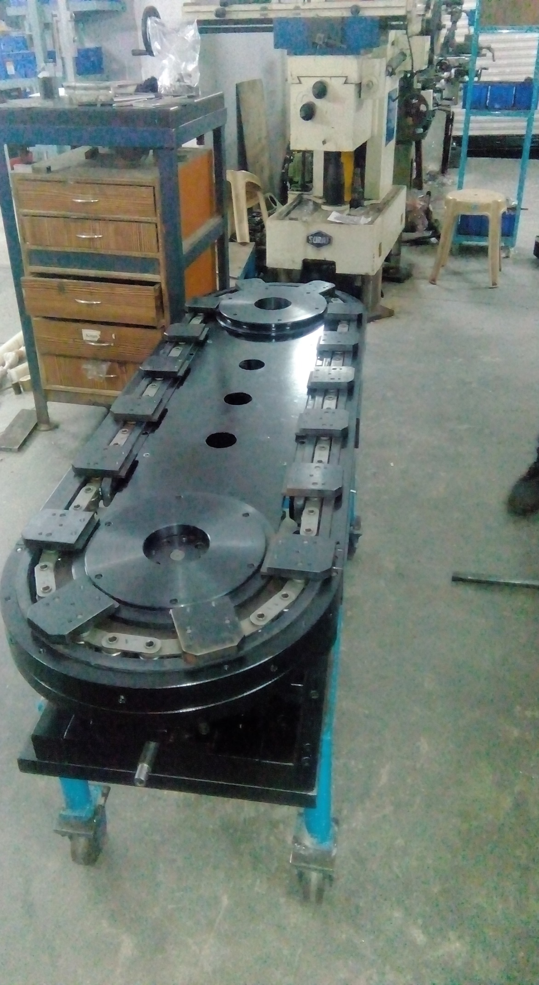
Shocker assembly sealing Machine 2 Station….
Let’s introduce to our Assembly
ID Cleaning Machine….
Let’s introduce to our Assembly Multiple station Conveyor ….
www.janai-group.com

Slide 8
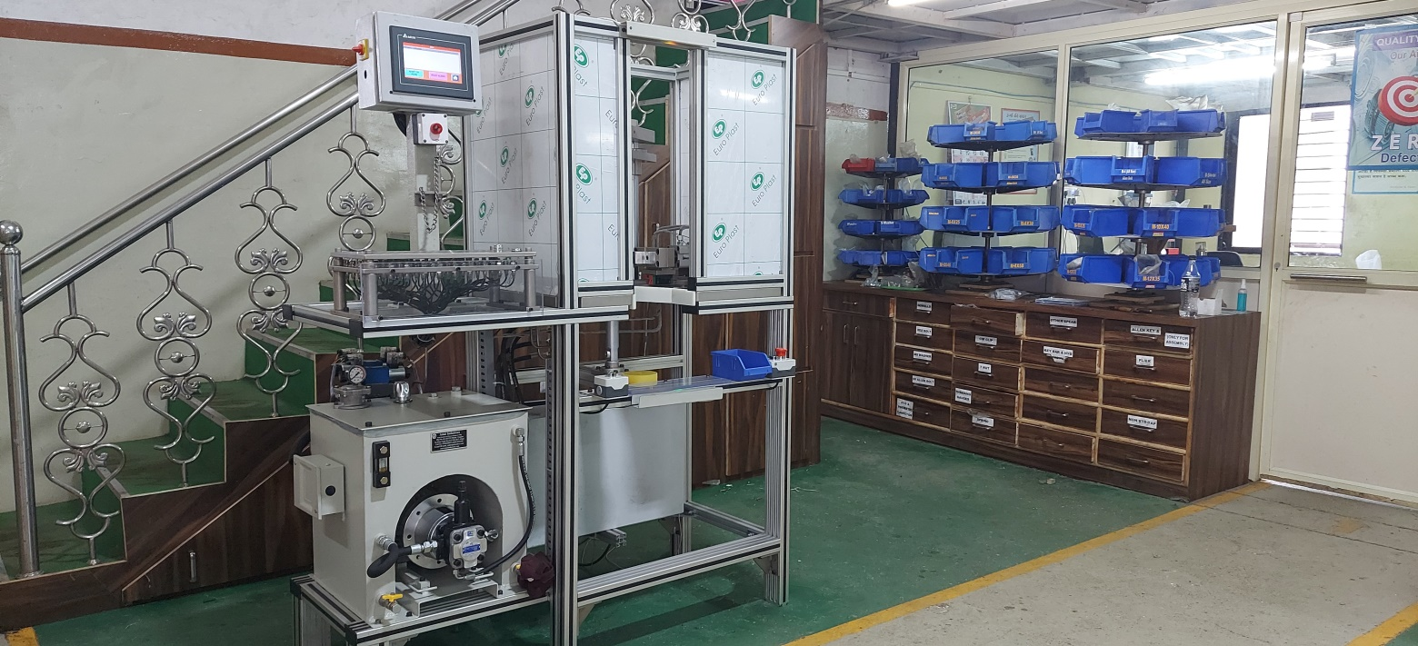
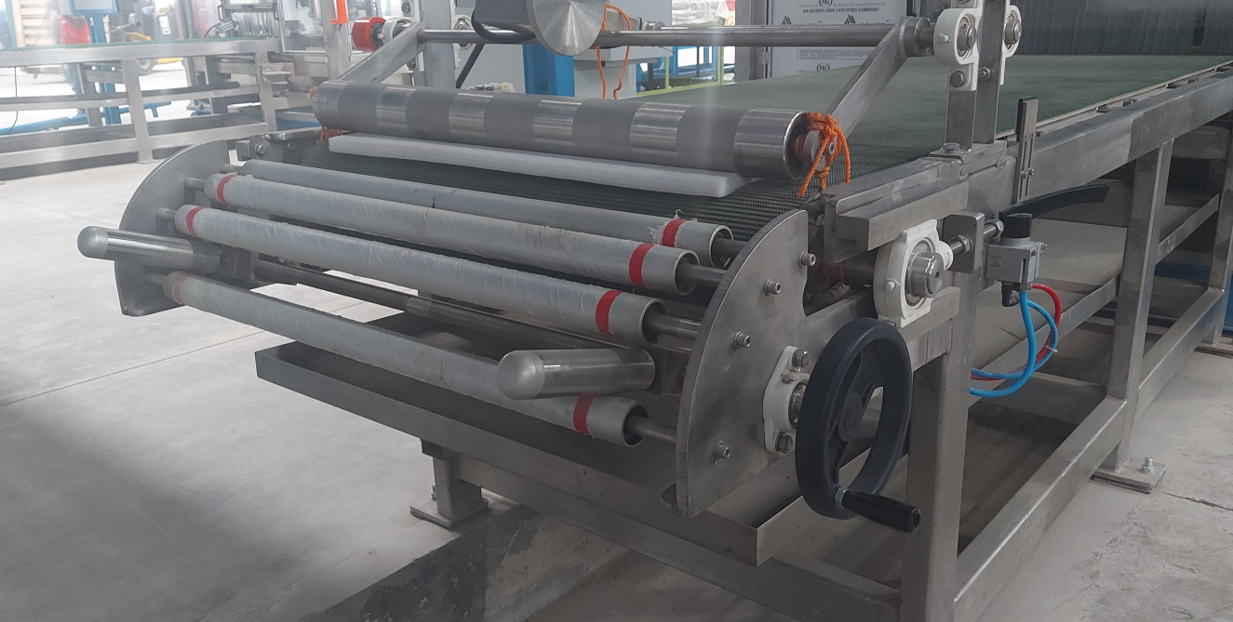
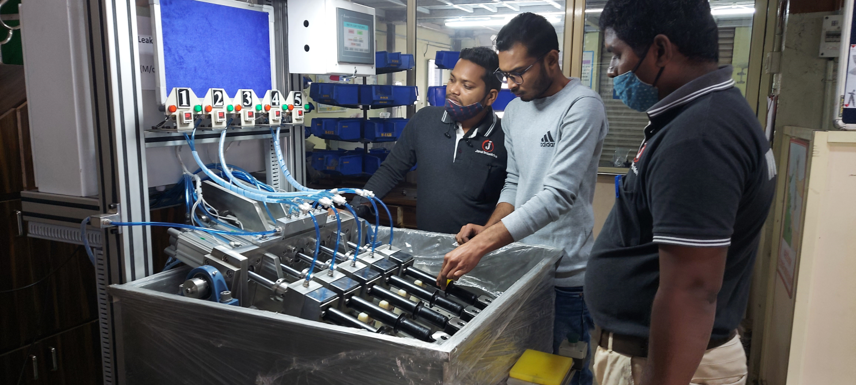
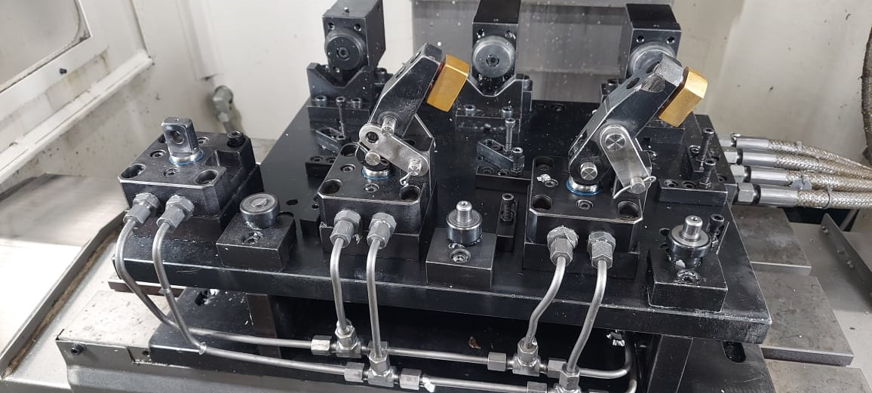
Let’s introduce to our Assembly
Circlip Pressing Machine….
Let’s introduce to our Assembly
Heavy Load Carry Conveyor….
Let’s introduce to our Assembly
Hydraulic Fixture….
www.janai-group.com

Slide 9
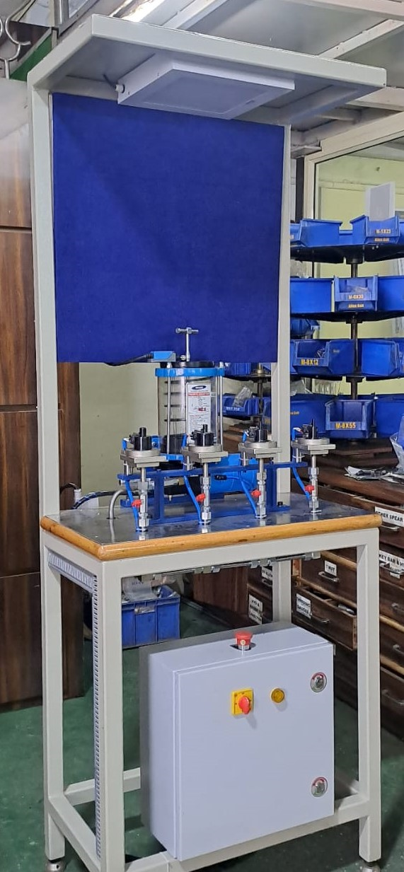
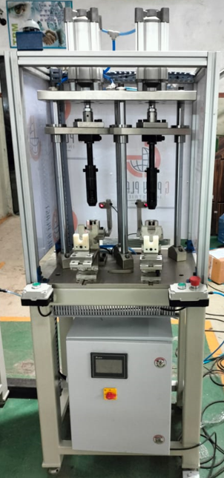
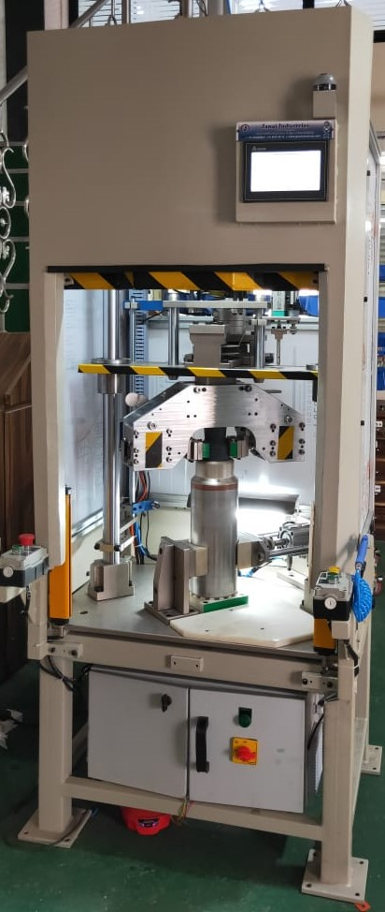
Oil Seal Greasing- 4 Station
Machine….
Rubber Bush Pressing
Machine….
Big Nozzle Assembly
Machine….
www.janai-group.com

Slide 10
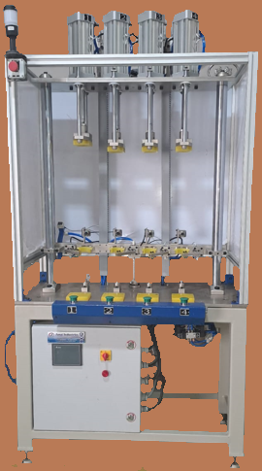
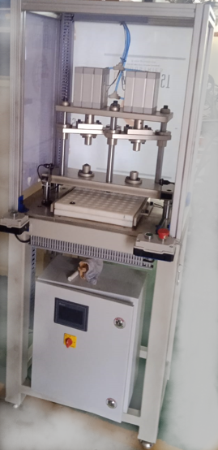
Stocking
Machine….
Cir Clip Pressing
Machine….
www.janai-group.com

Slide 11
Our Customer list
1) Sudharshan Sour Shakti
2) Endurance Technologies Plant K228/229
3) Endurance Technologies Plant E-92/93 , K120, Panthnagar,
4) Endurance Technologies Plant K226, L6/3, Sanand, Halol,
5) Green Sense Energy System
6) Anushka Solar
7) Tube Products Of India
8) Varroc Doru
9) Narsimha industries
10) Varroc Elastomers Pvt. Ltd.
11) Saur Shakti Enterprises
12) Suyash Engineering Works
13) Dekson Casting Ltd.
14) Agrovison Green Enargy Pvt. Ltd.
15) DNR Auto Engineering Ind.
16) M.A. Enterprises
17) Accrete Electromech Pvt. Ltd.
18) Indosculp Auto Comp. Pvt. Ltd.
19) NLMK Steel
20) Sangkaj Steel Ltd.
21) Munjal Showa ltd
22) Sangkaj Engineering Pvt. Ltd.
23) JBM
24) S.N. Metallurgical Service
25) Siemens Limited
26) Badve Engineering all plant
27) Varroc polymer
28) Siemens
29) Grware Polymer
30) Kohlar
31) Greaves Cotton
32) All Endurance Plant
www.janai-group.com

Slide 12
Thank You so much
We are here for serve you
“work together and grow together”
www.janaiindustries.com

