Slide 1
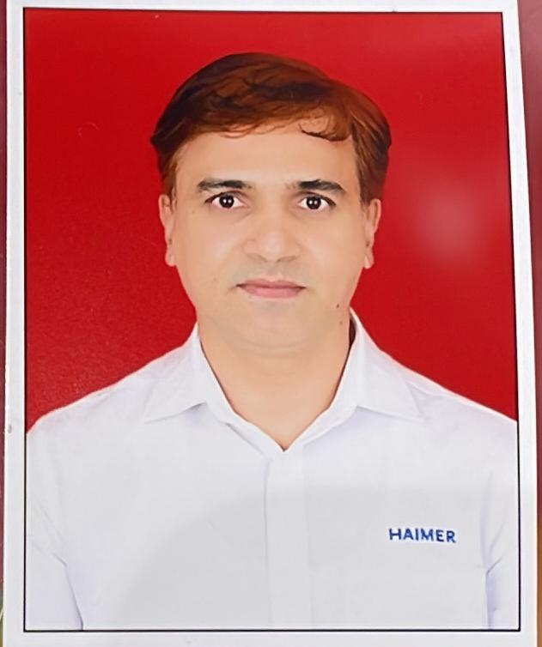
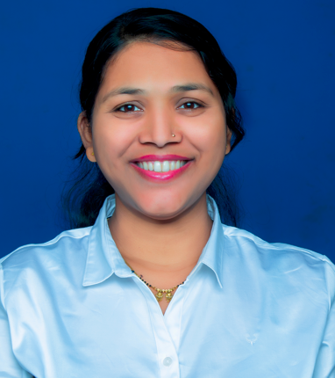
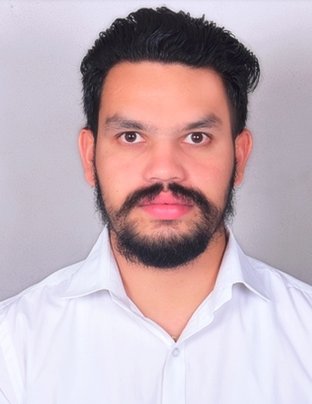
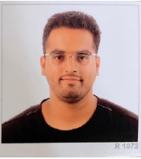
Haimer India Private Limited. Organizational Chart
President & MD -
Andreas Haimer
Head of BD &
Sales
Greater China.
SOEA & India
Jannik Kaspar
Managing
Director
HIPL
Amolak Singh
Senior
Office Mgr.
Santosh
Patankar
Country Mgr
Sales
Manas
Majumdar
Sr. Mgr (HD)-
CS & Logi
Nilesh
Bhalerao
Dy. Mgr
Finance
Ashwini
Adawade
Asst.Mgr
Mkt & Admin
Bhavana
Poste
AGM-BD-
West
Sharma Himanshu
Sr. Mgr. BD
(Chennai)
Loyola
Francis
DGM-BD
Electronics
& Aerospace
M. Venugopal
Sr. Mgr.
Bangalore
& East
Saumya
Biswal
Sr. Mgr. BD
(North)
Mayank
Ahuja
Dy. Mgr.
Service & Applications
Ravi Ghate
Sr. Mgr.
Customer Serv. & Log.
Santosh Parab
Executive
Mkt & Admin
Payal
Agrawal
DY Mgr-
BD
Abhijeet
Dalavi
DY Mgr.
BD
Mukesh
Kumar
Sr. Engineer
Sales &
Applications
Sangamesh
Avanti
Engineer
Service &
Applications
Abhishek
Chindhe
Engineer
Service &
Applications
(South)
Girisha A
Log. & Sales
Coordinator
Ujvala
Patil
Asst. Mgr.
Warehouse
Rakesh
Gawade
Sales-
Engineer-
VijayKumar
Pandey
Asst. Mgr-
BD
Bangalore
Keerthi Lava
Technician
Service &
Applications
Shubham
Alhat
Mgr. BD (East )
Supratim
Sarkar
Logistics
Assistant
Sanjay
Kharade
Warehouse
Assistant
Akshay
Hole

