Slide 2
1. Introduction
This slide is prepared for the workers in the working industry for a better understanding of the hazards associated with the machines used in the industry. Hence, control measures and risk levels can be assessed for effective control of the hazards.
The hazards identified in the presentation may be applicable to other industries.

Slide 3
2. Incident History
These incidents can cause:
Damage to the body, e.g. cuts, crushing of limb, etc
Injuries by energies released from the machine, e.g. electrical shock, burn, etc
Fatalities

Slide 4
3. Machine Hazards
Typical hazards related with operation of machines include:
mechanical:
e.g. crushing, shearing, cutting or severing, stabbing or puncture
high pressure fluid ejection
electrical shock
noise and vibration
contact with extremes of temperature
ergonomics
others

Slide 5
4. Machine Hazards
When identifying the hazards related with machines, we shall consider:
type of machines
layout of machines
driven method, e.g. electricity, air, etc
operating parameters, e.g. speed, pressure, temperature, size of cut, mobility, etc.
materials to be processed or handled and method of feed

Slide 6
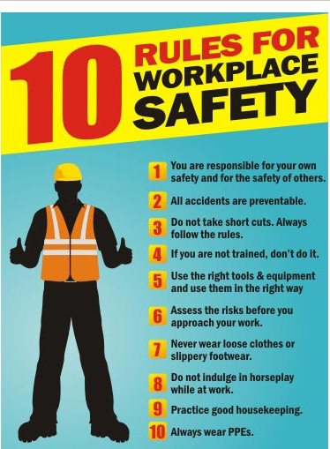

Slide 7
Enter Your Company Name ccHere
Enter Your Company Motto Here
Know How
to Lift
Heavy Load

Slide 9
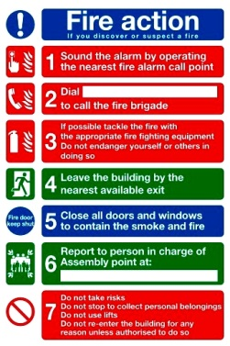
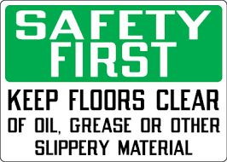

Slide 10
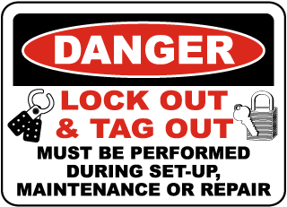
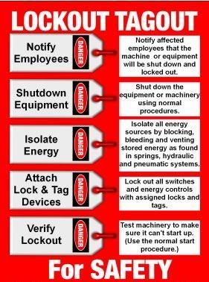

Slide 11
5. Machine Safety
Safe Practices
The following practices shall be observed at all times:
Always use the safety devices correctively;
Do not wear loose clothing/ties when operating machines with rotating parts;
Tie up or cover up long hair;
Use devices to remove trapped materials from machine;
Switch off the machine before retrieving dropped material(s) from inside the machine.

Slide 12
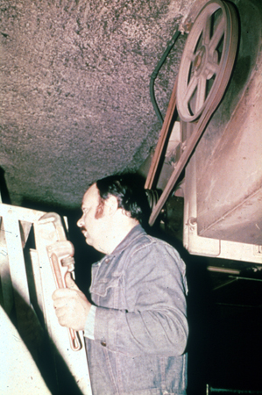
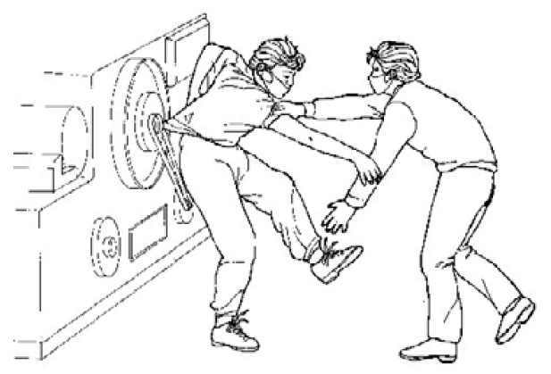
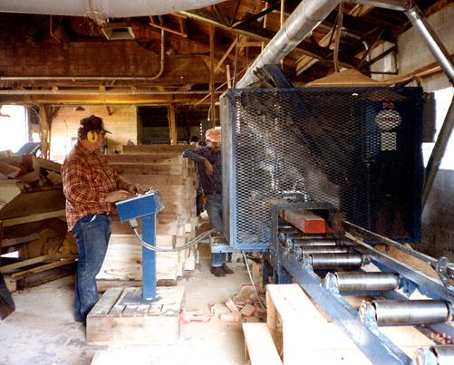
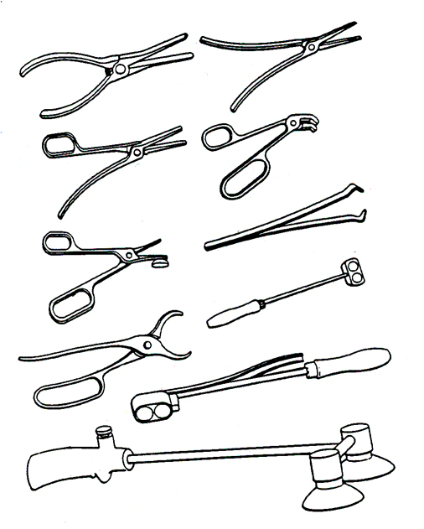

Slide 13
6. Machine Safety
Ergonomics
Some basic tips to improve ergonomics:
Use equipment to aid material handling
Use correct material handling position
Maintain comfortable position when working
Do the work with proper tools
Refer to Material Handling for Metalworking Industry for more details about ergonomic hazard control.

Slide 14
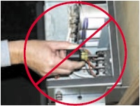
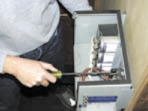
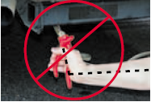
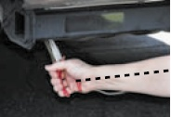
USE TOOLS WITH BETTER GRIP
USE CORRECT TOOLS

Slide 15
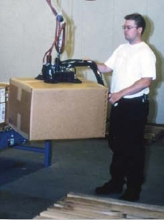
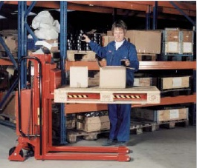
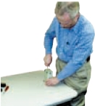
ADOPT CORRECT POSTURE

Slide 16
7. Machine Safety
Lockout/Tagout (LOTO) Procedure
What must workers do before removing LOTO device and reenergize the machine?
Step 1: Inspect machines or their components to assure that they are operationally intact and that nonessential items are removed from the area; and
Step 2: Check to assure that everyone is positioned safely and away from machines.

Slide 17
7-A. Machine Safety
Lockout/Tagout (LOTO) Procedure
What must workers do before maintenance activities?
Prepare for shutdown;
Shut down the machine;
Disconnect or isolate the machine from the energy source(s);
Apply the lockout or tagout device(s) to the energy-isolating device(s);
Release, restrain, or render safe all potential hazardous stored or residual energy. Regularly inspect to avoid re-accumulation of energy if necessary.
Verify the isolation and de-energization of the machine.

Slide 18
7-B. Machine Safety
Lockout/Tagout (LOTO) Procedure
What must be included in the LOTO Procedure?
A statement on how to use the procedures;
Steps to shut down, isolate, block, and secure machines;
Steps designating the safe placement, removal, and transfer of LOTO devices and identifying who has responsibility for the LOTO devices; and
Requirements to determine and verify the effectiveness of lockout devices, tagout devices, and other energy-control measures.

Slide 19
8. Machine Safety
4.2 Control Measures
Types of hazards control measures
Machine guarding
Using devices, e.g. sensor, gates, etc
Distance
Use of automatic or semi-automatic fed and ejection/robots
Use of feeding tools
Training, Procedures (LOTO), etc
PPE

