Slide 1
INDUCTION
March 2020

Slide 2
Introduction:
Name:
Branch:
Date of Joining:
Role:

Slide 3
Welcome on Board

Slide 4
Agenda
Cummins – Who We Are
Business & Functions Overview
HR Policies Overview

Slide 5
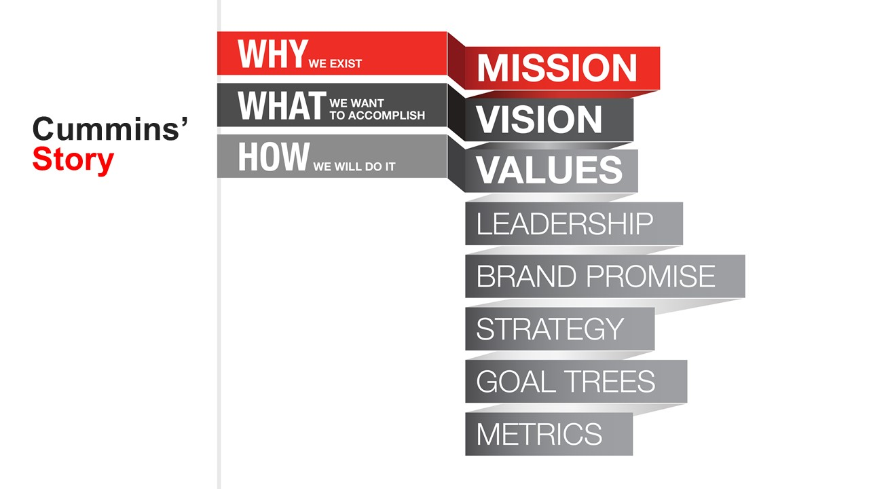
Cummins’
Story
Notes:
In revisiting our Mission, Vision and Values, we wanted a comprehensive framework. Over the past 16 years much content had been developed and it was confusing and overwhelming.
For example, we had 1 vision, 5 component mission, 6 core values, 5 personality traits 6 strategic principles, 5 growth accelerators, 10 leadership behaviors, an engineering slogan around innovation, and customer brand around dependability.
We sought to identify those areas critical to our future but also honor the past
We aimed to use words that inspire today and tomorrow
We wanted this to resonate globally
We thought about the long and short term
We included goal trees and metrics as we want to hold ourselves accountable
Mission “why we exist”
Vision or “what we want to accomplish.”
We will execute our Mission and Vision through our Values, Leadership Culture, Brand Promise and Strategy
Specifically call out customers
Personality traits are now imbedded in our values
Strategy in place of strategic principles and growth accelerators
Longer term at the top, shorter term at the bottom – strategies might change but our mission endures.
The stakeholder model applies here
We operate for the benefit of all of our stakeholders - shareholders, customers, employees, communities, partners and suppliers.

Slide 6
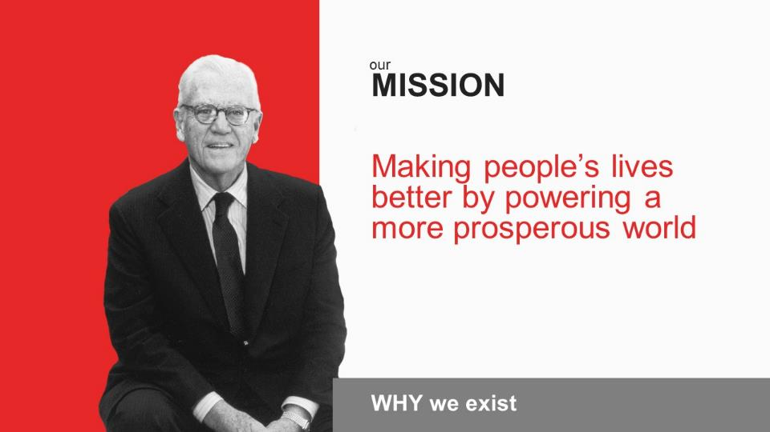
Notes:
Our Mission is defined as “why we exist.” It is the broadest statement of our purpose as a company.
“Making people’s lives better by powering a more prosperous world.”
“Making” is a nod to our role as one of the world’s leading manufacturers. Our products may look quite different in the years to come, but we will always be a maker – a “creator.”
“People’s lives” is applicable to all stakeholders. Our employees should be better for working here. We want our leaders to be able to reach your full potential from your development and experiences. We care deeply about our the people in our communities and are committed to improving their lives - short and long term. Our customers and the people they serve are who we are seeking success for.
“Powering” is a nod to our products and the industries in which we participate. It allows us the flexibility to grow and expand beyond our original products and technologies but still focus on where we have unique capability to serve.
“A more prosperous world” – Ultimately, our goal is to make people and places better because we are here.
A prosperous world is one where we create wealth for all of our stakeholders and we do so in a sustainable way.
To fulfill our Mission, we must create more wealth with less impact on the planet.

Slide 7
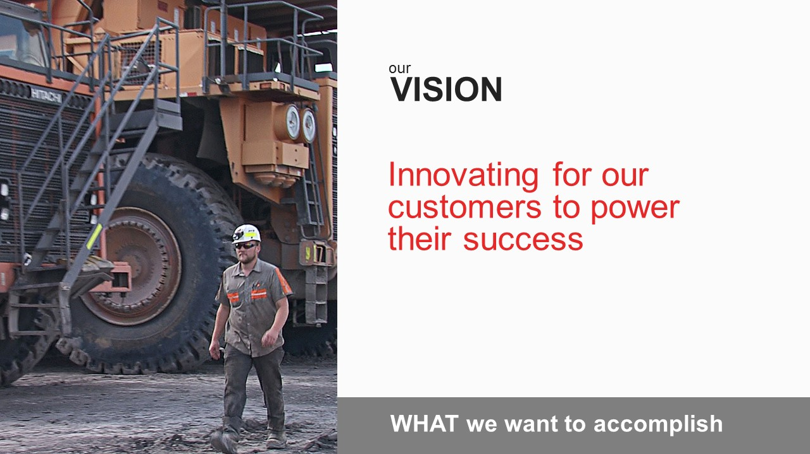
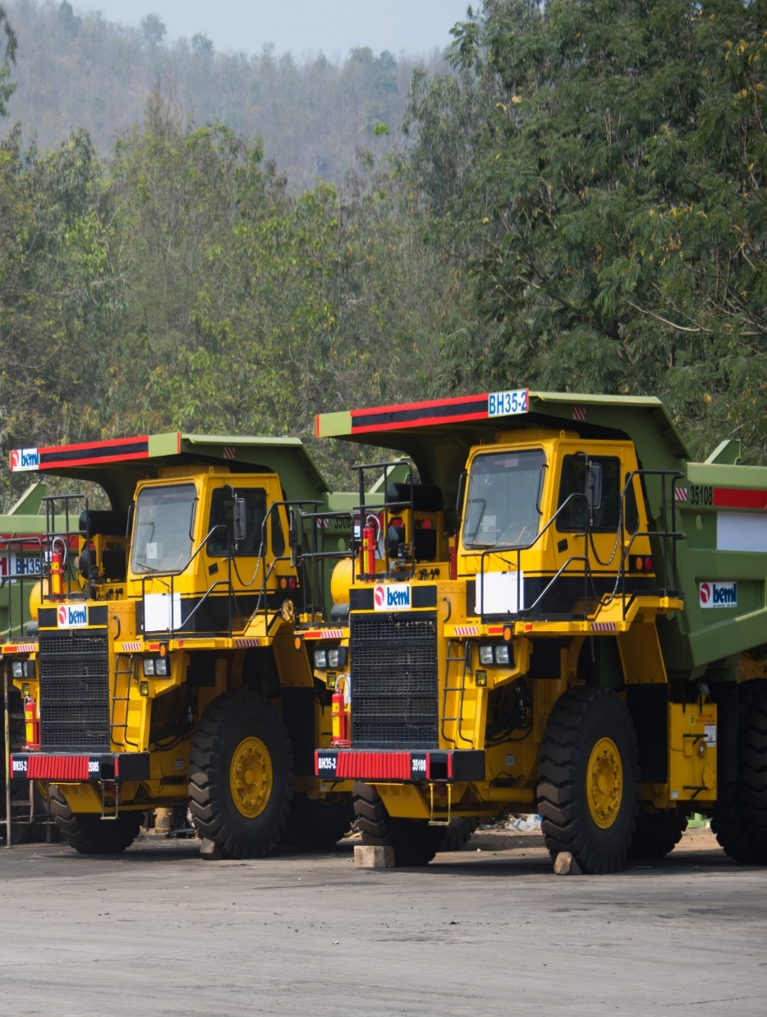
Notes:
Vision - “what we want to accomplish” and follows our Mission.
Think about our Vision as the “north star” for our strategy, which we will share a little later.
“Innovating for our customers to power their success.”
We started with “innovating” because doing so is critical to our future. I will talk more about this more in the Brand Promise.
We saw our Vision as an opportunity to put our customers front and center as we talk about what we want to accomplish.
We know that if our customers don’t succeed, we cannot succeed.

Slide 8
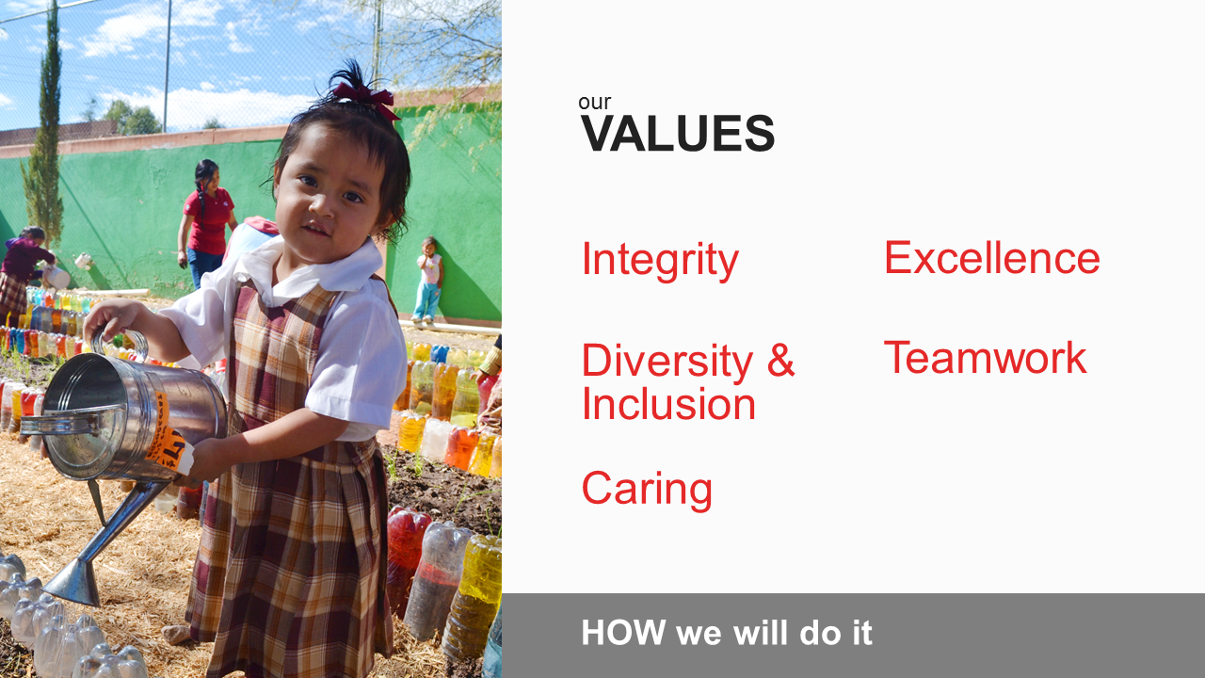
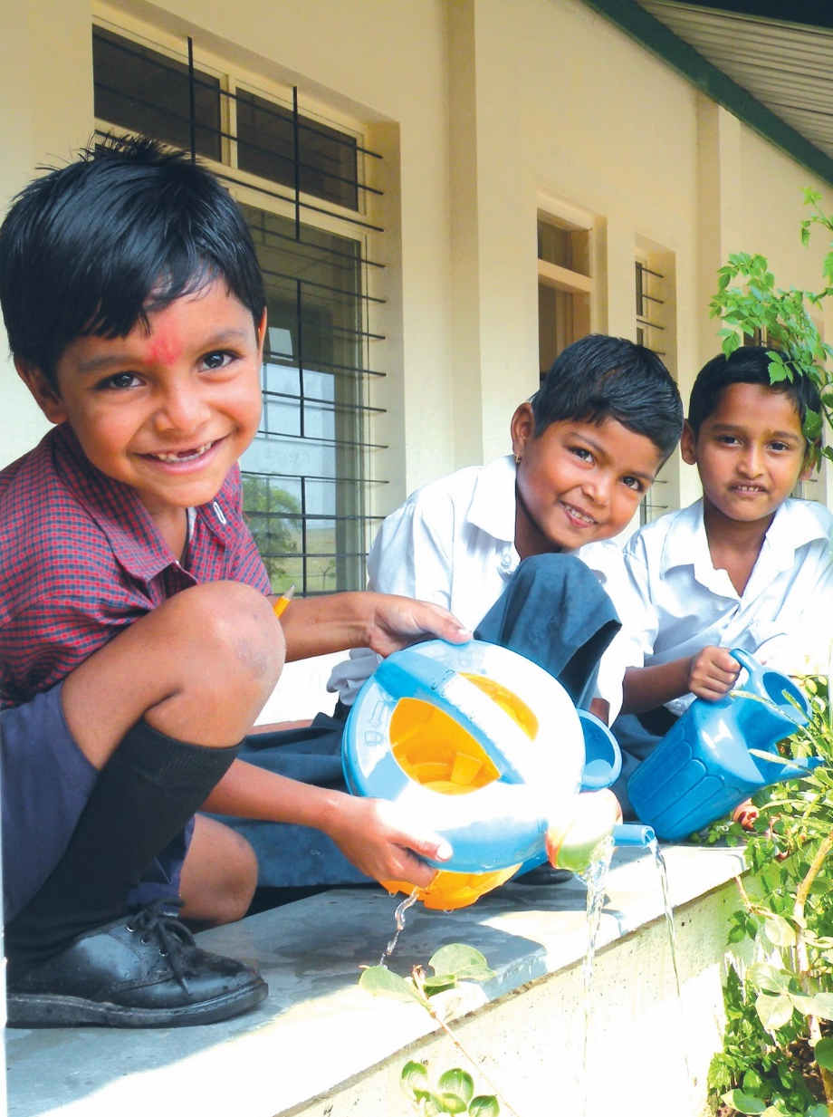
Notes:
Values are beliefs and behaviors
They are critical to who we are AND how we behave and work with each other and external stakeholders
Integrity
Integrity has always been our value
Integrity means
Doing what you say you will do and doing what is right
Being transparent -- admitting you don't know or made a mistake
Seeking help when you don't know
Acting within get the law -- and the spirit of the law
Without integrity, nothing else we do matters
We must live this value every day
Diversity and Inclusion
We expanded this value
The fact of diversity is given but inclusion is about recognizing and valuing our differences and using those differences to deliver results
This is about genuinely valuing all perspectives
Diversity and inclusion is our competitive advantage
When do this well, we attract and retain talent
Excellence
Set high standards; meet them
Commit ourselves to winning
Effort is important but results and quality matter
Be excellent at meeting needs of all stakeholders
It also means:
Financial results for shareholders
Products for customers
Jobs for employees
Solutions for communities
We expect employees reach for excellence every day
Caring
This was part of Cummins personality and we now state it as a value
Demonstrate awareness and consideration for well people of others – all people
About Dignity and respect
Reach full potential
Safe workplace; good jobs
Caring for communities
Drives Corporate Responsibility work and the long term impacts we want to have
Caring means that we seek to understand the needs of communities
Work with them to solve problems
Want communities to be stronger because we are there and we care
Teamwork
Our environment requires collaboration and teamwork
Work across functions, businesses and borders
Suppliers, communities, partners to deliver best work
We are required to be able to create new teams quickly to meet urgent challenges
Recognize where decisions can best be make and resources deployed
Break down barriers to work seamlessly as one Cummins
Commitments to every customer, every time, every part of the world
INTEGRITY
DIVERSITY AND INCLUSION
EXCELLENCE
CARING
TEAMWORK
We feel really good about these values and hope that they resonate with you

Slide 9
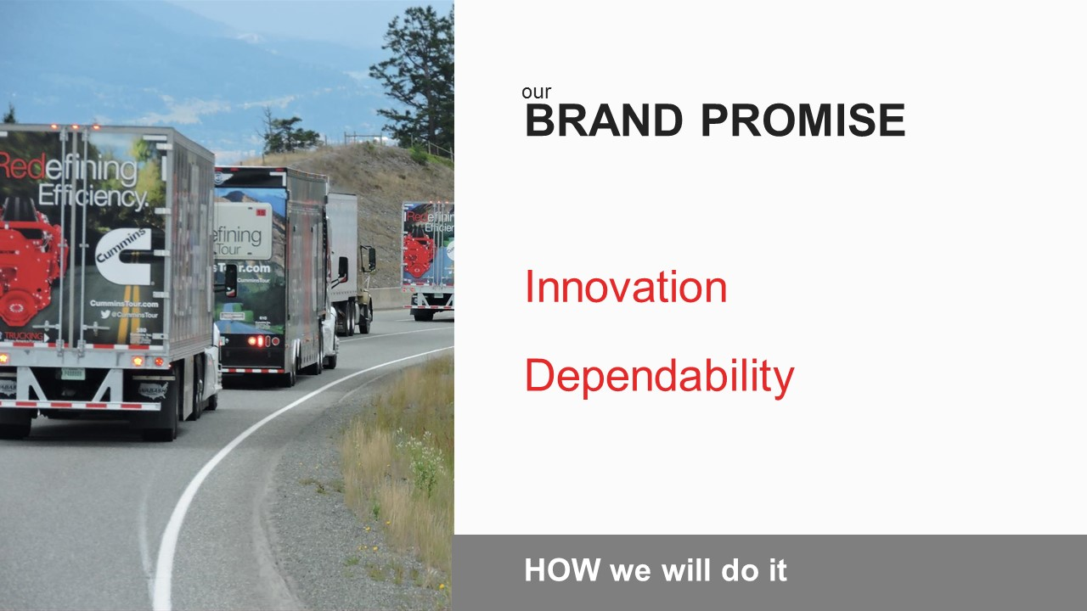
Notes:
“Powering our customers through innovation and dependability”
It’s important we are clear about our commitment to customers and what they can expect from all of us, every day.
We provide definitions of both Innovation and Dependability.
We talk about the power and combination of Innovation and Dependability and the tension that sometimes exists between them.
Need to address both if we want to win in the marketplace.
I am excited about the addition of our Brand Promise to our story. It can provide inspiration for how we communicate to customers and how we talk to each other about how to serve them.

Slide 10
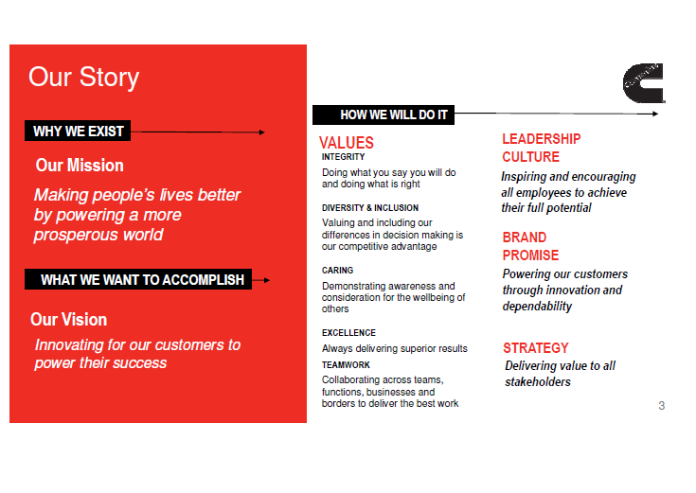

Slide 11
Business & Functions Overview

Slide 12
Dealership Overview
Vision Statement
To become a model dealership which acts as a platform to innovate in service and develop best practices for replication across the DBU India Channel
Quick Glance
Supporting ~ 39884 engines; ~ 23780 customers
Service Request Volume: ~ 78,476 SRNs per annum
~ 46,390 quotes sent per annum to customers; ~ 80,061 invoices made per annum
People Strength: ~425
Branches:
Okhla & Moti Nagar(Delhi)
Noida, Gr Noida, Ghaziabad, Bareilly (UP)
Lucknow & Gorakhpur
Rudrapur (Uttara Khand)
Outlet at Aligarh

Slide 13
Dealership Background
Part of DBU India Service Strategy with following objectives:
  Significantly improve customer service levels
  Gain experience of running a front end service organization
  Understand first hand Dealer business & challenges
  Use JV as a platform for business process improvements
50:50 JV in Feb’12 between CIL & SVAM Power Plants Pvt. Ltd.
Fully acquired by Cummins India in Oct’15
Lucknow & Gorakhpur added to current territory in Jan ‘18
Key Milestones
JV Company formation
Jan ‘12
Start of Operations
Feb ‘12
Additional Area of UP & Uttarakhand added to JV Territory
Jul ‘12
CDOS-DRM implemented with JV as a pilot project
April ‘13
Lucknow & Gorakhpur added to territory
Jan ‘18
Full Time General Manager appointed
Jan ‘14
100% acquisition by Cummins India Ltd.
Oct ‘15

Slide 14
What does CSSPL do?
Customer complaints
Parts Support
Service Contracts
  Attending customer complaints on our products (Cummins Engines/ DG Sets)
  24*7 customer support
  Spare Parts
  New & Recon Engines
  Oil
  Battery
  ReCon Components
  Annual Maintenance
  Regular Health Checks
  Operations & Maintenance
  Repair/ Overhauling of Engines/ Equipments

Slide 15
Service Delivery Process(SDP)

Slide 16
CSSPL Product Offerings
Cummins Genuine Parts
  Why CGP: Ensures uptime of your engine/equipment & saves on repair cost
  Guaranteed for performance, Value for money, meets Cummins specification
  Minimum chances for engine failure, reducing cost of parts due to heavy damage to related parts or to even an engine
ReCon Engine & DG Sets
  Re-manufactured engine/DG deliver exactly the same performance as new engine and are offered at reasonable price
  Under this scheme, we supply a reconditioned engine & take back old engine
  Recon Engine warranted for 2 Years or 5000 Hrs; Recon DG Warranted for 18 months or 3600 hrs.
New Engines
  New engine option is available when we are looking for replacement & repowering.
  Replacement: Old model engine replacement with new technology brand new engine with 2 year or 5000 hrs warranty.
  Repowering: Other make engine repower with Cummins make engine.
Coil Cooler
  Maintenance free remote radiator, compact & can be reconfigured, lowest dB levels
  Globally recognized technology, eco friendly operations, energy efficiency & cost reduction
  100% water saving & no scale formation, Fit & forget aspect
Cummins ReCon Component
  Recon products are not just repaired or rebuilt but remanufactured in factories.
  Recon products are the best choice when it is time for a major repair like D/E checks
  Value for money - Like new product at a lower price, Top performance & higher durability, Available off the shelf, warranty.
Cummins Genuine Battery
  Maintenance Free Battery.
  Ready to use: Light weight, Factory charged
  Reliable performance; Faster recharging & longer shelf life
Valvoline Genuine Oil
  Valvoline 15W40 engine oil is designed to provide advanced lubricants performance in modern, low emission diesel engine operating under a variety of service condition. It is endorsed by Cummins Engine company

Slide 17
Service Parameters
Service Parameters | Target | Details
NPS (Net Promoter Score) | 80% | Survey conducted by 3rd party asking customers to rate the Cummins Services on a scale of 0 -10. 0-6 Detractors, 7-8 Passive & 9-10 Promoters.
MTTR | 95% | Maximum Time To Restore (Warranty Engines): No. of hours taken to commission the engine from the time of failure. MTTR target is within 48 hours from failure
RECT | 90% | Repair Event Cycle Time: No. of hours taken to invoice / claim the engine from the time of failure. RECT target is within 72 hours from failure
NEPI A Check Compliance | 100% | New Engine Performance Inspection
B Check Compliance | 85% | Free services of an engine under warranty within defined time periods (based on model / KVA)
C Check Compliance | 85%
D Check Compliance | 85%
Call Acknowledged within 30 min | 90% | Customer call will be acknowledged by our service team within 30 minutes as per SDP process
Call attended within 4 hrs | 100% | Customer call will be attended by our engineer within 4 hours as per SDP process
Call resolved within 48 hrs | 95% | Customer call will be resolved by our engineer within 24 hours as per SDP process
DSC Score | 75% | Dealer Score Card: Means to measure overall dealership performance

Slide 18
LOTO

Slide 19
Health, Safety and Environment (HSE)
Wearing of PPEs by technical staff & material handling staff is mandatory.
Wearing a helmet while driving two wheeler is must for both driver and pillion rider. Similarly wearing seat belt is must for both the driver as well as co-passenger
Near hit reporting & tracking - Near hit is an undesired and unplanned event which is likely to cause either physical harm like personal injury or damage to property and loss of time.
Safety - Safety is practices, procedures & actions for prevention of accident.
Accident Investigation & analysis - Safety audits
Report all injuries on duty on the same day to Reporting Manager

Slide 20
HR Policies & Overview

Slide 21
Attendance & Leaves Policy
EL | SL | CL | Holidays
15 | 15 | 10 | 10
SL: > 3 days, Medical certificate mandatory
Leaves:
Technical Employees: Leave needs to be applied on the leave card and has to be approved by manager prior to proceeding on leave. In case of emergency leave, leave card has to be updated immediately after return.
Backend Employees: Leave to be applied in RAMCO system
Maximum of 45 days EL can be accumulated in a year & carried forward. SL & CL cannot be carried forward
Uninformed absence from work beyond 8 days without approval will invite disciplinary action
Compensatory Off to be availed against working on a Sunday within next 3 days
Leave encashment (EL) is done on separation from the company

Slide 22
Attendance & Leaves Policy
Timings: 6 days a week (9.00am - 5.30pm for All staff)
Attendance marked through biometrics machine only. Punching in & out on daily basis is mandatory.
  In case of a technical problem, make manual entry at gate register. Missed punch/ late punch needs to be approved by the manager
Uninformed absence will be marked as Loss of Pay (LOP)
Late coming beyond 15 minutes to be informed to manager. Habitual late coming can invite disciplinary action
Half day pay (LOP) would be deducted in case of late coming beyond 45 minutes total in a month
Technical staff is entitled for Over Time (OT) pay depending on business requirement with prior approval of Branch & Operations Head.

Slide 23
Travel Policy
Local Travel
Local DA: To meet any incidental or out of pocket expenses if outside base work location, for more than 4 hours at a stretch. Bills not required.
  If NCR employee visits another branch in NCR, DA should be claimed only if out of pocket expenses actually incurred.
Local Conveyance: Travel from home to base work location & back not covered. Bills not required
  Expenses regarding toll/ parking charges can be claimed with receipts/ bills.
  Two wheelers beyond 50 kms. (one side) from base work location not allowed.
Grade | Staff | Technical | Managers
Mode of Travel | 2 wheeler, public transport | 2 wheeler, public transport | 2 wheeler, personal 4 wheeler, public transport
Local travel | Two wheeler – Rs. 3.5/km Four Wheeler – Rs. 7/km
 | Public transport – Rs. 3/ km or actuals whichever is less
Local DA | Rs. 60/day | Rs. 60/day | Rs. 60/day

Slide 24
Outstation Travel
Bills mandatory to claim expenses (travel, hotel, meals)
Outstation DA: To meet expenses related to meals and any other expenses.
  Out of pocket expenses can be claimed up to Rs. 100/day if any incidental expenses incurred without bills. This is NOT an entitlement.
  Liquor expenses not to be reimbursed.
  Meal wise limits are mentioned in the policy for S & T grades
Outstation Stay: Bookings preferably at pre-negotiated hotels through admins.
  Laundry expenses only if number of nights is more than 3 at a stretch.
  Own Stay arrangement: 50% of stay limit or Rs. 500 which ever is less can be claimed without bill
Local travel during outstation visit:
  Charges for local travel will be reimbursed at actuals.
Grade | Staff | Technical | Managers
Mode of Travel | AC bus/ AC shared taxi/ train (3rd AC, chair car) |  | AC bus/ AC shared taxi/ train (2nd AC, 3rd AC, chair car)
DA | Rs. 500/day (meal wise limits added) |  | M1 – Rs. 700/day M2 & above – Rs. 1000/day
Hotel Stay | S1, S2, T1, T2 – Rs. 1000/day S3, T3 – Rs. 1800/ day |  | M1 – Rs. 2500/ day M2 & above – Rs. 3500/ day

Slide 25
Payroll
Cut off cycle for Attendance & Leaves: 20th to 19th of a month
Any leaves, OT or other approvals must be provided to Branch admin before 19th of the month
Salary disbursement is around 3rd of every month
Access to ADP Portal for new hires – Access will be given after the first month’s payroll processing.
    Link: www.ess.adp.in
    Welcome mail consisting of your Login Id & Password will be sent to your official mail id.
    Salary slip: Can be viewed a day after salary disbursement on the ADP portal.
For those falling under IT brackets
    Investment declaration can be provided on the ADP portal after the first salary processing
    Investment proofs to be submitted on the ADP portal in January along with hard copy to HR
Payroll queries to be addressed to hr.noida@csspl.in

Slide 26
Employee Indirect Benefits
PERSONAL ACCIDENT COVER
  Employees to intimate HR, HSE Leader & Branch Head asap in case of accident
  Coverage includes disablement (partial, temporary, permanent), Insurance Provider: TATA AIG
  Requirement – Unfit certificate, fitness certificate upon resuming duties
TERM LIFE INSURANCE
  Flat coverage of 10 lacs, Insurance Provider: ICICI Prudential
GROUP MEDICLAIM POLICY
  Employee, spouse and children are covered for floater sum of 2 Lacs
  Insurance provider: New India Assurance, Administrator: Medi Assist
    Modes: Cashless in Network hospital or Reimbursement
  During the course of employment, if there is any addition into the family on account of marriage/child, pls. inform HR (Minu Joseph) immediately so that coverage can be ensured
Annual Variable Pay (AVP) based on the branch performance
ESI & Bonus coverage based on eligibility & policy
Mobile phone Reimbursement
Uniform, safety shoes, PPEs, Tyre replacement coupons as per the guidelines & applicability

Slide 27
Training & Development
Training programs conducted for employees are both Internal & External.
Internal Trainings:
  MS Excel
  (An In-house customised full-day program designed on MS Excel. The module covers most commonly used and critical functionalities of Excel )
  CBA (Cummins Brand Ambassador) training.
  (An externally designed customised 2-days program for our customer facing roles i.e SPC, Tele-callers, ELPs, CCD executives or Parts team, Field Engineers & Technicians interacting with customers. )
External Training: LHP, LHP to HHP upgrade
  ( Technical trainings conducted by DBU at Phaltan, Jaipur, Greater Noida etc)
Upcoming: Communication Skills training program planned for this year.
To enroll in the sessions:
  Express your interest to the manager
  Nominations from Branch Manager to HR

Slide 28
Confirmation Appraisal Process
Every new hire is on probation period for first 6 months.
Nearing 6 months completion, his/her performance & values are assessed by the manager. Based on manager and HR’s feedback, an employee is confirmed/ probation extended
If the employee is to be confirmed, HR will issue him/her a confirmation letter on the due date or within 7 working days after the due date.
If the employee’s performance or alignment to core values needs improvement, the probation period can be extended for another 3 months. During these 3 months, employee is put on PIP (Performance Improvement Plan) with close tracking and supervision. At the completion of 3 months, the assessment process is repeated.

Slide 29
Performance Management Process
Annual Performance Review COMPLETE!
Jan
Dec
Update Performance and
Development Objectives Status
Complete Year End Assessment
Q1
Create Performance and
Development Objectives
Identify Stakeholders
Discuss Objectives with Manager
Informal Conversations
On Going
Stakeholder Feedback
Mid-Year
(Jul)
Update Performance and Development
Objectives Status
Complete Mid Year Comments

Slide 30
Dress Code Guidelines
Purpose is to ensure that all employees are dressed appropriately and present themselves in a professional manner to all stakeholders and customers.
Technical staff & customer facing employees are expected to be in Cummins uniform on all working days
Other employees are expected to wear formals from Mon – Fri. Business casuals are allowed on Saturdays
Employee to maintain good personal hygiene
Wearing uniform is an important criteria for CBA Score (Cummins Brand Ambassador) of a branch
  Identity Cards (I-Cards)
Wearing of the I Card is MANDATORY during work hours - within office premises, at customer sites or field visits
Wearing I Card at all times is an important part of CBA (Cummins Brand Ambassador).
In case of loss of I Card, employee needs to inform the branch admin/ HR within 2 days. Charges of issuing a duplicate I Card will be Rs. 200/- only, which will be debited from the salary.
Employees are requested to cooperate with Security/ Admins when they conduct I Card checks

Slide 31
Employee Engagement
Every Employee Every Community (EEEC)
Every employee can contribute voluntarily towards the Community we live in
In by participating in CSSPL signature project: Sahyog
(Traffic Signal Management), Go Green or DBU signature project-
CTY (Coach Them Young)
Monthly birthday celebration in each branch
Weekly birthday mailer from HR
Festivals celebrated in each branch
Employee Engagement
Corporate Responsibility (CR)
Women Affinity Events (WAG)
Birthday & Festival Celebrations
Reward & Recognition
Quarterly Communication
Trainings
Quarterly
Extra Mile Awards - Recognition for good
projects/ initiatives during quarterly communication

Slide 32
Fostering the Right Environment
“Cummins is committed to fostering a physically and psychologically safe, integrity based, respectful, inclusive, high performance culture that breaks down hierarchies and organizational boundaries, and engaging the full talents of our diverse employees to delight all our stakeholders (employees, customers, partners, shareholders, suppliers, communities) consistently.”
जहाँ शारीरिक और मानसिक सुरक्षा हो, ईमानदारी हो, एक दूसरे के प्रति सम्मान हो, सभी को साथ लेकर चलने की भावना हो, पदानुक्रम एवं संगठनात्मक सीमाएं तोड़ते हुए जहाँ सभी कर्मचारी अपनी पूर्ण प्रतिभानुसार अपने हितधारकों को लगातार आनंदित करें, ऐसी संस्कृति को प्रेरित करने वाला वातावरण देने के लिए कमिन्स प्रतिबद्ध है.
Cummins’ Commitment
  Violations of the Code at any level of the Company will be acted upon swiftly & appropriately
  Anyone who violates the Code will be held accountable
  We will protect the whistleblower (Non Retaliation Policy)
“Fostering right environment is the job of each & every employee”

Slide 33


