Slide 1
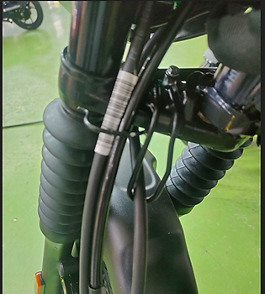
B105L Model Under Bracket Hook Position:

