Slide 1
Action Plan Evidences
Fork Bolt RE-J1A- Circular Mark on OD

Slide 2
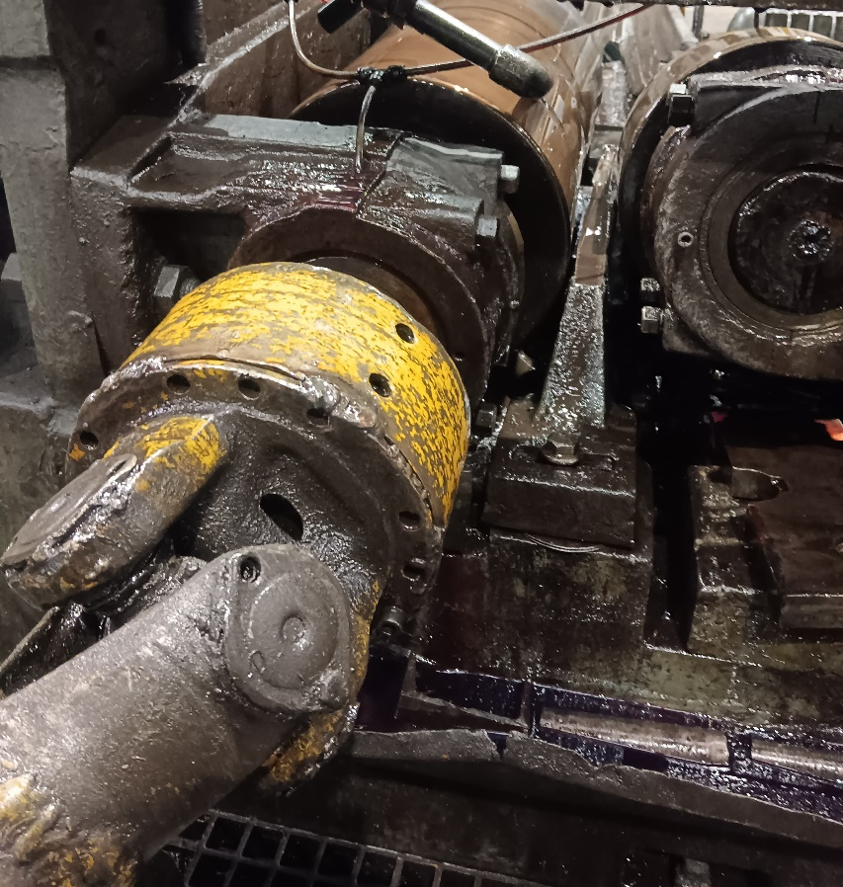
Action Plan Evidences
OCCURRENCE SIDE- AFTER
Worn Out Strip Replaced with new one. Resting Strip condition detectable only during the bar processing. Therefore Checkpoint added in Setup Approval. Aesthetic parameter checkpoint added in Hourly Inspection

Slide 3
Action Plan Evidences
OCCURRENCE SIDE- AFTER

