Slide 1
Action Plan Evidences
Fork Bolt RE-J1A- Circular Mark on OD

Slide 2
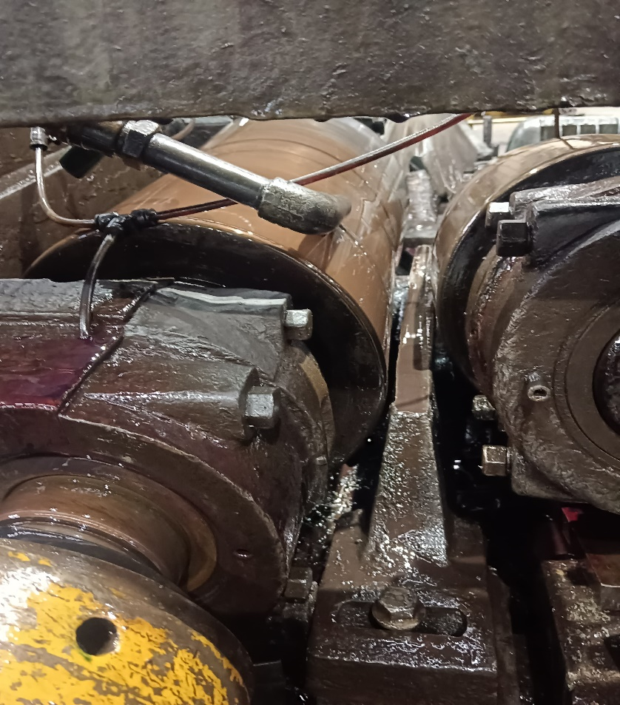
Action Plan Evidences
OCCURRENCE SIDE- BEFORE
Bar Resting Strip at Straightening & polishing stage worn out, due to this this Circular Scratch Generated on the Bar Surface

