Slide 1
Action Plan Evidences
Fork Bolt RE-J1A- Circular Mark on OD

Slide 2
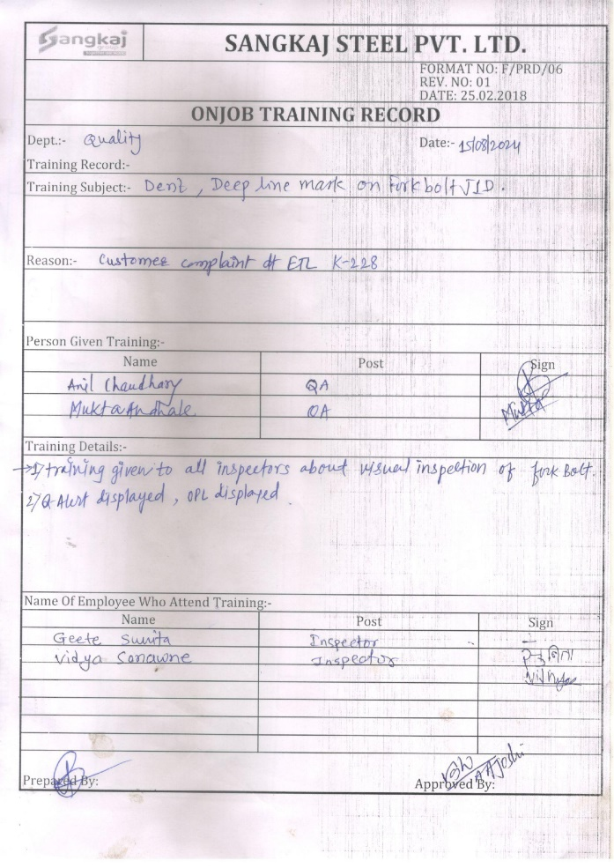
Action Plan Evidences
OUTFLOW - AFTER
Awareness given to inspectors about Visual parameter Inspection. Q-Alert and OPL Displayed.

