Slide 1
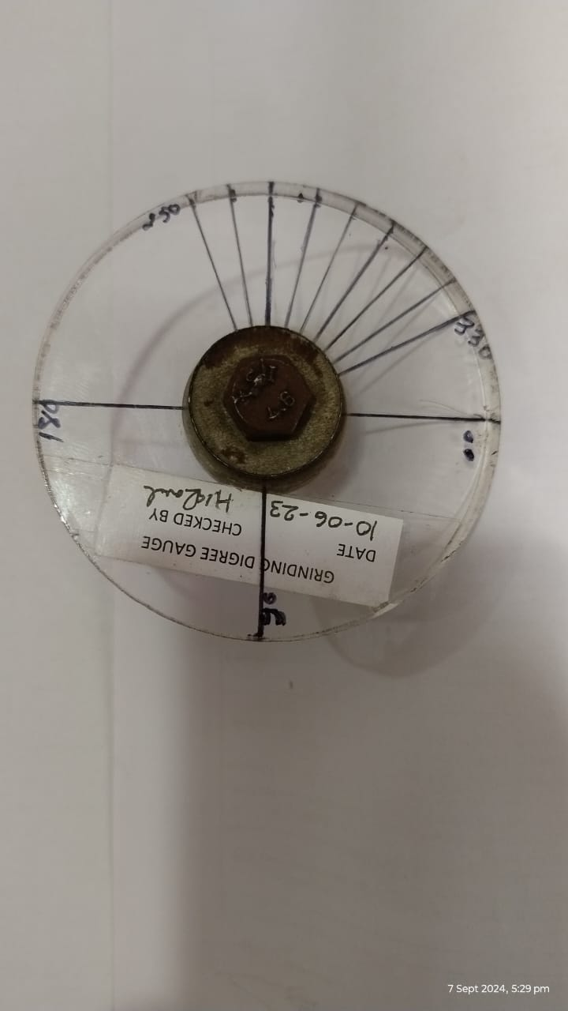
SAGAR SPRINGS PVT LTD
ONE POINT LESSON
Customer: Endurance Technologies Limited, Sanand
Part No. S1HT 5507B
Part Name: Outer Coil Spring
Complaint: Tip Thickness Less (1.50 mm against 2.00 mm)
BEFORE
AFTER
1
Grinding angle > 300°
Grinding angle – 250°-300°

