Slide 1
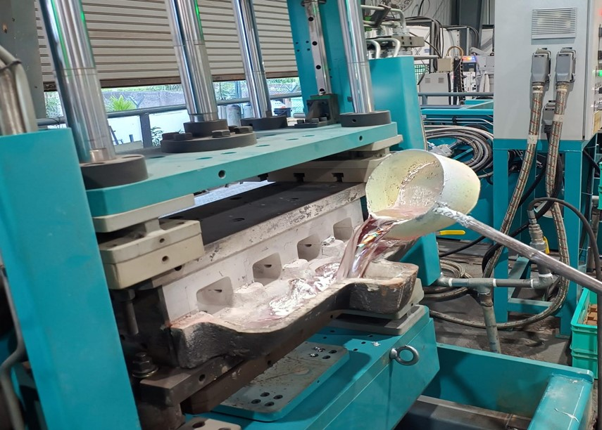
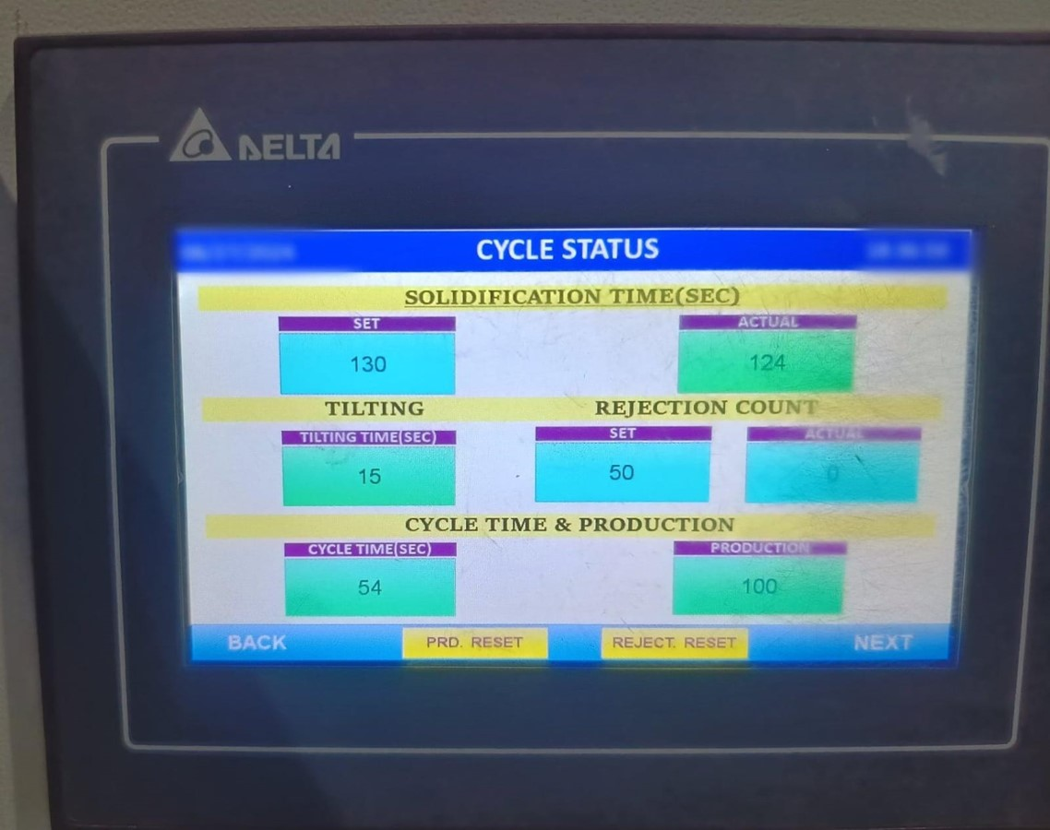
On job training is given to the GDC operator how to do metal pouring.
Now by first pouring the metal into the saucer, then the machine is tilted so that slowly and uniformly the metal goes into each cavity.
Tilting time Is fixed as much as needed

