Slide 1
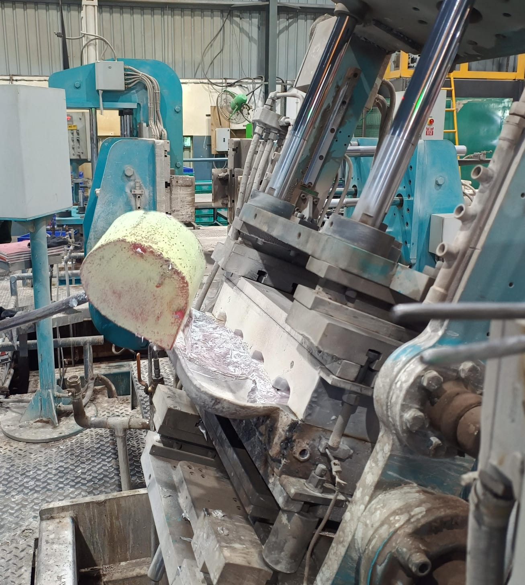
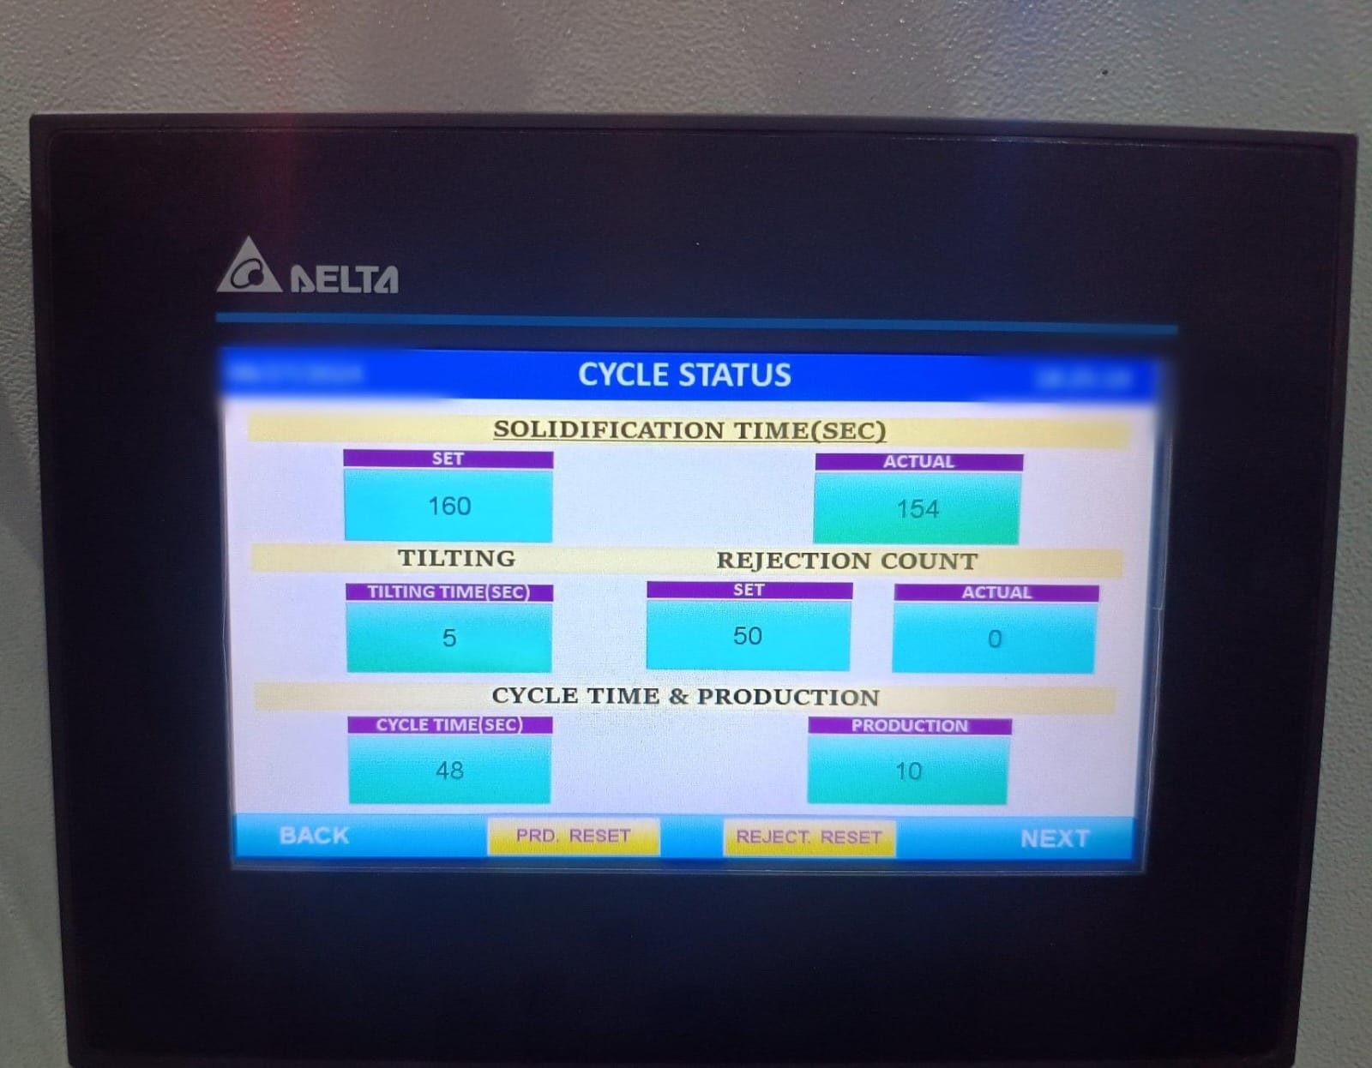
The operator was pouring metal when the machine was half tilted, due to which the metal was going very fast and directly into the very thus creating turbulence
Less tilting time

