Slide 1
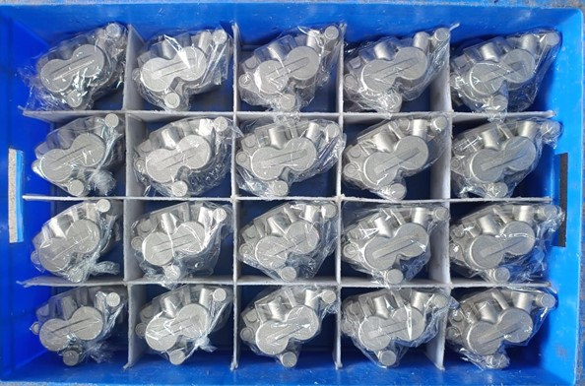
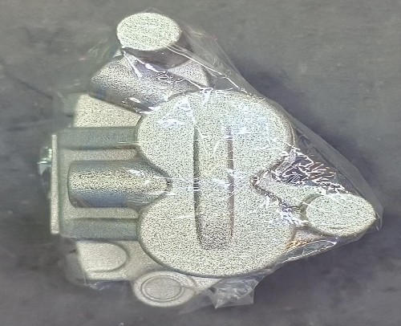
We using polythene bag to prevent dent ,damage & dust to the casting due to bin and traveling.

