Slide 1
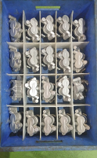
We NO used polythene bag to prevent dent ,damage & dust to the casting due to bin and traveling.

