Slide 1
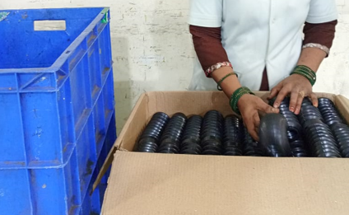
Offline Box Packing

