Slide 1
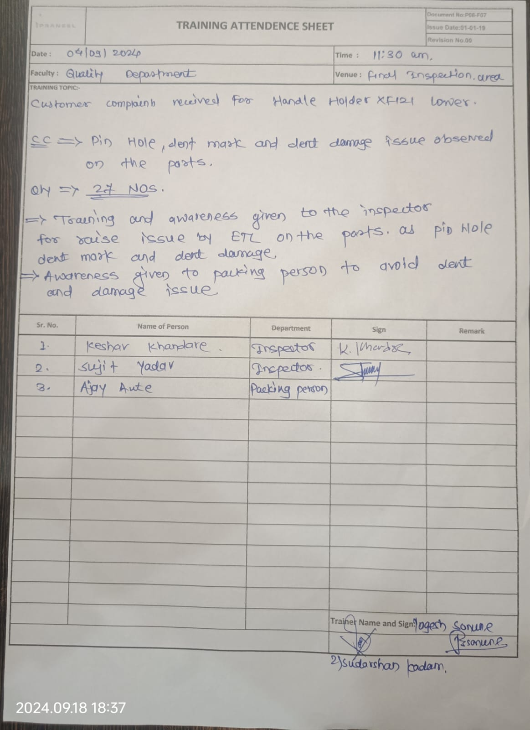
Evidences
Q-Alert for Pin Hole
Training record for Pin hole, dent damage issue.

Slide 2
Lux Level increase on Final Inspection for visual inspection.

