Slide 1
XF1F1 LOW HARDNESS Action Plan

Slide 2
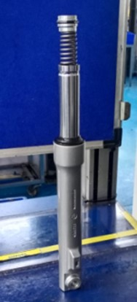
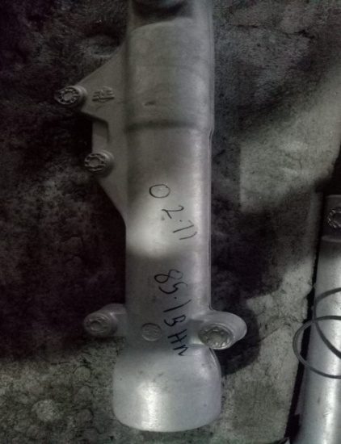
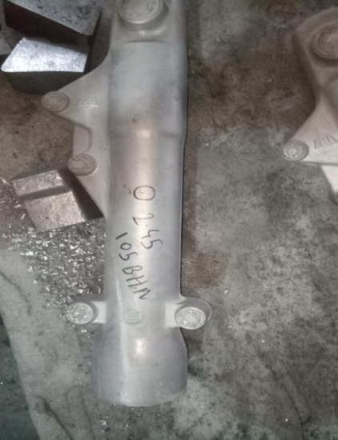
CONDITIONS FOR OCCURRENCE
● Phenomenon: LOW HARDNESS
Trouble content
NG Part | OK Part
・Supplier: Endurance Technologies Ltd.
・Model: XF1F1
・Parts name: Front Fork
・Part No.:
・Date of Occurrence:06.09.2024
・Qty NG: 40 Nos
●Parts Stock check results
Action
Area | Total Stock | Checked | Checking Method | NG Qty | Status
Dekson Casting Ltd | 50 | 50 | By Hardness Tester | 0 | All available stock qty. verified & found NG
ETL | 40 | 40 | By Hardness Tester | 240

Slide 3
UNDERSTANDING OF ACTUAL CONDITION AND CONTROL
Process Flow
Possible defect occurrence area.
R M Inward
Melting
Gravity Die Casting
Riser Cutting
SPM Drilling
1
Packing and Dispatch
Final Inspection
Grinding and Fettling
Heat Treatment
Belt Grinding

Slide 4
UNDERSTANDING OF ACTUAL CONDITION
● Understanding the actual cause – (Factor analysis)
Man
Machine
Less Awareness
Heat Treatment Furnance Fan bearing jam
Quenching tank not clean
Unskilled operator & Inspector
Training not followed for New inspector and operator
Hardness less than specification
Metal Temp high/low
temp variation
Method
Material

Slide 5
FACTS VERIFICATION
SR NO | 4M | PROBABLE CAUSES | FACTS VERIFICATION | Judgment
1 | MAN | Less Awareness | verify Awareness of operator and found Not Ok | O
 |  | Unskilled operator & Inspector | Verified skill level of Inspector & fond Ok as per the skill matrix | O
 |  | Training not followed for New inspector and operator | Verified training record and work procedure for inadequacy while appointing new inspector and found Ok. | O
2 | MACHINE | Fan bearing not ok Quenching tank not clean | Heat Treatment Furnance Fan bearing jam & Also Monthly cleaning tank frequency. | x
3 | METHOD | temp High/low | temp check found ok | O
 |  | Die temp variation | Die temp check found ok | O

Slide 6
ROOT CAUSE ESTABLISHMENT (WHY-WHY ANALYSIS)
● Root cause establishment (Why-Why Analysis)
 | WHY – 1 | WHY- 2 | WHY -3 | WHY-4 | Why-5
Occurrence | Hardness less than specification | Heat Treatment Furnance Fan suddenly Off &Quenching tank not clean, | Furnance Fan bearing jam | air circulation not proper
Outflow | Hardness less than specification | Not detected in Inspection | Inspection done on sampling basis | - | -

Slide 7
COUNTERMEASURES
 | Cause | Countermeasure | Tgt. Dt. | Status
Supplier End | <Occurrence > | 1.Fan Bearing changed & its Life monitoring started. 2. Fan check point added in heat Treatment WI. 3. Water tank cleaning frequency changed to weakly. 4. Tank cleaning check point added in heat Treatment WI. | 15.09.2024 | Completed
Supplier End | <Outflow> | Checking Hardness in every Lot after Heat Treatment. | 15.09.2024 | Completed
ETL End | <Outflow> | Start inspection in every lot. | 15.09.2024 | Completed

Slide 8
GDC
Shop: GDC
Implementation Date: 15.09.2024
Operation: Pouring
Low Hardness 85 BHN | Hardness OK 105 BHN
BEFORE
AFTER

