Slide 1
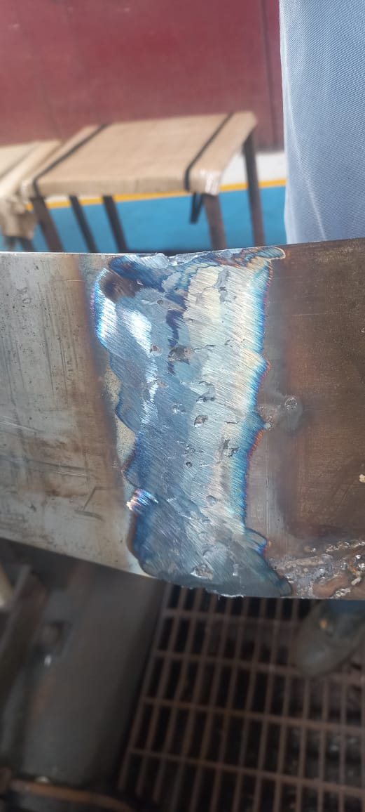
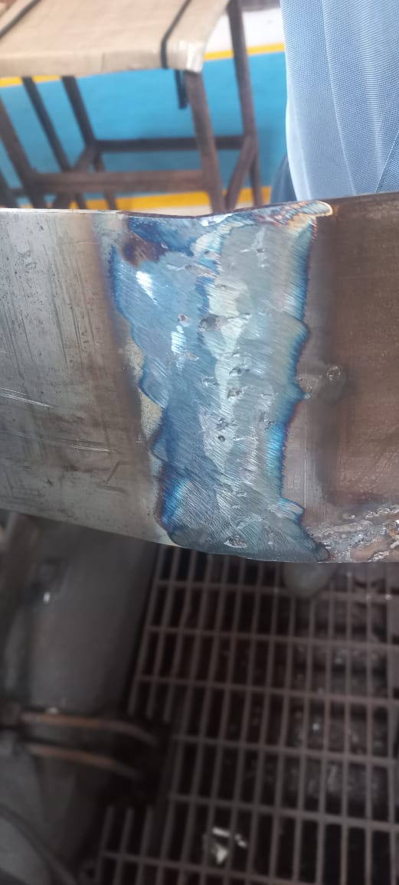
Occurrence Side Before & After
Before
After
Edge Preparation after coil Joining Profile
New Coil begin
Coil end
New Coil begin
Coil end
From
De-coiler
To forming
roller
From
De-coiler
To forming
roller
Fine edge bead projection even after flat grinding of end weld joint
Concave c-shape grinding to be done on both edge up to 2mm from strip width

Slide 2
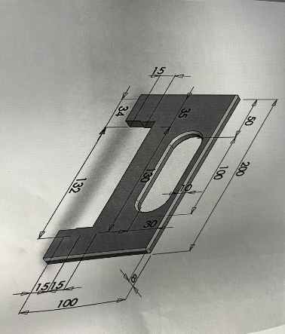
Occurrence Side Before & After
Before
After
Visual inspection after every end weld grinding
The end weld ground strip to be verified snap gauge for each end weld period

