Slide 1
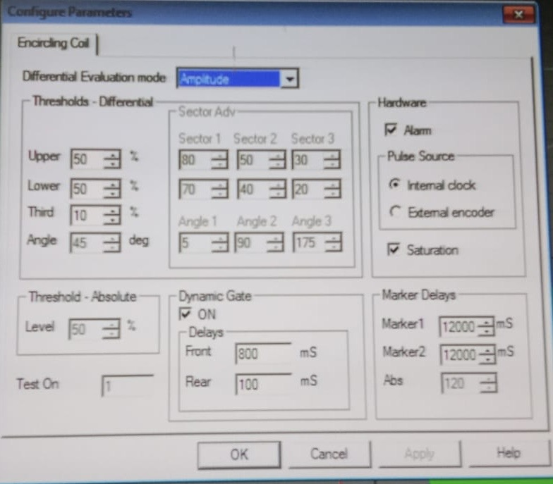
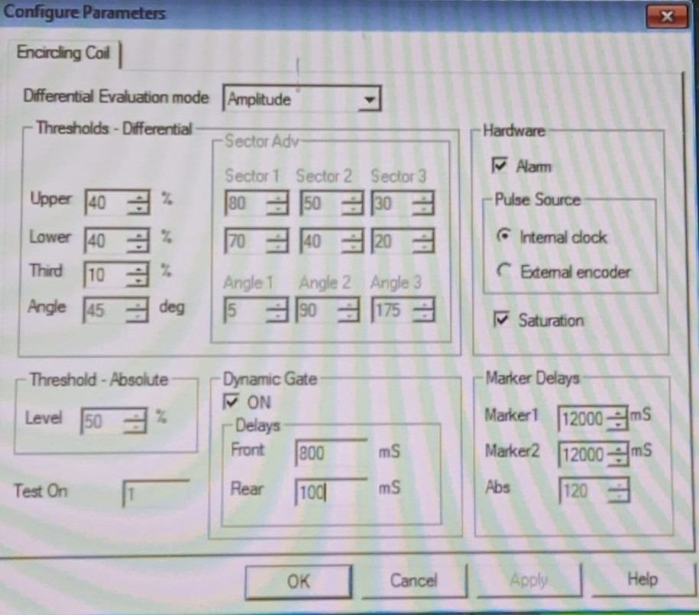
Detection Side Before & After
Before
After
Eddy current test threshold setting of upper & lower controlled with 50%
ECT setting threshold limit changed from 50% to 40% for stringent control

