Slide 1
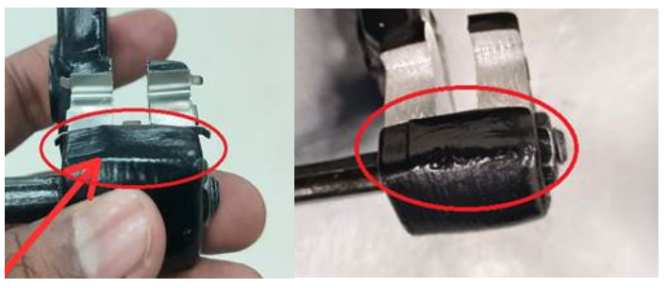
Problem Definition Sheet
Part name & Part no. : HOLDER BRACKET BODY RAW CASTING-C101 & B2FP02303O
Model :
Customer complaint : Extra Casting (Dimension 16+0.3 mm observed 17.25 mm).
Physical Phenomenon : Extra material observed at the clip fitment area.
1. Rejection Quantity – Month wise
Mfg. Month | Jan 24 | Feb 24 | Mar 24 | April 24 | May 24 | June 24 | July 24 | Aug 24 | Sep 24
Rejected qty. in nos. | 0
2. Photograph/Video – failure phenomenon
Containment location | Check Qty | Qty Verified | Not ok Qty | Identification mark if any on Ok parts
BAL (Waluj +Chakan)
Warehouse +Sub supplier | 1440 | 1440 | 400 | On Box – Corrected Lot
ETL (Master+ brake kit) | 1450 | 1450 | 450 | Marking on the Rej Box
Extra material observed at the clip fitment area.
3. Whether the defect is detectable at part manufacturing line – Yes/No (please indicate)
IF ANSWER IS YES
Check and confirm whether the defective pieces pass the detection stage of the manufacturing line – Yes / No
1

Slide 2
Corrective Action sheet
Part Name & number | Defect Phenomena | Qty | Root Cause |  | Corrective Action |  | Target date & Status | Preventive action | Sustenance/ System action | Effectiveness
 |  |  | Inspection | Cause | Inspection | Cause
HOLDER BRACKET BODY RAW CASTING-C101 & B2FP02303O | Extra material observed at the clip fitment area so dimension 16mm found 17.25mm. | 450 nos. | Cause 1: W1:Dimension 16mm found 17.25mm W2: Extra material observed at the clip area W3: No template gauge for checking the dimension due to inspection method is in-adequate. Root Cause : No template gauge for checking the dimension due to inspection method is in-adequate. std. – Add in PDIR report. | W1:Dimension 16mm found 17.25mm W2: Extra Dome observed at the clip fitment area W3: In-adequate fettling/belt rework at the clip fitment area W4: Dome not removed due to Belt life is over. W5:No monitoring of belt life. Root Cause : No monitoring of fettling rework belt life. | 1.Quality alert was displayed at the final inspection area, 2.Training has been provided to the inspector for checking the casting in template gauge 3.Template gauge is provided for ensure the dimension 16mm, 4.Limit sample displayed at the final inspection area, 5.Rework Limit sample displayed at the fettling area 6.SOP is make for fettling rework, 7.3D scanning of casting after 20000nos for 16mm. | 1.Rework Limit sample displayed at the fettling area 2.WI is make for fettling rework, 3.Training is provided to the fettling rework person 4.Belt life monitoring is started, 5.Belt life reduced from the 2000pcs to 1200pcs. | Inspection Side -20.09.2024 – Completed, Cause Side- 20.09.2024., Completed | Inspection Side – PDIR report is updated. Cause Side – Belt life monitoring started. | Sustenance Side: PDIR report updated. T. Date & Status: 21.09.2024. System Side : Process audit report updated. T. Date & Status: 21.09.2024 & Completed. | Under Monitoring
Actions | C101 | Avenger
1.Belt life monitoring started. | Completed | Completed.
2.Template gauge made. | Completed | Completed.
Before
After
1.No Fettling rework belt life is monitored.
2.No Template Gauge.
HD Matrix
1.Fettling rework belt life monitoring started,
2.Template gauge made.

Slide 3
Process Flow Information
  Receipt of raw material
INCOMING INSPECTION of AC2A Alloy
STORAGE
Degassing (if DI not ok)
Holding Molten metal in Holding chamber
Melt treatment inside chamber and at Holding chamber
Continuous Charging and Melting
DI and Spectro Check
N2 Lance Degassing
Die preparation & Die loading
Casting
Heat No. Punching.
HEAT TREATMENT
FETTLING/Grinding
RUNNER/RISER CUTTING
Transfer to Inspection & Final inspection
PACKING
DISPATCH
Note: Fill Red Color in process Block where defect is occurred.

Slide 4
FTA (Fault Tree Analysis)
Defect phenomena - Extra material observed at the clip fitment area so dimension 16mm found 17.25mm.
Defect
Contributing factor (4M+1T)
Man
Machine
Method
Material
Tool
Cause (Subdivision)
Skip from the inspection
N/A
In-adequate fettling rework at the clip fitment area due to belt wear out issue.
N/A
N/A
Current control/Spec.
Visual inspection of the casting. Dimension 16mm is from the center of the casting hence not possible to measure.
Visual inspection of the casting. Dimension 16mm is from the center of the casting hence not possible to measure.
Actual observation (during Gemba)
Extra metal observed on the clip fitment area and no gauge concept for checking the dimension.
Dome observed at the clip fitment area.
Countermeasure
We had made the template gauge for measuring the width dimension 29.25mm to ensure CD dimension 16
Belt life is change from the 2000 pcs to 1500nos.
Preventive Action
Template gauge is added in the PDI report. 100% inspection by the inspector at the final inspection.
Belt life monitoring is started.
Sustenance Action
QA Confirmation in PDIR
QA Confirmation in Belt life monitoring sheet.
.
Document reference
PDIR Check sheet record
Belt life monitoring sheet.

Slide 5
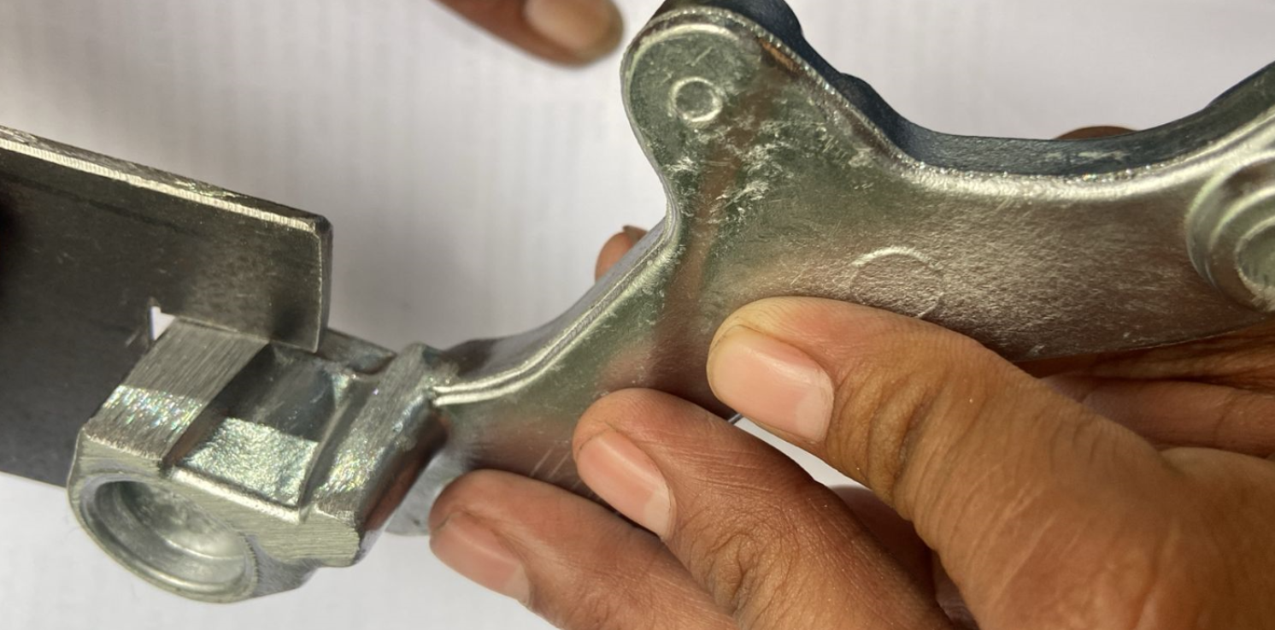
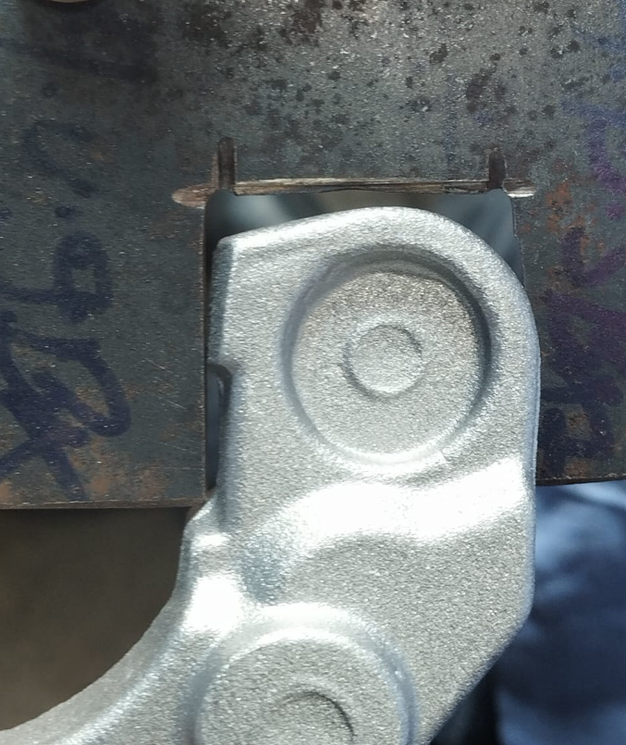
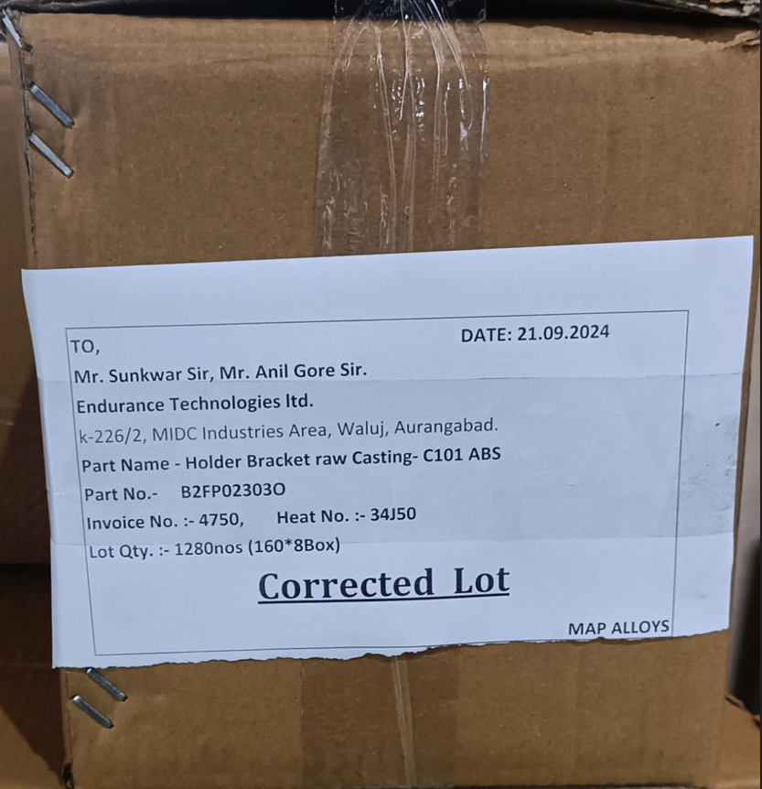
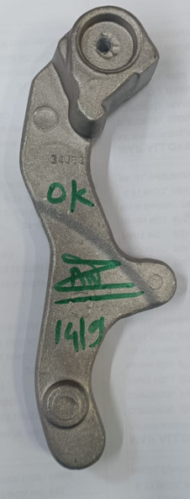
Actions Closure details
ABS Bracket check in Template Gauge for dimension.
1.Extra metal on clip fitment area.
2.Template gauge is provided for checking the casting at the rework stage
3.Template gauge is provided for checking the casting 100% at final inspection stage.
4. Corrected lot send to customer.
OK PART

Slide 6
System failure and concerned horizontal head
PART | DEFECT PHENOMENON (QSR, EFR, FFR) | QTY | ROOT CAUSE |  | SYSTEM FAILURES | RESP HORIZONTAL (NAME)
 |  |  | INSPECTION SIDE | PROCESS SIDE
HOLDER BRACKET BODY RAW CASTING-C101 & B2FP02303O | Extra material observed at the clip fitment area so dimension 16mm found 17.25mm | 450 | No template gauge for checking the dimension as inspection method is in-adequate. | Dome observed on the clip fitment area of the casting due to in-adequate fettling rework because of the belt life is over. | Inspection side- CD 16mm dimension not possible to check. Process side- No belt life monitoring at the fettling stage. | Inspection side- QA- Manish Kolte / Rajesh Pandey Process side- Prod Dept.- P D Patil.

Slide 7
Corrective Action sheet
Part Name & number | Defect Phenomena | Qty | Root Cause |  | Corrective Action |  | Target date & Status | Preventive action | Sustenance/ System action | Effectiveness
 |  |  | Inspection | Cause | Inspection | Cause
HOLDER BRACKET BODY RAW CASTING-C101 & B2FP02303O | Extra material observed at the clip fitment area so dimension 16mm found 17.25mm. | 450 nos. | Cause 1: W1:Dimension 16mm found 17.25mm W2: Extra material observed at the clip area W3: No template gauge for checking the dimension due to inspection method is in-adequate. Root Cause : No template gauge for checking the dimension due to inspection method is in-adequate. std. – Add in PDIR report. | W1:Dimension 16mm found 17.25mm W2: Extra Dome observed at the clip fitment area W3: In-adequate fettling/belt rework at the clip fitment area W4: Dome not removed due to Belt life is over. W5:No monitoring of belt life. Root Cause : No monitoring of belt life. | 1.Quality alert was displayed at the final inspection area, 2.Training has been provided to the inspector for checking the casting in template gauge 3.Template gauge is provided for ensure the dimension 16mm, 4.Limit sample displayed at the final inspection area, 5.3D scanning of casting after 20000nos for 16mm. | 1.Rework Limit sample displayed at the fettling area 2.WI is make for fettling rework, 3.Training is provided to the fettling rework person 4.Belt life monitoring is started, 5.Belt life reduced from 2000pcs to 1200pcs/ | Inspection Side -20.09.2024 – Completed, Cause Side- 20.09.2024., Completed | Inspection Side – PDIR report is updated. Cause Side – Belt life monitoring started. | Sustenance Side: PDIR report updated. T. Date & Status: 21.09.2024. System Side : Process audit report updated. T. Date & Status: 21.09.2024 & Completed. | Under Monitoring

Slide 8
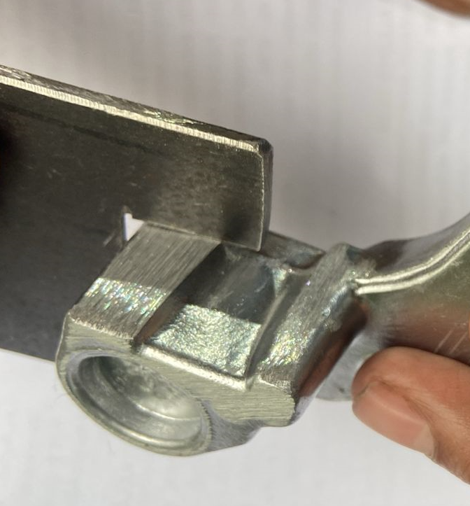
Material handling improvement
Area : Final Inspection stage Date : 14.09.2024
Before Improvement | After Improvement
Description (Before)- No template gauge for checking the dimension. | Description (After)- Template gauge is provided for checking the dimension.
No Template Gauge for checking the width.

Slide 9
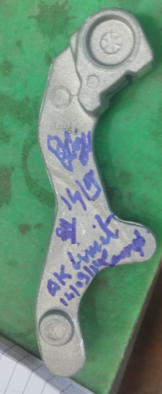
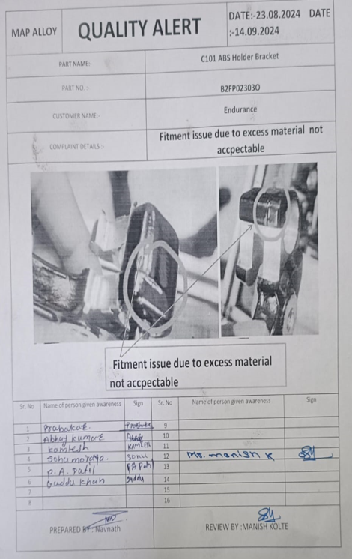
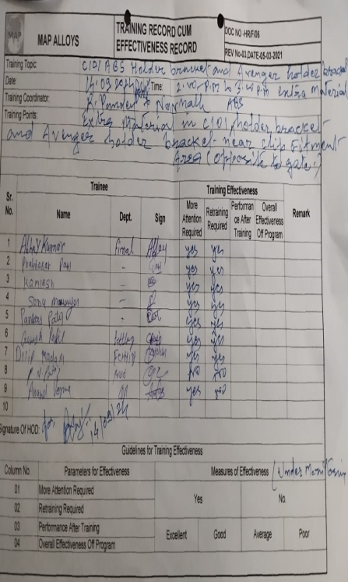
Material handling improvement
Area : Final Inspection stage Date : 14.09.2024
Before Improvement | After Improvement
Description (Before)- No Limit sample at final inspection area. | Description (After)- Limit sample displayed at the final inspection area with training of the inspector and also quality alert was displayed.
No limit Sample
Limit Sample
Quality Alert
Training Record

Slide 10
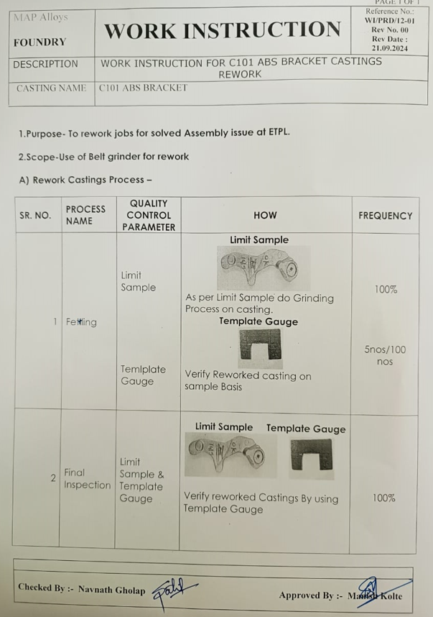
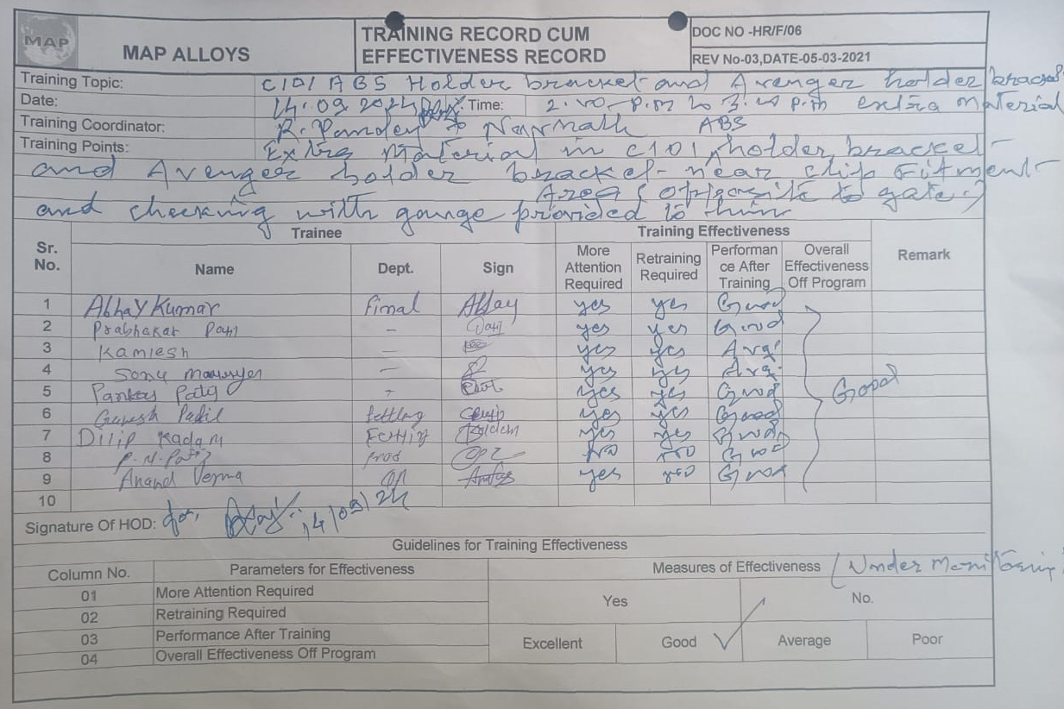
Material handling improvement
Area : Fettling Stage Date : 14.09.2024
Before Improvement | After Improvement
Description (Before)- No work instruction at the fettling stage. | Description (After)- SOP displayed at the fettling stage with training of the fettling rework persons.
No work instruction for fettling rework.
Limit Sample
WI
Training Record

Slide 11
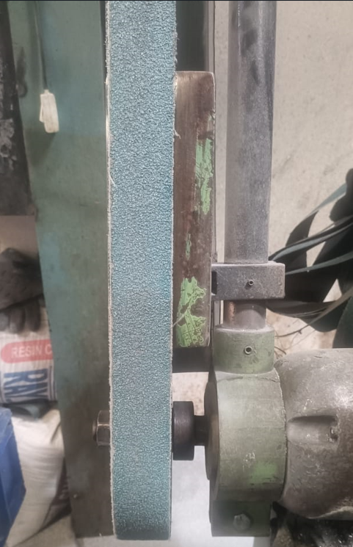
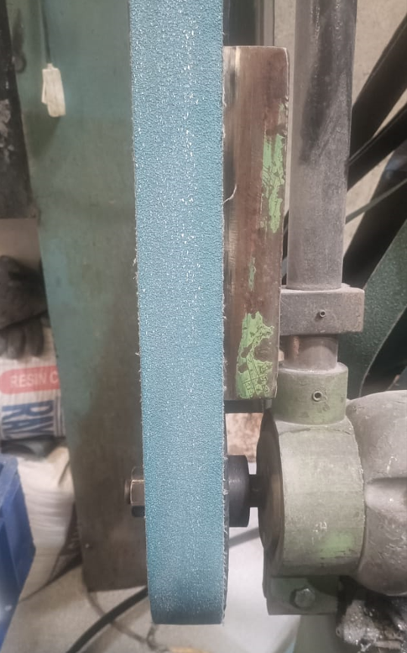
Material handling improvement
Area : Fettling Stage Date : 14.09.2024
Before Improvement | After Improvement
Description (Before)- In-adequate Belt used during fettling rework of the casting. | Description (After)- Adequate belt used during fettling rework at clip fitment area of the casting.

Slide 12
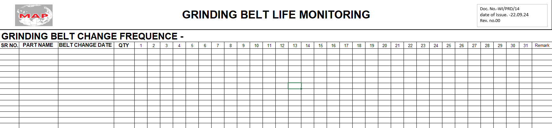
Material handling improvement
Area : Fettling Stage Date : 14.09.2024
Before Improvement | After Improvement
Description (Before)- No belt life monitoring at the fettling stage. | Description (After)- Grinding Belt life monitoring is started at fettling stage.
No Belt Life Monitoring

Slide 13
Thank You

