Slide 1
ENDURANCE TECHNOLOGIES
ACTION PLAN

Slide 2
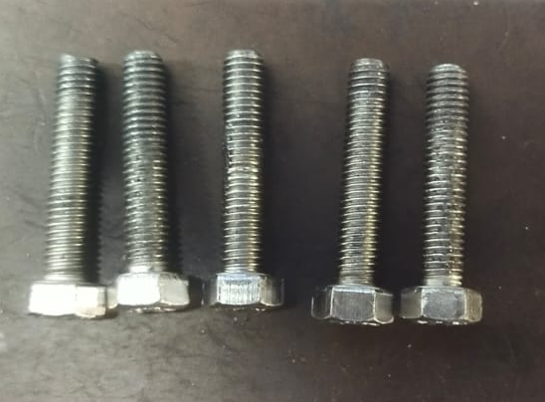
Extra material on middle in the thread issue

Slide 3
Action plan
Sr. No. | When | What |  | Which |  | Where | How many | Why | Corrective action |  |  | Who | When | Status
 |  |  |  | Part No | Part Name
 |  | Customer Complaint | Defect Phenomenon
1 | 12.04.24 | Extra material on middle in the thread issue | More plating | 520FK00102/520ks00302 | M5 Bolt/M6 bolt | ETL | 10 | Insp side: W1: Sampling inspection as per sampling plan Cause side: W1: Extra material on middle in the thread issue W2: More plating deformation in threads W3: During plating process small parts stucked up in corners and trap points W4- Barrels trap points are open | Insp Side: 100% visual inspection and fix the lady inspector for this part Cause side: Close the trap points |  |  | SCA Jaikishan | 13/04/24 20.04.24 | C C
Sustenance action |  | Target date | Status | Preventive action |  | Tgt date | Status | System action | Tgt date | Status
QA Alert display |  | 12.04.24 |  | Trap point audit |  | 25.04.24 | IP

Slide 4
Action plan
Sr. No. | When | What |  | Which |  | Where | How many | Why | Corrective action |  |  | Who | When | Status
 |  |  |  | Part No | Part Name
 |  | Customer Complaint | Defect Phenomenon
1 | 27.06.24 | Fitment not ok | Thread itching | 520FK00102 | M5 Bolt | ETL | 20 | Insp side: W1: Sampling inspection as per sampling plan Cause side: W1: Fitment not ok W2: More plating deformation in threads W3: Itching for thread area and un uniform plating for thread are W4- In proper cleaning for heat treatment scale for thread area | Insp Side: 100% visual inspection and fix the lady inspector for this part Cause side: Anodic cleaning and De-scaling chemical concentration maintain higher side (Anodic cleaning and descaling chemical concentration is low that time also itching observed for thread area ) |  |  | SCA Jaikishan | 28.06.2024 04.07.2024 | C C
Sustenance action |  | Target date | Status | Preventive action |  | Tgt date | Status | System action | Tgt date | Status
QA Alert display |  | 27.06.2024 |  | Anodic cleaning and De-scaling current increased from 0.5 am/dm2 to 0.7 amps/dm2 3, Preventive maintenance side barrel inside danglar hole area sticky material barrel wise check and material scraped |  | 04.07.024 | IP | Change the control plan for small parts of plating | 04.07.02024 | C

