Slide 1
Endurance Technology
Quality Review

Slide 2
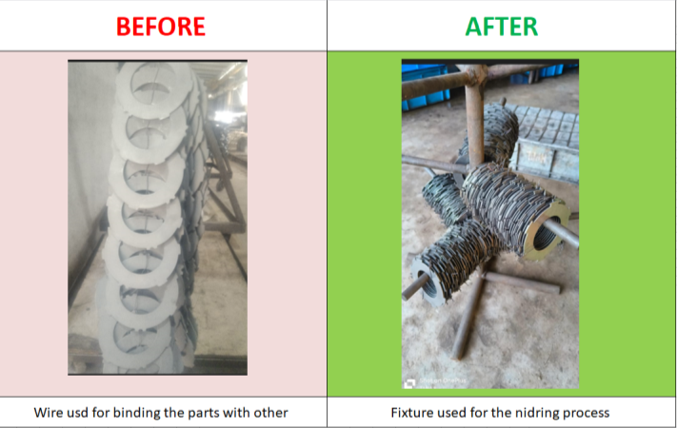
Fixture trail Metal tech -30.09.2024
Trail done on fixture for parts 520HR00502. Parts will moved in fixture and stacked each other.

Slide 3
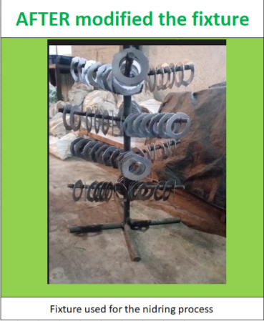
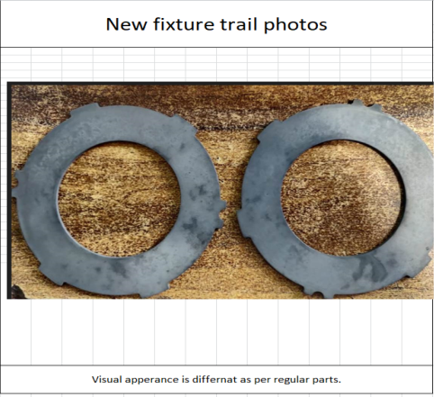
Modification Fixture trail Metal tech -08.09.2024
Trail done on modified fixture for parts 520HR00502. Visual appearance in different as per regular parts.

