Slide 1
Accrete Electromech Pvt Ltd
Accrete Electromech Pvt Ltd -II
Suggestions to reduced rejection - H105 Front outer tube sub assembly
Date 10.10.2023

Slide 2
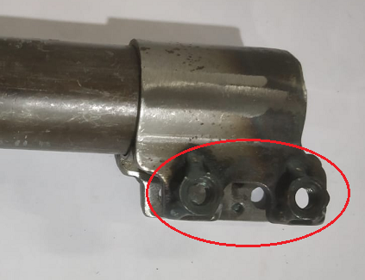
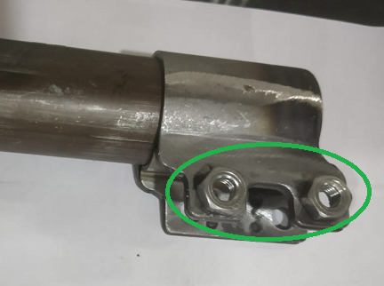
Outer tube assembly nut welding
Before
After
Nut projection welding + MIG welding
only projection welding
Benefits:- To eliminate deformation of the nut due to MIG welding temperature which is resulting in thread go gauge not pass & re-tapping

Slide 3
Process Flow
Before
After
Sr No | H105 FR Process Flow
1 | RM Receiving
2 | RM Inspection
3 | Tube Cutting
4 | Chamfering
5 | Marking
6 | Squeezing
7 | Machining (ID and OD)
8 | Knuckle bracket - Inner and Outer sub-assly
9 | Knuckle bracket - Inner and Outer tag welding
10 | Knuckle bracket pressing
11 | Spot welding C bracket + Tube
12 | Knuckle bracket grinding
13 | Bottomcap inward Inspection
14 | Bottom Cap CNC
15 | Bottom Cap pressing in Tube sub assly
16 | MiG welding (Bottom cap, C bracket + Tube )
17 | Leak Test
18 | Knuckle Bracket Sizing
19 | Knuckle Bracket Piercing
20 | Knuckle Bracket Sizing
21 | Nut Projection welding
22 | Inward Inspection
23 | Nut MiG welding
24 | Spatter removeing
25 | Final Inspection
26 | 100 % nut threading inspection by Tapping gauge & PPG
27 | 100 % nut threading inspection by Bolt
28 | Dispatch
Sr No | H105 FR Process Flow
1 | RM Receiving
2 | RM Inspection
3 | Tube Cutting
4 | Chamfering
5 | Marking
6 | Squeezing
7 | Machining (ID and OD)
8 | Bottom cap inward Inspection
9 | Bottom Cap pressing & Crimping in Tube
10 | Knuckle bracket - Inner and Outer sub-assembly
11 | Knuckle bracket pressing
12 | MiG welding (Bottom cap, C bracket + Tube )
13 | Leak Test
14 | Knuckle Bracket Sizing
15 | Knuckle Bracket Piercing
16 | Knuckle Bracket Sizing
17 | Nut Projection welding
18 | Inward Inspection
19 | Spatter removing
20 | Final Inspection
21 | Sampling inspection by Tapping Gauge & PPG
22 | Dispatch

Slide 4
Accrete Electromech Pvt Ltd

