Slide 1
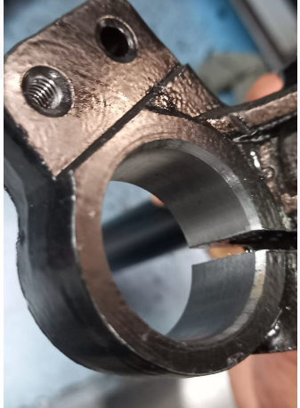
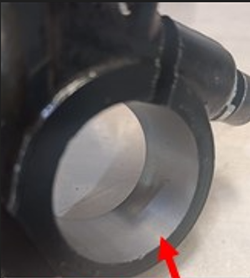
Problem Definition Sheet
1. Rejection Quantity – month wise
Mfg. Month | Jan.24 | Feb.24 | Mar.24 | Apr.24 | May.24 | Jun.24 | Jul.24 | Aug.24 | Sept. 24 | Oct.24 | Nov.24 | Dec.24
Rejected qty. in nos. | 0 | 0 | 0 | 0 | 0 | 0 | 0 | 0 | 0 | 525
Part name & Part no. : UBA / E101B / F20514702O
Customer complaint : Side Bore bottom side chamfer missing
Defect Phenomenon : Side bore chamfer 2X 10° Missing
Photographs
Ok
Not Ok
Containment Action: All lot at Customer End checked 525 no's 22 Nos not ok . In WIP 250 no's rechecked 9 nos defected part found .
Target Date & Status: 01.10.2024- Completed .

Slide 2
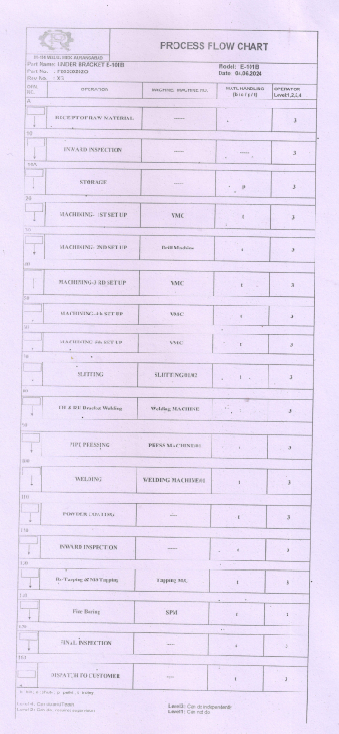
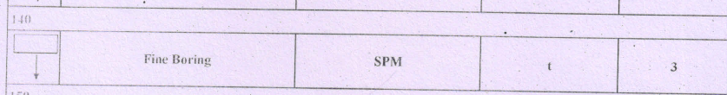
Process Flow

Slide 3
FTA (Fault Tree Analysis)
Defect
 |  |  |  | Defect – M16 Tight
Unskilled Operator |  |  | Cycle control electrical limit switch not working . |  |  |  |  |  |  |  |  | Chamfer Cartage moved back
Less awareness |  |  | Dust build up on switch & Dog control area |  |  |  |  |  |  |  |  | Resting Bolt not used to cartage
Training to new operators . |  |  | Not cleaned regularly |  |  |  |  |  |  |  |  | Tool using training to operators
New operator |  |  | Not aligned to to JH Sheet |  |  |  |  |  |  |  |  | Check point not aligned in set up
L4 Level person will be deployed with training |  |  | Limit switch & controlling dog to be address in JH |  |  |  |  |  |  |  |  | Check point to be address in Set up
Marking on each part |  |  | Addressed in JH Sheet . |  |  |  |  |  |  |  |  | Marking to each part at chamfer point
Final inspection record |  |  | Daily record of JH |  |  |  |  |  |  |  |  | Set up record
Final inspection check sheet updated |  |  | Jh sheet updated |  |  |  |  |  |  |  |  | CP Updated
Contributing factor (4M+1T)
Man
Machine
Method
Material
Tooling
Cause (Subdivision)
Why
Current Control (Spec)
Actual observation (during Gemba)
Countermeasure
Preventive Action
Sustenance Action
Document reference

Slide 4
Corrective Action sheet
Part Name & number | Defect Phenomena | Qty | Root Cause |  | Corrective Action |  | Target date & Status | Preventive action | Sustenance/ System action | Effectiveness
 |  |  | Inspection | Cause | Inspection | Cause
UBA & E101B | Side bore back side chamfer 2X 10° Missing . | 22/525 | W1: Side bore back side chamfer 2X 10° Missing W2: Not aware about defect . W3: New Inspector . Root Cause : New Inspector a) New inspector was working this station . | W1: Side bore back chamfer missing W2: Chamfer tool insert not worked in running . W3: Cartage of chamfer tool gone back side in running . W4- Resting bolt not used for cartage movement . Root Cause : Resting bolt to chamfer cartage not used . a) Resting bolt to chamfer cartage not used | Training given to inspectors & Operator . Q Alert Displayed b) All material at customer end cross checked Qty -525 nos 22 nos found suspected . c) All material in WIP rechecked 250 nos 9 nos found suspected . | Cartage resting bolt using started to chamfer tool . Training given to operators . Its interlock with setup approval . | Inspection side : a) 01.10.2024 B & C) 01.10.2024 Completed Cause side : a) 01.10.2024 & Completed | 100% Inspection marking started at point of chamfer . T. Date & Status: 01.10.2024& Completed | Sustenance Side: 100% Inspection record System Side : Control plan updated ,OPL Displayed T. Date & Status:02.10.2024 & Completed
HD Matrix
Actions | Model
1. Cartage resting bolt using started to chamfer tool . | UBA-T101C,K17BD.K17AB,K8,B104D,K19,K11.

Slide 5
Corrective Action sheet
Part Name & number | Defect Phenomena | Qty | Root Cause |  | Corrective Action |  | Target date & Status | Preventive action | Sustenance/ System action | Effectiveness
 |  |  | Inspection | Cause | Inspection | Cause
UBA & E101B | Side bore back side chamfer 2X 10° Missing . | 22/525 | W1: Side bore back side chamfer 2X 10° Missing W2: Not aware about defect . W3: New Inspector . Root Cause : New Inspector a) New inspector was working this station . | W1: Cycle stopping electrical limit switch not working in running W2: Dust accumulated in limit switch & Dog . W3: Not cleaned regularly . W4- Point not addressed in JH . Root Cause :Limit switch & Dog dust cleaning point not addressed in JH .. a) Limit switch & Dog dust cleaning point not addressed in JH .. | Training given to inspectors & Operator . Q Alert Displayed b) All material at customer end cross checked Qty -525 nos 22 nos found suspected . c) All material in WIP rechecked 250 nos 9 nos found suspected . | a) Aligned to clean regularly limit switch mechanism .b) Training given to operators . | Inspection side : a) 01.10.2024 B & C) 01.10.2024 Completed Cause side : a) 02.10.2024 & Completed | 100% Inspection marking started at point of chamfer . T. Date & Status: 01.10.2024& Completed | Sustenance Side: 100% Inspection record System Side : JH Sheet updated T. Date & Status:02.10.2024 & Completed
HD Matrix
Actions | Model
1. Cartage resting bolt using started to chamfer tool . | UBA-T101C,K17BD.K17AB,K8,B104D,K19,K11.

Slide 6
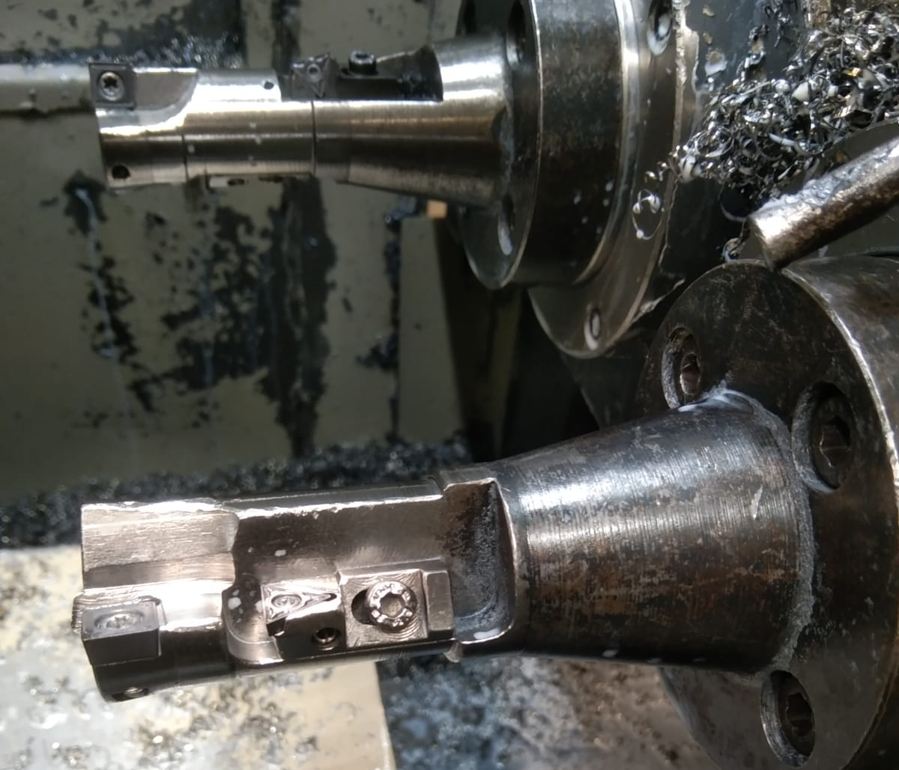
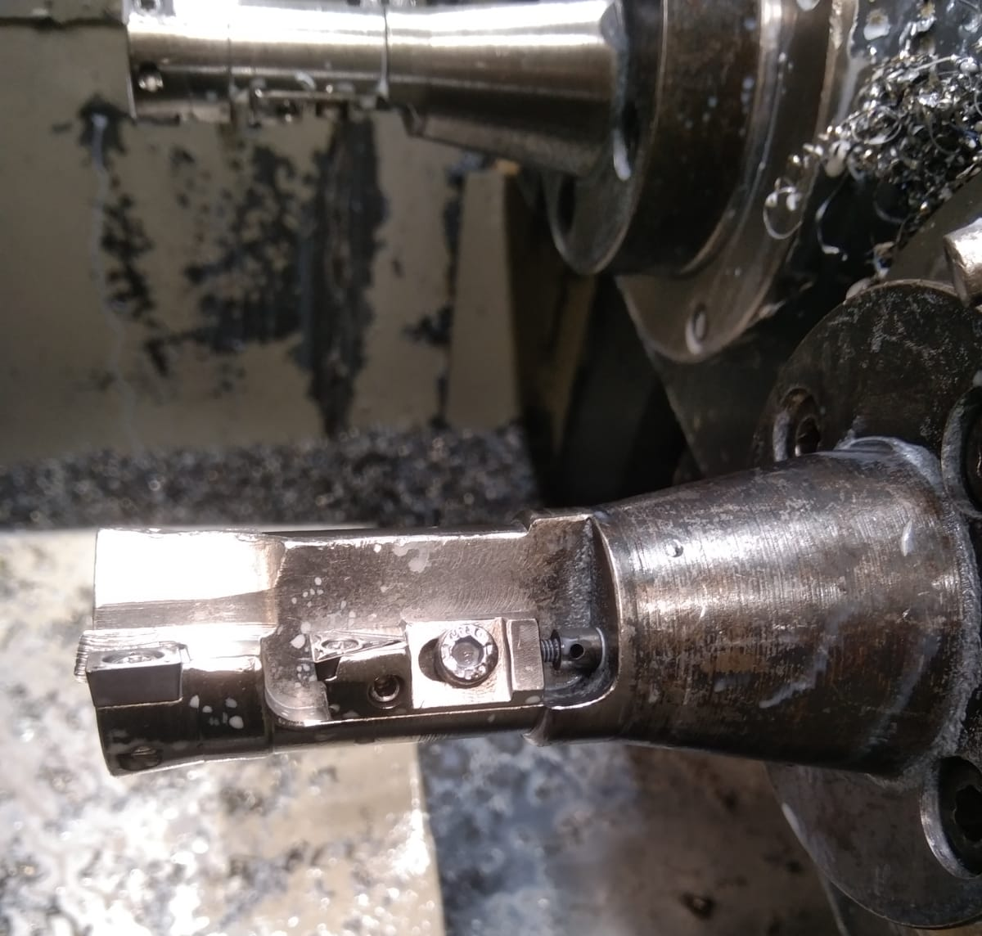
Cartridge resting bolt
Before
After
No cartridge resting bolt
Resting bolt using started.

Slide 7
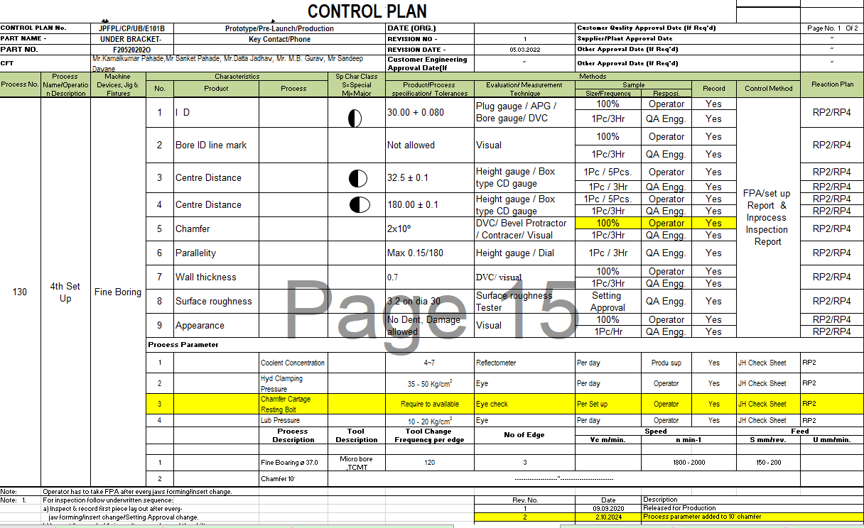
CONTROL PLAN
CONTROL PLAN No. |  | JPFPL/CP/UB/E101B |  | Prototype/Pre-Launch/Production |  |  | DATE (ORG.) |  | Customer Quality Approval Date (If Req'd) |  |  |  | Page No. 1 Of 2
PART NAME - |  | UNDER BRACKET- E101B |  | Key Contact/Phone Mr Kamalkumar Pahade/ 9970300061 |  |  | REVISION NO - | 1 | Supplier/Plant Approval Date |  |  |  | ~
PART NO. |  | F20520202O |  |  |  |  | REVISION DATE - | 05.03.2022 | Other Approval Date (If Req'd) |  |  |  | ~
CFT |  | Mr.Kamalkumar Pahade,Mr Sanket Pahade, Mr.Datta Jadhav, Mr. M.B. Gurav, Mr Sandeep Davane |  |  |  |  | Customer Engineering Approval Date(If Req'd) | ~ | Other Approval Date (If Req'd) |  |  |  | ~
Process No. | Process Name/Operation Description | Machine Devices, Jig & Fixtures | Characteristics |  |  | Sp Char Class S=Special Mj=Major C=Critical | Methods |  |  |  |  |  | Reaction Plan
 |  |  | No. | Product | Process |  | Product/Process specification/ Tolerances | Evaluation/ Measurement Technique | Sample |  | Record | Control Method
 |  |  |  |  |  |  |  |  | Size/Frequency | Resposi.
130 | 4th Set Up | Fine Boring | 1 | I D |  |  | 30.00 + 0.080 | Plug gauge / APG / Bore gauge/ DVC | 100% | Operator | Yes | FPA/set up Report & Inprocess Inspection Report | RP2/RP4
 |  |  |  |  |  |  |  |  | 1Pc/3Hr | QA Engg. | Yes
 |  |  | 2 | Bore ID line mark |  |  | Not allowed | Visual | 100% | Operator | Yes |  | RP2/RP4
 |  |  |  |  |  |  |  |  | 1Pc/3Hr | QA Engg. | Yes
 |  |  | 3 | Centre Distance |  |  | 32.5 ± 0.1 | Height gauge / Box type CD gauge | 1Pc / 5Pcs. | Operator | Yes |  | RP2/RP4
 |  |  |  |  |  |  |  |  | 1Pc / 3Hr | QA Engg. | Yes |  | RP2/RP4
 |  |  | 4 | Centre Distance |  |  | 180.00 ± 0.1 | Height gauge / Box type CD gauge | 1Pc / 5Pcs. | Operator | Yes |  | RP2/RP4
 |  |  |  |  |  |  |  |  | 1Pc/3Hr | QA Engg. | Yes |  | RP2/RP4
 |  |  | 5 | Chamfer |  |  | 2x10º | DVC/ Bevel Protractor / Contracer/ Visual | 100% | Operator | Yes |  | RP2/RP4
 |  |  |  |  |  |  |  |  | 1Pc/3Hr | QA Engg. | Yes
 |  |  | 6 | Parallelity |  |  | Max 0.15/180 | Height gauge / Dial | 1Pc / 3Hr | QA Engg. | Yes |  | RP2/RP4
 |  |  | 7 | Wall thickness |  |  | 0.7 | DVC/ visual | 100% | Operator | Yes |  | RP2/RP4
 |  |  |  |  |  |  |  |  | 1Pc/3Hr | QA Engg. | Yes
 |  |  | 8 | Surface roughness |  |  | 3.2 on dia 30 | Surface roughness Tester | Setting Approval | QA Engg. | Yes |  | RP2/RP4
 |  |  | 9 | Appearance |  |  | No Dent, Damage allowed | Visual | 100% | Operator | Yes |  | RP2/RP4
 |  |  |  |  |  |  |  |  | 1Pc/Hr | QA Engg. | Yes |  | RP2/RP4
 |  |  | Process Parameter
 |  |  | 1 |  | Coolent Concentration |  | 4~7 | Reflectometer | Per day | Produ sup | Yes | JH Check Sheet | RP2
 |  |  | 2 |  | Hyd Clamping Pressure |  | 35 - 50 Kg/cm² | Eye | Per day | Operator | Yes | JH Check Sheet | RP2
 |  |  | 3 |  | Chamfer Cartage Resting Bolt |  | Require to available | Eye check | Per Set up | Operator | Yes | JH Check Sheet | RP2
 |  |  | 4 |  | Lub Pressure |  | 10 - 20 Kg/cm² | Eye | Per day | Operator | Yes | JH Check Sheet | RP2
 |  |  |  |  | Process Description | Tool Description | Tool Change Frequency per edge | No of Edge | Speed |  |  | Feed
 |  |  |  |  |  |  |  |  | Vc m/min. | n min-1 |  | S mm/rev. | U mm/min.
 |  |  | 1 |  | Fine Boaring ø 37.0 | Micro bore ,TCMT | 120 | 3 |  | 1800 - 2000 |  | 150 - 200
 |  |  | 2 |  | Chamfer 10° | --------------------"-------------------------
Note: | Operator has to take FPA after every jaws forming/insert change.
Note: 1. | For inspection follow underwritten sequence: |  |  |  |  |  |  | Rev. No. | Date | Description
 | a) Inspect & record first piece lay out after every- |  |  |  |  |  |  | 1 | 09.09.2020 | Released for Production
 | jaw forming/insert change/Setting Approval change. |  |  |  |  |  |  | 2 | 2.10.2024 | Process parameter added to 10° chamfer
CP Updated

Slide 8
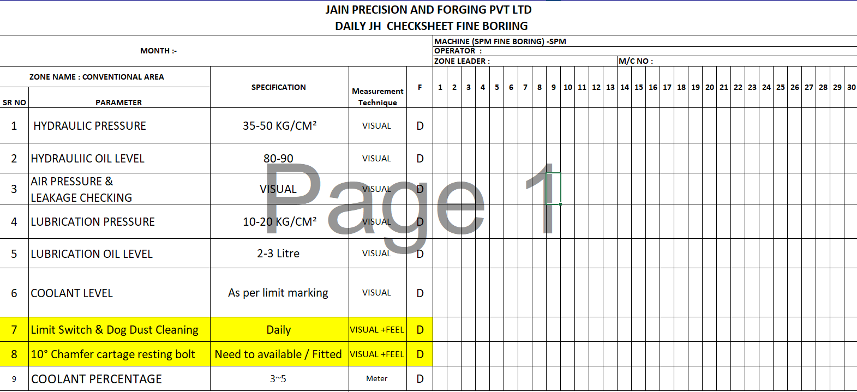
JH check sheet updated .

Slide 9
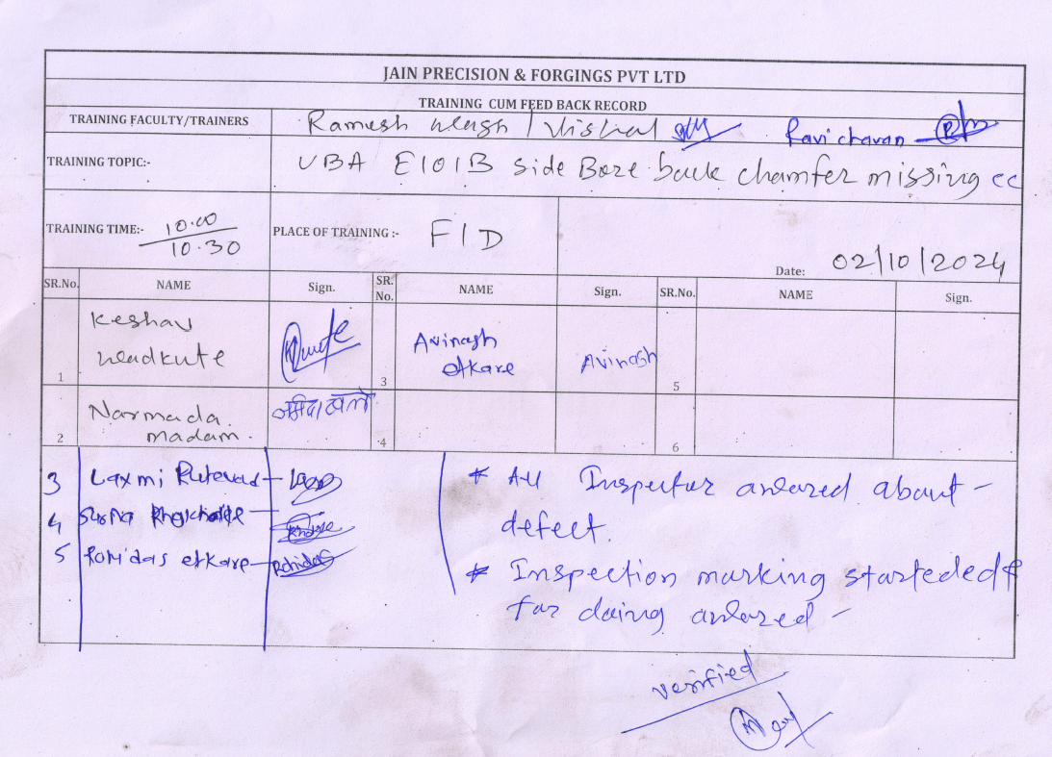
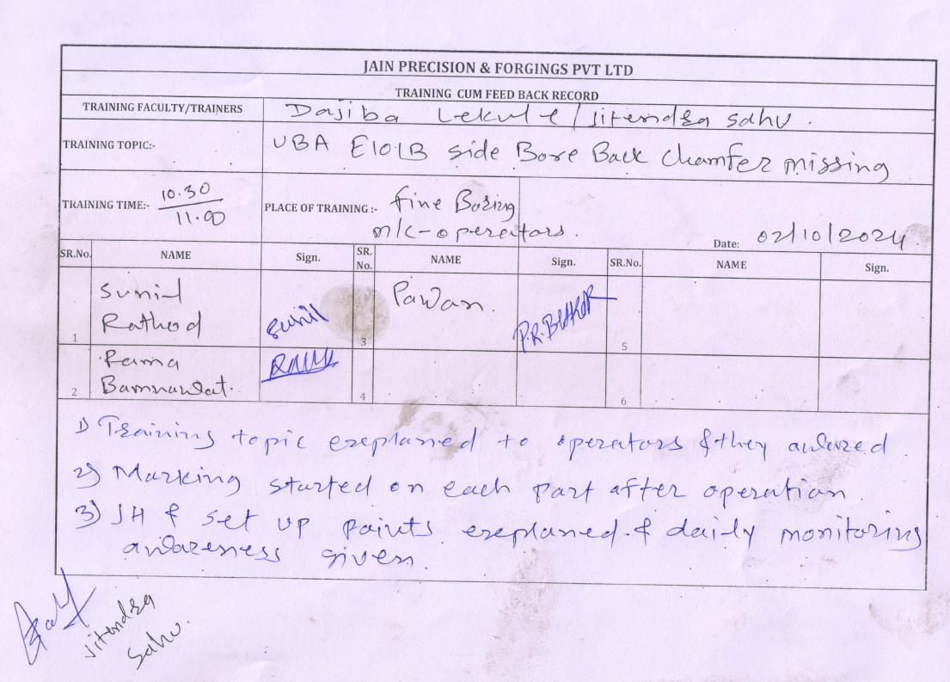
Training Record FID & Operators

Slide 10
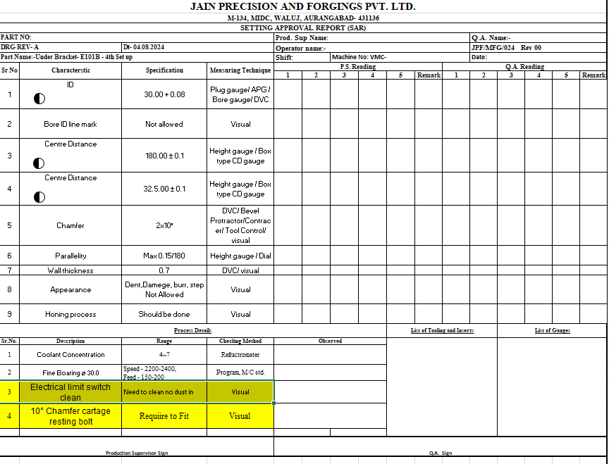
Set Up Approval Updated

Slide 11
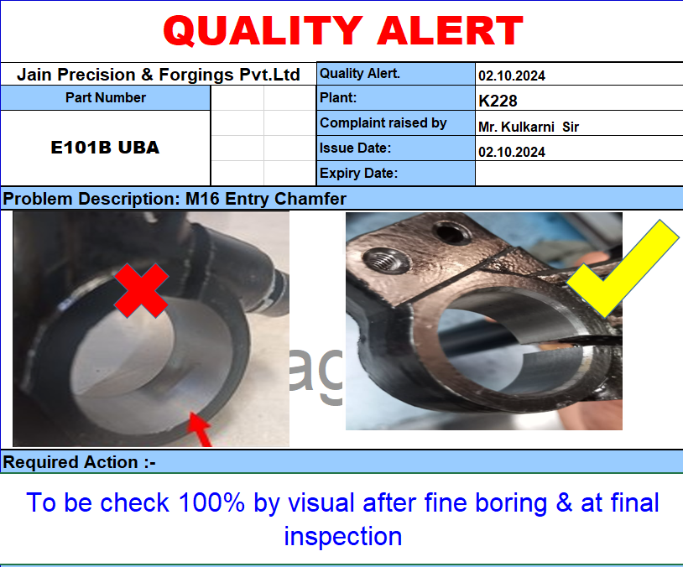
Q alert

Slide 12
Thank You !

