Slide 1
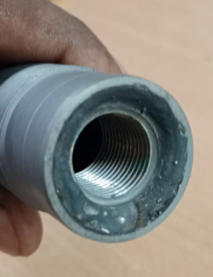
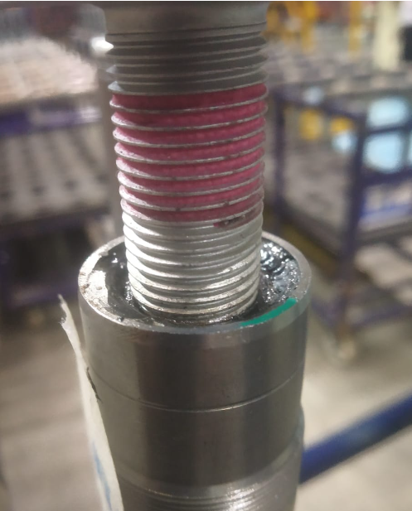
Problem Definition Sheet
Part name & Part no. : Steering Shaft & SPD Model :
Customer complaint : Threading Issue
Physical Phenomenon : M16 Threading tight, Bolt entry very hard .
1. Rejection Quantity – month wise
Mfg. Month | Jan.23 | Feb.23 | Mar.23 | Apr.23 | May.23 | Jun.23 | Jul.23 | Aug.23 | Sept. 23 | Oct.23 | Nov.23 | Dec.23
Rejected qty. in nos. | 0 | 0 | 0 | 0 | 0 | 0 | 0 | 0 | 3
2. Photograph – failure phenomenon
M16 Threading tight
Containment location | Total Qty | Qty Verified | Not ok Qty | Not Ok Qty disposal status | Identification mark if any on Ok parts
BAL | 0 | 0 | 0 | 0 | 0
Warehouse | 6 | 6 | 6 | Sent Back | 0
Transit | 2000 | 2000 | 0 | 0 | Pink marking
Vendor end | 400 | 400 | 0 | 0 | Green Marking
3. Whether the defect is detectable at part manufacturing line – Yes/ No (please indicate)
IF ANSWER IS YES
Check and confirm whether the defective pieces pass the detection stage of the manufacturing line – Yes / No
1

Slide 2
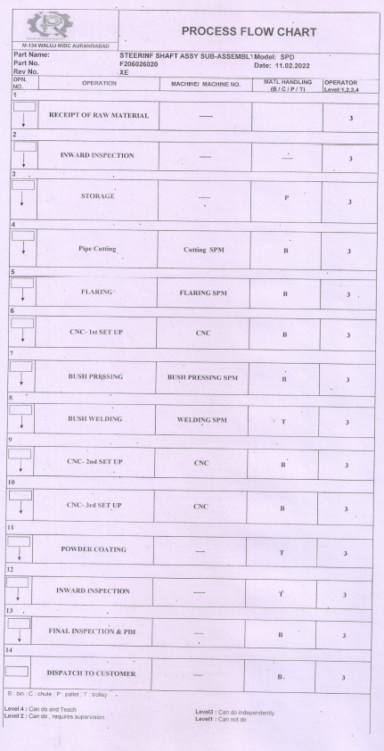
Process Flow

Slide 3
FTA (Fault Tree Analysis)
Defect
 |  |  |  | Defect – M16 Tight
Unskilled Operator |  |  | Entry chamfer of threading no provision |  |  | With adjusting thread gauging inspection
Less awareness |  |  | Was not given on drawing |  |  | No awareness
Training to new operators . |  |  | With gauge adjusting checking . |  |  | With adjusting gauge inspection to thread
New operator |  |  | No provision to do chamfer in programme |  |  | No awareness to Inspector
L4 Level person will be deployed with training |  |  | No provision for chamfer |  |  | To be check 100% visual
Marking on each part |  |  | Chamfer included to dia 14.50 |  |  | Inspection record
Final inspection record |  |  | Set up & IHR Record |  |  | Set up & IHR
Final inspection check sheet updated |  |  | CP Updated |  |  | CP
Contributing factor (4M+1T)
Man
Machine
Method
Material
Tooling
Cause (Subdivision)
Why
Current Control (Spec)
Actual observation (during Gemba)
Countermeasure
Preventive Action
Sustenance Action
Document reference

Slide 4
Corrective Action sheet
Part Name & number | Defect Phenomena | Qty | Root Cause |  | Corrective Action |  | Target date & Status | Preventive action | Sustenance/ System action | Effectiveness
 |  |  | Inspection | Cause | Inspection | Cause
Steering Shaft ,SPD | M16 Tight not qualifying Bolt. | 3 | W1: M16 Thread Tight W2: Mixed up, not inspected, parts in Ok lot W3: OK & not ok parts kept openly on inspection table . W4: No provision to keep W5: Root Cause : Mix up not inspected parts a) Mix up not inspected parts in OK lot | W1: M16 Thread Tight W2: Go gauge not engaging to thread W3: Chamfer of entry threading no provision Root Cause : M16 entry threading chamfer not provided . a) M16 Entry chamfer not provided | Inspection Table modified with divisions . b) station wise parameter & Inspector defined . c) All material at customer end cross checked | a) On CNC machine bush boring Dia 14.50 mm Entry Chamfer included 1x45°. Programme revised | Inspection side : a) 28.09.2024 B & C) 29.9.2024 Completed Cause side : a) 28.09.2024 & Completed | 100% Inspection marking started at point of entry thread . T. Date & Status: 28.09.2024 & Completed | Sustenance Side: 100% Inspection record System Side : Control plan updated ,OPL Displayed T. Date & Status:29.09.2024 & Completed
HD Matrix
Actions | Model
1. On CNC machine bush boring Dia 14.50 mm Entry Chamfer included 1x45° . | PRF SHAFT & Completed 28.09.2024

Slide 5
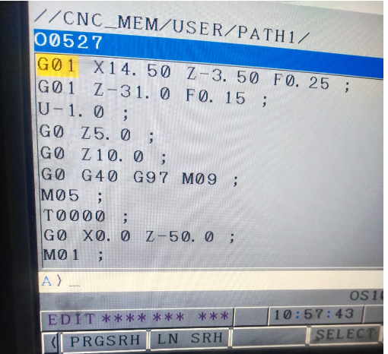
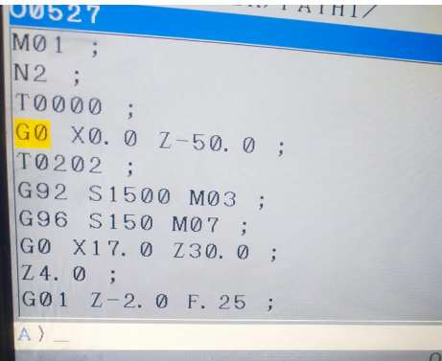
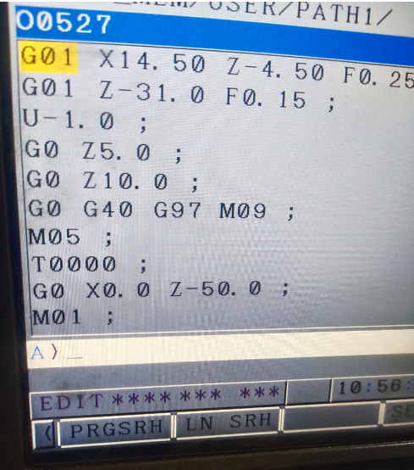
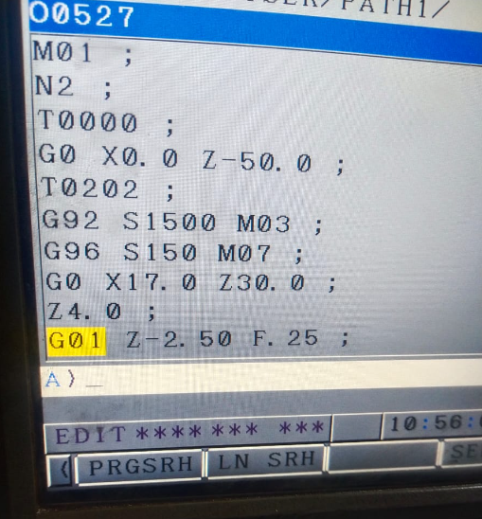
Programme revised for Chamfer
Before
After
Dia 14.50 mm Entry chamfer no provision in programme
Now Dia 14.50 mm Entry chamfer provision done programme & Insert life interlocked .

Slide 6
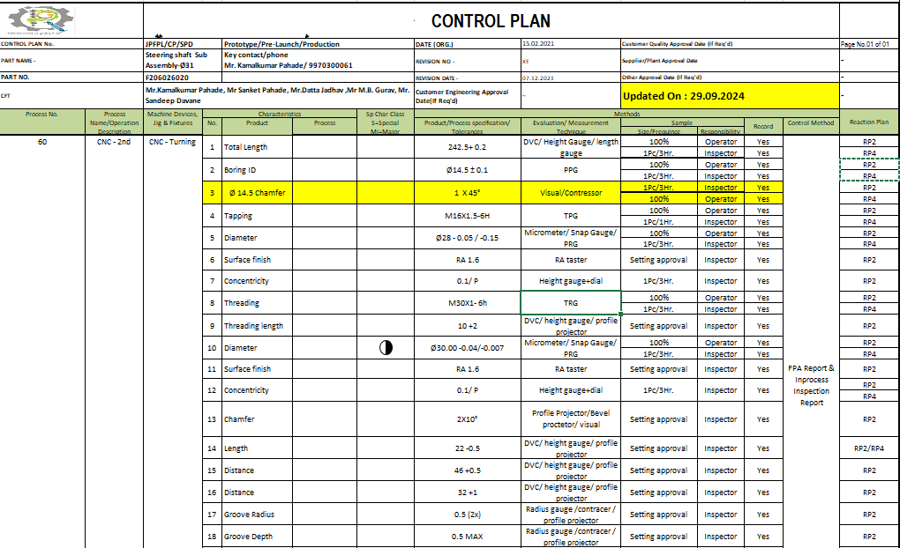
CP Updated

Slide 7
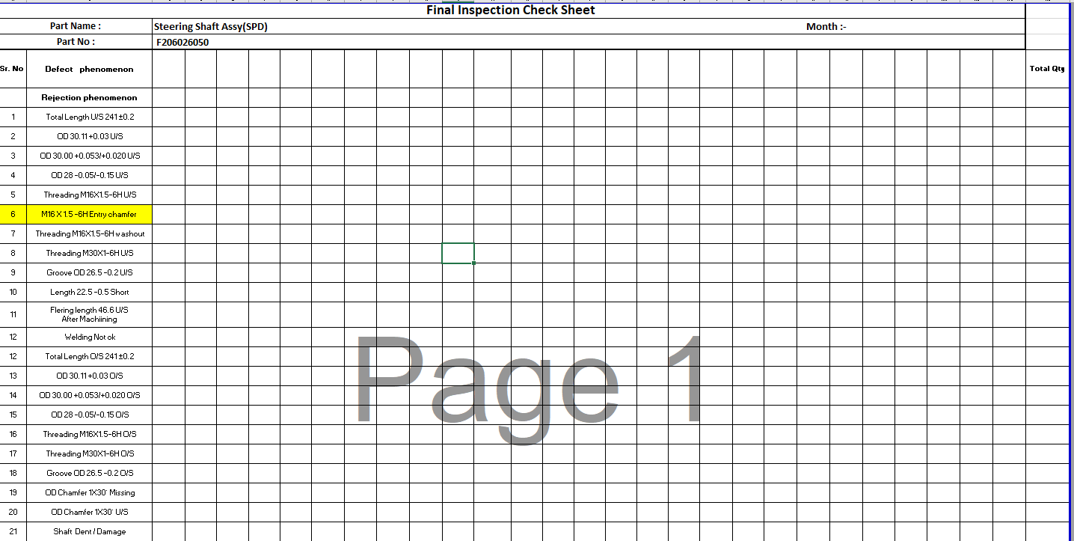
Final Inspection check sheet updated .

Slide 8
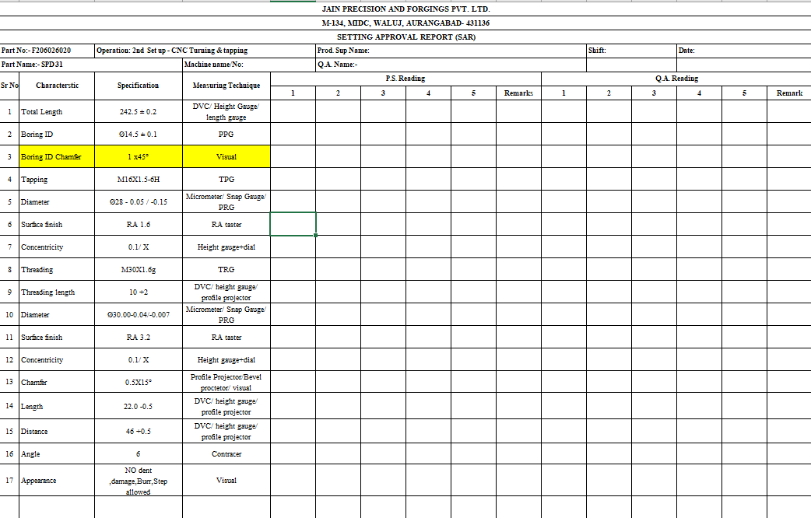
Set up Approval updated

Slide 9
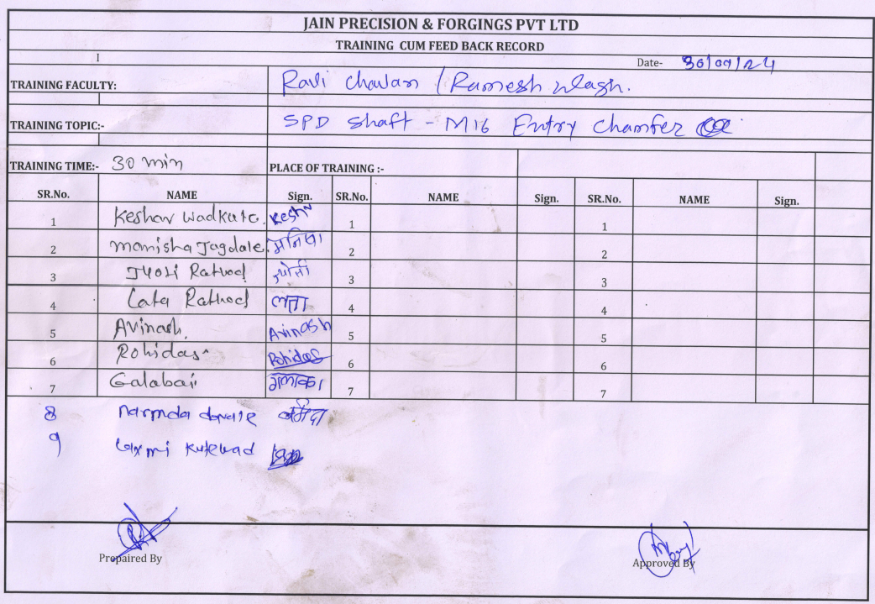
Training to FID

Slide 10
Q alert

Slide 11
Thank You

Slide 12
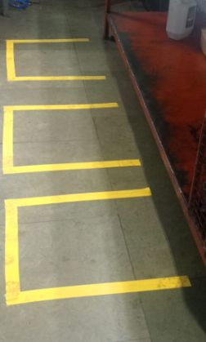
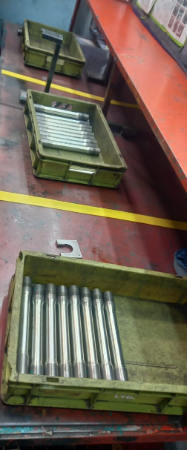
Station defined to check at final
Inspector location defined
Station wise bins provision done to avoid mix up .

Slide 13
System failure and concerned horizontal head
PART | DEFECT PHENOMENON (QSR, EFR, FFR) | QTY | ROOT CAUSE |  | SYSTEM FAILURES | RESP HORIZONTAL (NAME)
 |  |  | INSPECTION SIDE | PROCESS SIDE
SPD & PRF | M16 Tight | 6 | Not checked part mix up in OK Lot . | No provision to threading entry chamfer |  | Mr. Jetendra Sahu & Ramesh Wagh

Slide 14
Thank You !

