Slide 1
Action plan
Dt.: 15th Oct 2024

Slide 2
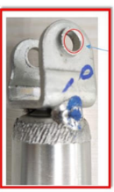

CONDITIONS FOR OCCURRENCE
● Phenomenon:M8 X 1.25 -6h thread missing
Trouble content
・Supplier: M/s Saptagiri Industries
・Model: HMSI
・Parts name: U Type Bracket
・Part No.: 530PE00402
・Date of Occurrence: 03.10.2024
・Qty NG: 01 Nos.
NG Part | OK Part
●Parts Stock check results
Thread missing
Actual: M8X1.25-6h
Thread Available
Actual: M8X1.25-6h
Action
Area | Total Stock | Checked | Checking Method | NG Qty | Status
ETL | 7000 | 7000 | Movement & Visual check | 0 | All available stock qty. verified & found OK.

Slide 3
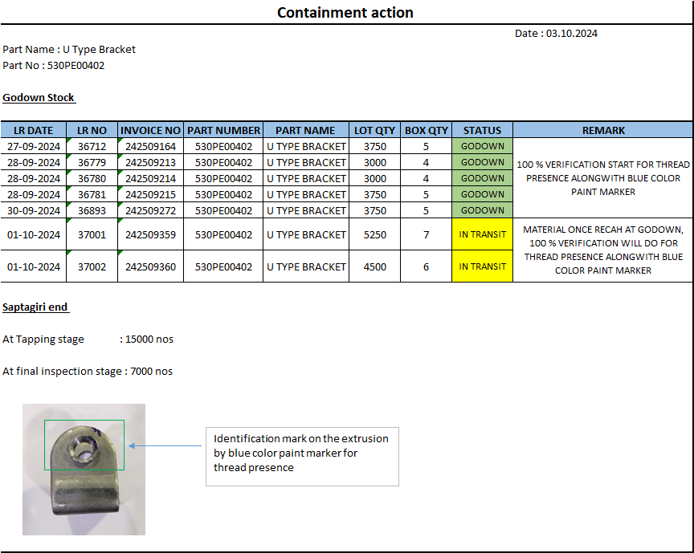
CONTAINMENT ACTION: FOR THREAD MISSING

Slide 4
UNDERSTANDING OF ACTUAL CONDITION AND CONTROL
Process Flow
Possible defect occurrence area.
Raw Material Inward
Sheet Sharing
Blanking
Two side chamfer
First forming
U forming
Tapping
Chamfer
Extrusion Chamfer
Piercing Second Hole
Piercing first Hole
Cleaning
Final Inspection
Packaging / Storing

Slide 5
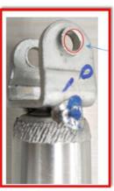
UNDERSTANDING OF ACTUAL CONDITION
● Understanding the actual cause – (Factor analysis)
Man
Machine
Without threaded part mix up with threaded while tapping operation
Operator not aware about threaded & without threaded part
Incomplete thread length Due to inadequate stoper setting at on tapping machine
Thread missed due to tap broken during tapping operation
M8 X 1.25 – 6h
Thread missing
At tapping area few parts Fallon at shop floor
For material storing & movement used gunny bag Press shop to tapping stage
Bolt engaging process skip at tapping stage
Material Not identified by tagging
Method
Material

Slide 6
FACTS VERIFICATION
# | 4M | PROBABLE CAUSES | FACTS VERIFICATION | Jud.
1 | MAN | Operator not aware about threaded & without threaded part | Verify the operators’ awareness about threaded and with out threaded part, few people observed not aware about it. | ❒
2 | MACHINE | Incomplete thread length Due to inadequate stoper setting at on tapping machine | Stopper setting verified and its observed as require set up so can not possible to generate incomplete thread length | O
 |  | Without threaded part mix up with threaded while tapping operation | As observe few parts Fallon at machine area and those are threaded and without threaded parts | ❒
 |  | Thread missed due to tap broken during tapping operation | As observed no any tap broken incident happened in last few month | O
3 | METHOD | For material storing & movement used gunny bag Press shop to tapping stage | For material storing & movement used bin from Press shop to tapping stage | O
 |  | Material Not identified by tagging | Material identified by tagging | O
 |  | Bolt engaging process skip at tapping stage | As per SOP threaded parts engaging with the bolt | O
 |  | At tapping area few parts Fallon at shop floor | As observe few parts Fallon at machine area and those are threaded and without threaded parts | ❒
4 | MATERIAL | -

Slide 7
ROOT CAUSE ESTABLISHMENT
(WHY-WHY ANALYSIS)
● Root cause establishment (Why-Why Analysis)
 | WHY – 1 | WHY- 2 | WHY -3 | WHY-4 | Why-5
Occurrence | M8 X 1.25 – 6h Thread missing | Without threaded part mix up with threaded while tapping operation | As observe few parts Fallon at machine area and those are threaded and without threaded parts
Outflow | M8 X 1.25 – 6h Thread missing | Operator not aware about threaded & without threaded part | Operators are newly joined
Conclusion
As observe few parts Fallon at machine area and those are threaded and without threaded parts
Operators are newly joined.

Slide 8
COUNTERMEASURES
 | Cause | Countermeasure | Tgt. Dt. | Status
Supplier End | <Occurrence > | At tapping machine input and out put material keep store in to the bin. Awareness given to all operators and inspectors for 1S & 2S and which parts are Fallon at shop floor | 04-10-2024 04-10-2024 | Completed Completed
Supplier / ETL End | <Outflow> | One point lesion display at work place Awareness training given to final inspector for threaded parts inspection Awareness training to operator for inspection of threaded part After that bolt dis-engagement Dia 6.7 mm pin verification started After that pin verification 100 % colour mark identification started | 04-10-2024 04-10-2024 04-10-2024 04-10-2024 | Completed Completed Completed Completed

Slide 9
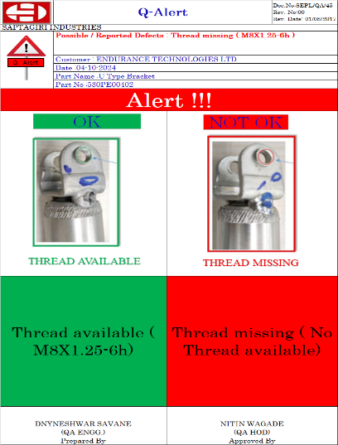
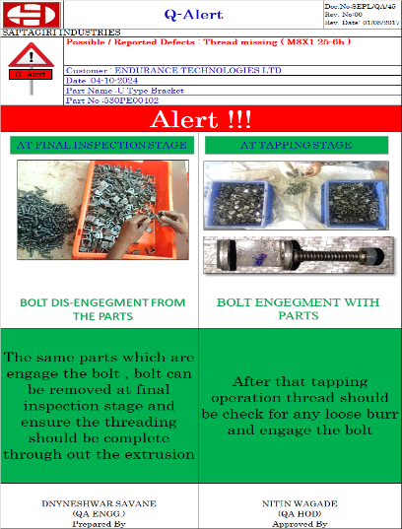
OPL / Q –Alert FOR : Thread missing M8X1.25-6h

Slide 10
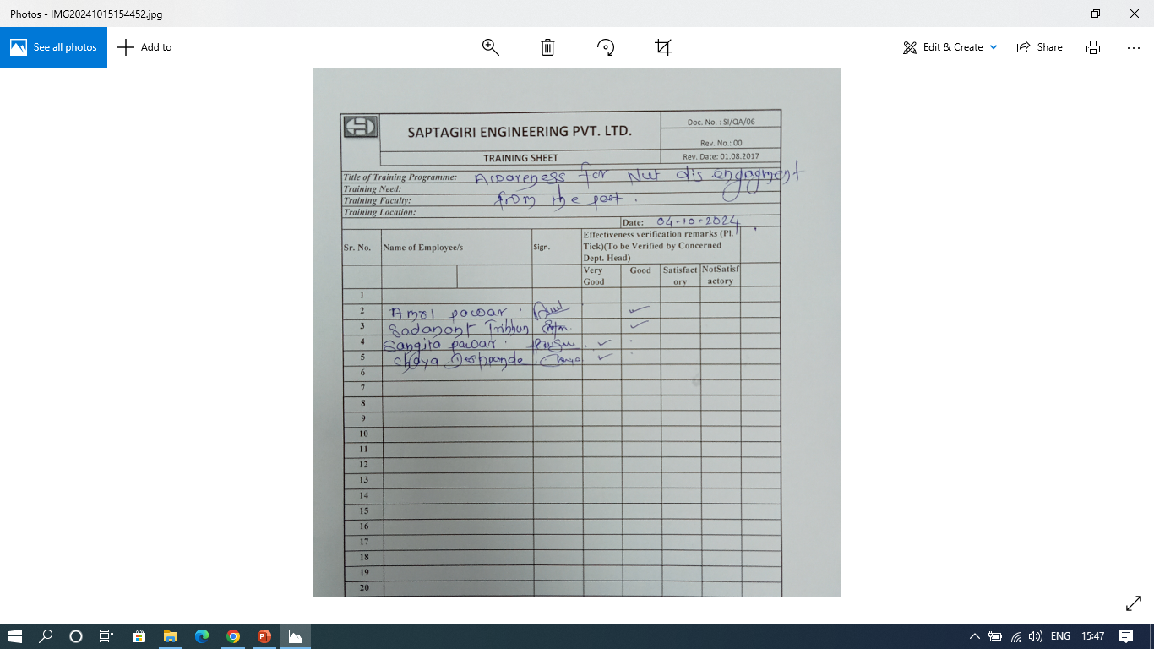
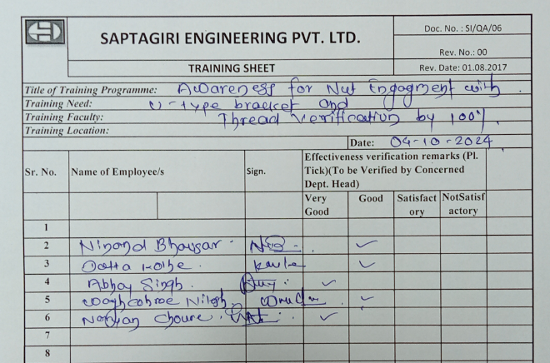

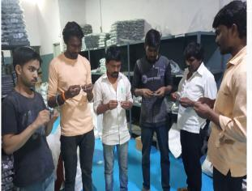
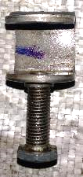
OPERATOR TRAINING RECORD: for nut engagement with thread parts
Awareness training given to newly joined operator for nut engagement with thread parts
Awareness training to newly joined final inspector for engagement of nut with threaded parts
Awareness training given to newly joined final inspector for disengagement of nut with threaded parts

Slide 11
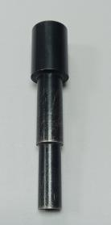
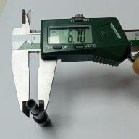
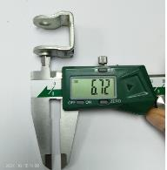
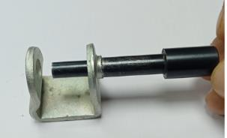
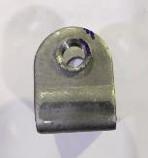
Thread verification by Step pin
Step pin made available for thread major dia verification
Step pin dia Ǿ 6.7 mm
Thread major dia Ǿ 6.72 mm
Thread major dia inspection and ensure thread presence
Identification mark on the extrusion by blue colour marker for thread presence

Slide 12
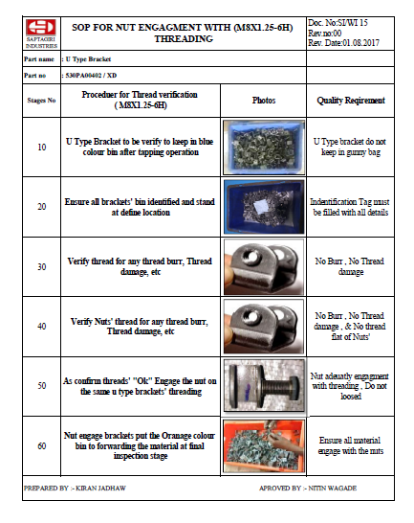
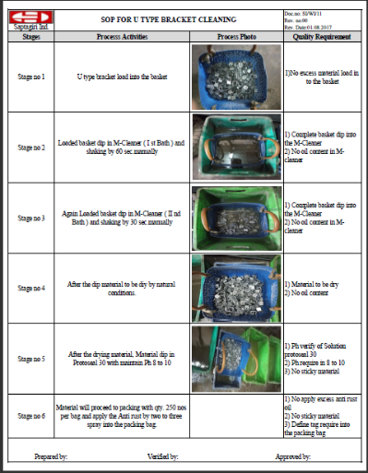
SOP FOR : Bolt engagement with parts and same bolt Dis engage
at final inspection stage
SOP for Bolt engagement with parts and same bolt Dis engage
at final inspection stage
SOP for parts Cleaning

Slide 13
THANK YOU

