Slide 1
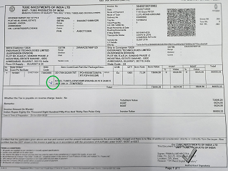
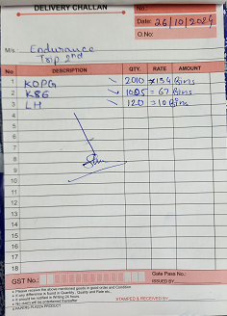
ACTION EVIDENCIES
BEFORE
AFTER
No Cross verification of Material Loaded with Invoice copy while dispatch the Material.
with Tick mark on invoice Copy as verification .
No Cross verification of Material Loaded with Invoice copy while dispatch the Material.
Loading Slip / DC Started with Cross verification of Material Loading Slip with Invoice copies while Dispatch with Tick mark on invoice Copy as verification .

