Slide 1
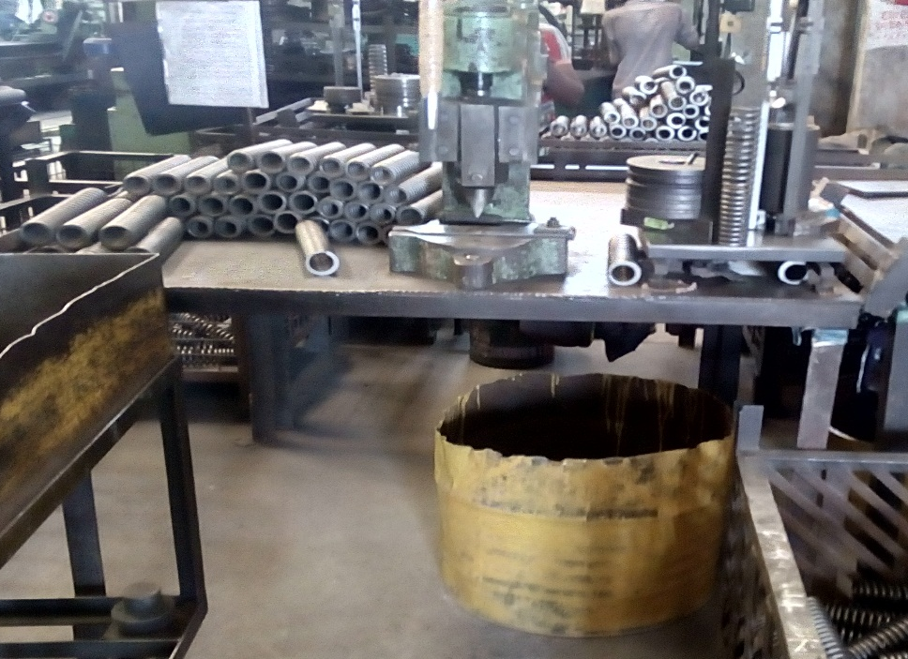
Sagar Springs Pvt Ltd
O.P.L (One Point Lesson)
Basic Knowledge: | Improvement Case: √ | Trouble Shooting Case:
OPL Theme: To ensure Height setting as per specification | Lesson No: 208 | Date: 20.10.2024
Before - Wrong | After - Right
Impact: * Height setting by production personnel without referring specification. | Corrective Action: *Height setting by QA personnel by referring specification
Height setting by production personnel
Not referred specification
Height setting by QA personnel
By referring specification

Slide 2
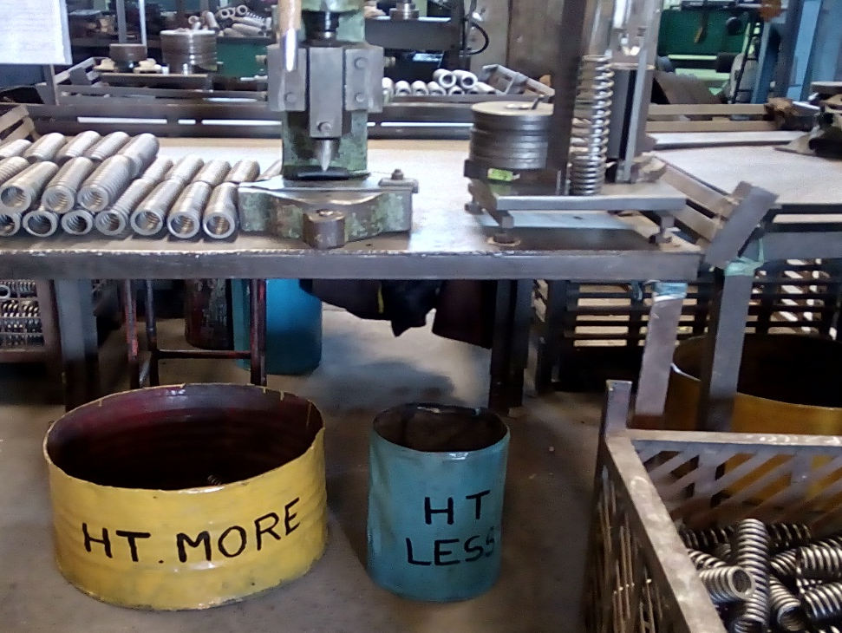
Sagar Springs Pvt Ltd
O.P.L (One Point Lesson)
Basic Knowledge: | Improvement Case: √ | Trouble Shooting Case:
OPL Theme: To eliminate mixing of height less spring at height checking cum sq. correction stage. | Lesson No: 209 | Date: 20.10.2024
Before - Wrong | After - Right
Impact: * Possibility of mixing height less spring with OK spring as ht less spring is kept on the table. | Corrective Action: *Bin provided for putting height less spring observed at height checking stage and avoid rework mix up with OK spring.
Separate Bin provide for HT More and HT Less springs
Ht less spring is kept on the table.
OK Spring

