Slide 1
Action Plan Evidences
OUTFLOW - AFTER
100% Inspection of Groove Width with Slip type Width gauge . This will Arrest incomplete Operation Part.

Slide 2
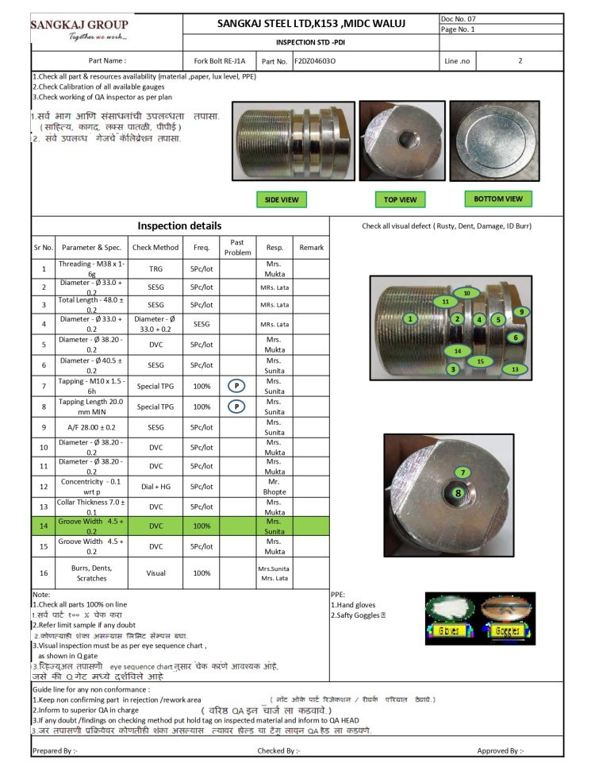
Action Plan Evidences
OUTFLOW - AFTER
Q-Alert
Inspection Standard Updated

