Slide 1
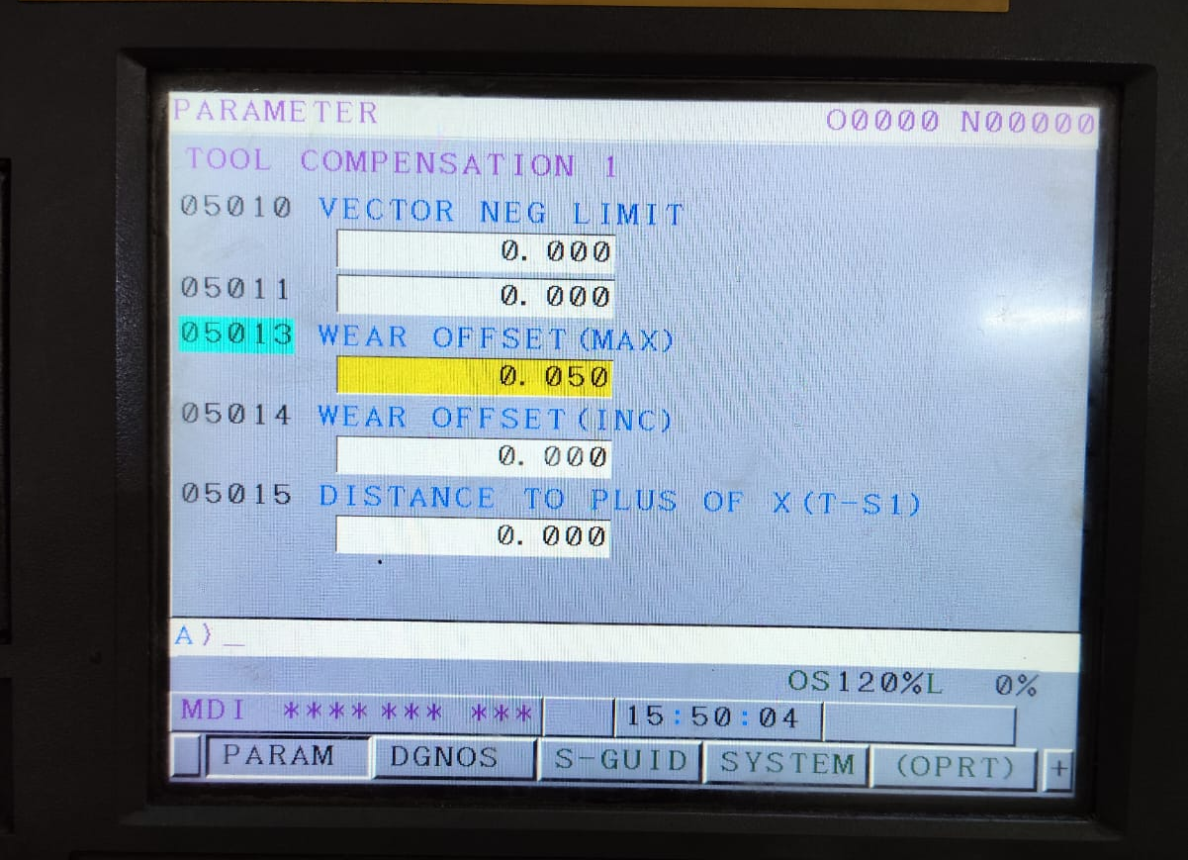
Action Plan Evidences
OCCURRENCE SIDE- AFTER
Offset Interlocked within 0.05mm to avoid the Wrong Offset and undersize Diameter

