Slide 1
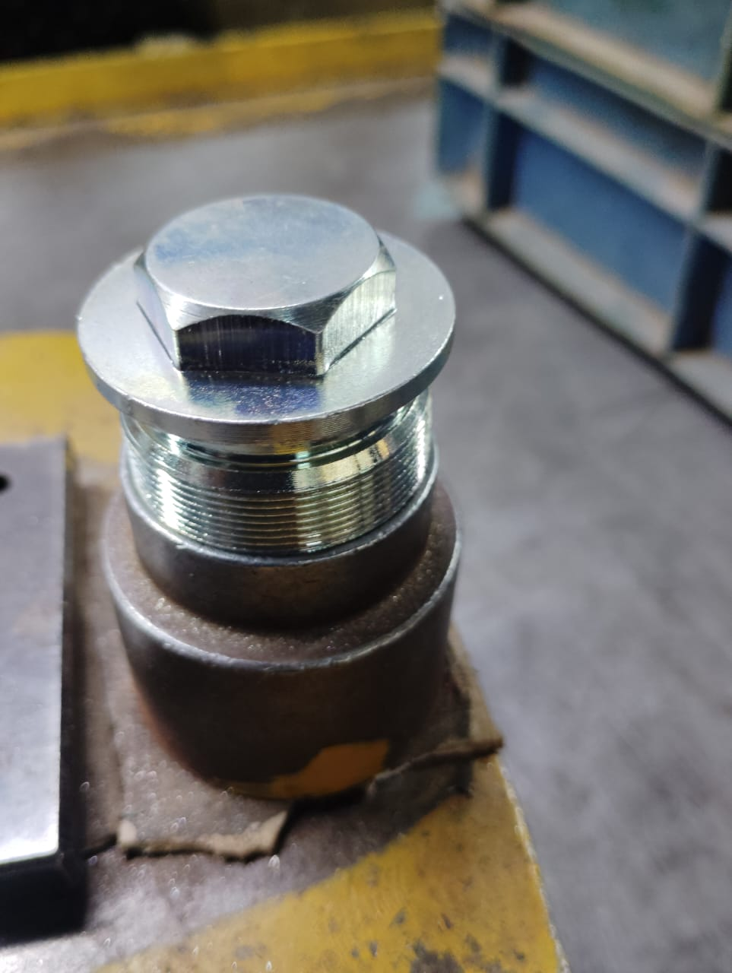
Action Plan Evidences
OUTFLOW - AFTER
100% Inspection of Major Diameter with Ring Gauge. This will arrest the Undersize Diameter parts.

Slide 2
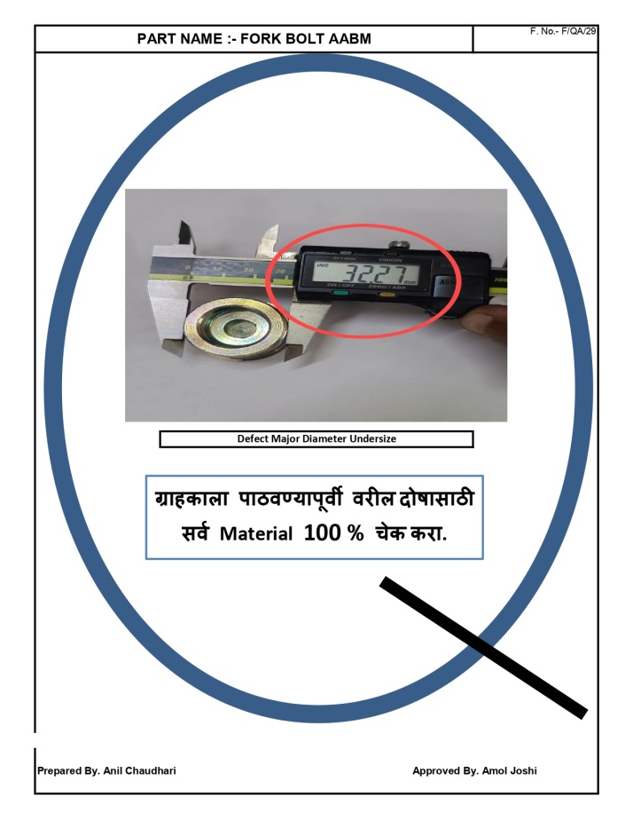
Action Plan Evidences
OUTFLOW - AFTER
Q-Alert

