Slide 1
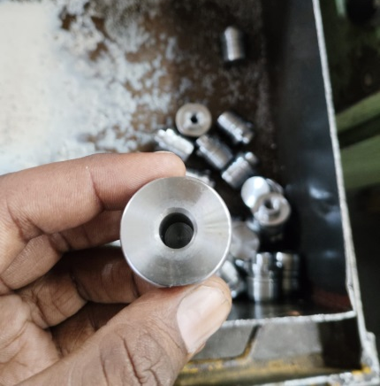
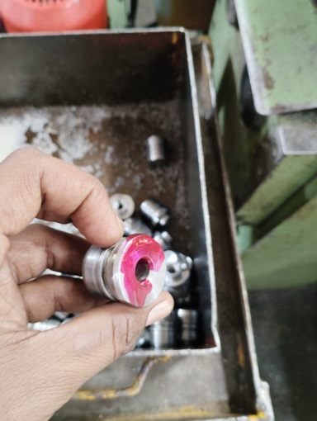
Counter measure Status
Stage | Problem | Countermeasure | Responsibility | Target Date | Status
Occurrence | Setting Part Mix-up | Operator has been instructed to take parts for Setting by applying Red Color to it and keep that part in the Rej. or R/w bin after setting to avoid mix up with regular part. | Mr. Santosh Raut | 20.10.2024 | Completed
BEFORE
AFTER
Operator is taking part for Setting without applying the Red Paint to it, making difficult to understand the Setup Part.
Instruction has been given to operator to use parts for Setup only after the application of red paint.

