Slide 1
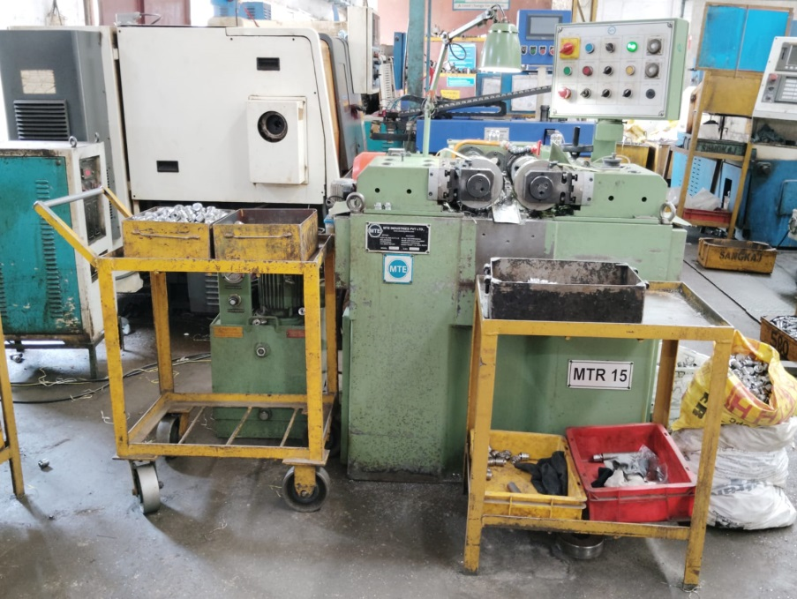
Counter measure Status
Stage | Problem | Countermeasure | Responsibility | Target Date | Status
Occurrence | Input-Output material Mix-up | To Avoid the possibility of Input Output Material Mix-up, Separate Tables already has been Provided. Instruction given to operator to follow the process flow as -Input-Process-Output to avoid material Mix-up. | Mr. Santosh Raut | 21.10.2024 | Completed
BEFORE
AFTER
Input Output tables are already provided at Thread Rolling stage to avoid the Mix-up of Material and to eliminate the Operation Missing Defect.

