Slide 1
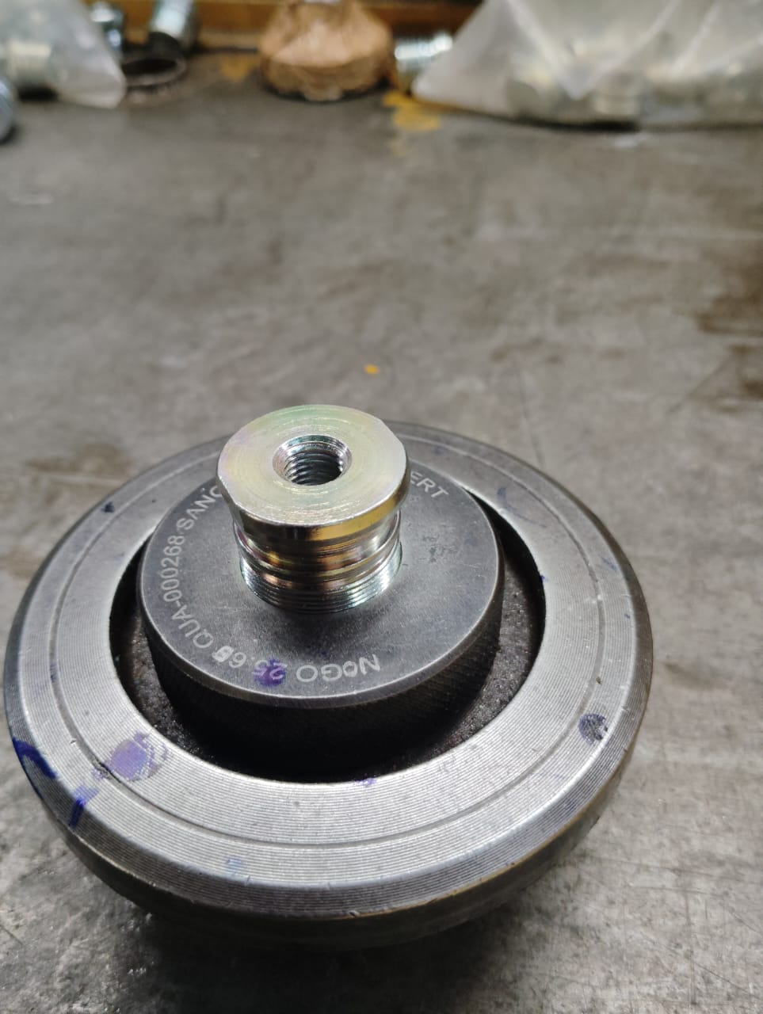
Counter measure Status
Stage | Problem | Countermeasure | Responsibility | Target Date | Status
Out-Flow | Possibility of skipping fork bolt during visual Inspection. | 100% Inspection of Fork Bolt Major Diameter with Plain Ring gauge. This will Arrest the Threading Missing part. | Mr. A.A. Joshi | 23.10.2024 | Completed
BEFORE
AFTER
Visual inspection of Fork Bolt is done for the Threading and sampling Inspection is done with mating part.
100% Inspection of Fork Bolt major Diameter with Plain Ring gauge

