Slide 1
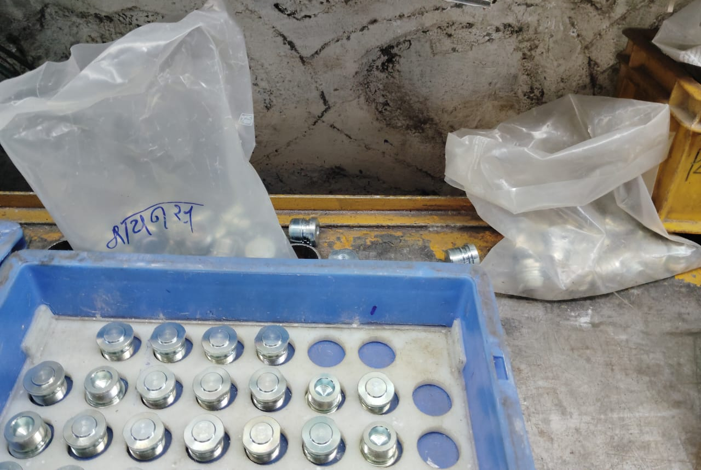
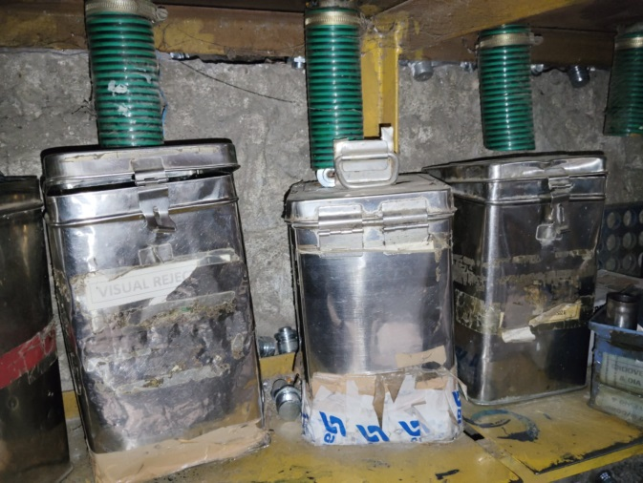
Counter measure Status
Stage | Problem | Countermeasure | Responsibility | Target Date | Status
Out-Flow | Defective part found kept on inspection table by inspector without any marking | Separate Rejection bins are provided for the each defect of Fork Bolt. Inspectors has been Instructed to mark the defective part and to keep it in the Rejection bin. | Mr. A.A. Joshi | 21.10.2024 | Completed
BEFORE
AFTER
Defective Parts Kept on Inspection Table near the OK Bin, this will increase the possibility of Defective Part Mix-up
Separate Bins provided for the each Defect of fork bolt and inspectors are instructed to kept Defective parts in the Rejection Bin.

