Slide 1
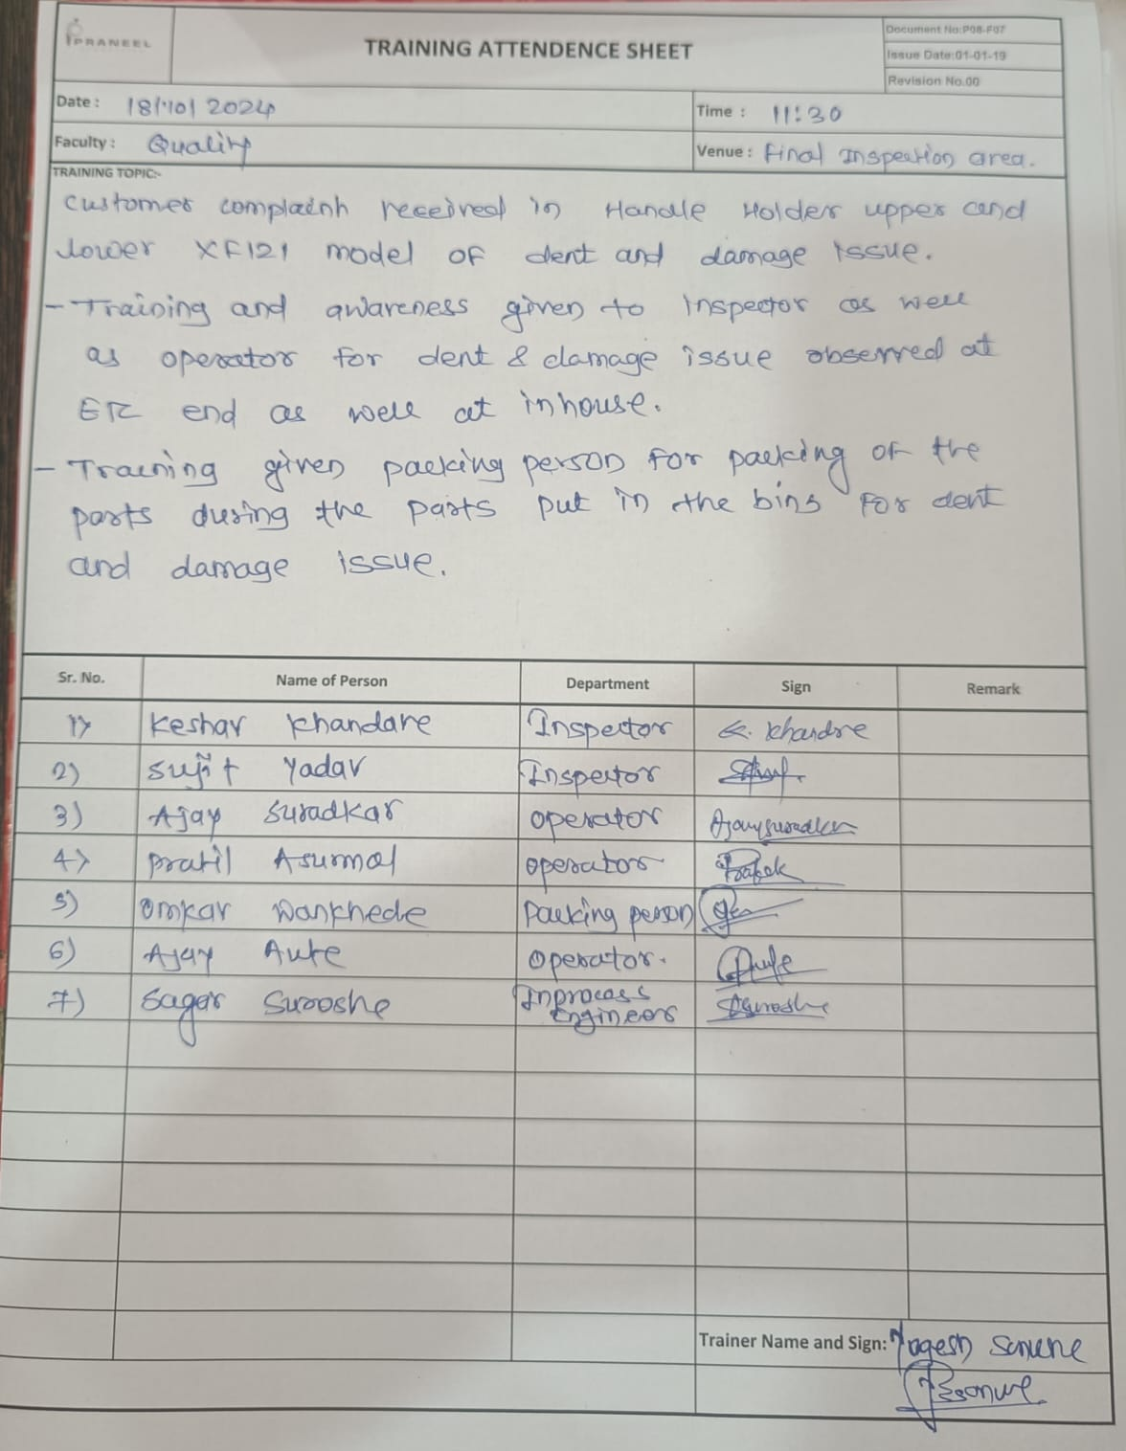
Evidences
1. Q-Alert
2.Training Record.

