Slide 1
8D Problem Solving Methodology Problem –Ball depth observed under size up to 8.32, against 8.7 ± 0.1 Supplier Name- Cast 4 Aluminium ltd Part Name- SECONDARY LEVER FINISHE ATHER DISC DRUM.

Slide 2
8D - Overview
Supplier Name : Cast 4 Aluminium Ltd.
D1: Problem Solving Team :
Mahesh Ghadmode
Datta Moin
Mubarak Shaikh
Solving Team Leader: Mr. Mahesh Ghadmode
Problem Sub Suppliers Team members:
Endurance Team Members:
Format No.:QLQL_FMT_007 Rev-00 Effective Date:29-09-2022

Slide 3
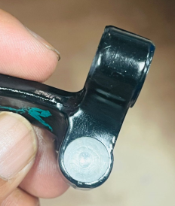
8D - Overview
D2 :Problem description details (with Pictures)
(Clearly mention what is the defect found at Ather & what is the deviation found in the part with respect to the drawing requirements)
Problem Description in 4W 1H
NG Photograph
 | Details
What | Ball depth observed under size up to 8.32, against 8.7 ± 0.1
Where | ETL
When | 26-10-2024
Who | Mahesh Ghadmode
How Much | 01 no’s

Slide 4
8D - Overview
D3 : Immediate Containment action (ICA):
Notes:
1. Clearly mention ICA Action and identification mark after ICA
2. ICA to be in place at supplier end of line till D7 effectiveness
Stocks | Description of Action | Sorting results |  | Resp. | Target Date | Quantitative assessment in %
 |  | How many checked | How many failed
IQC | - | - | - | - | -
Ather Store Stock
In Transit ( At WH)
At Supplier | 535 | 535 | 05 | Vishwas Borkar | 28-10-2024
Endurance Spares | NA | NA | NA | NA | NA | NA

Slide 5
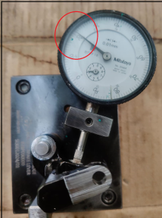
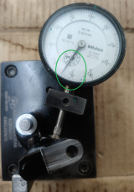
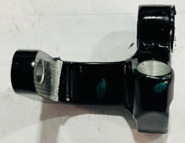
QUALITY ALERT
Date : 04.11.2023
Part Name : Secondary brake lever Ather Dnd | Operation Details : VMC Machining
Process Deviation details with Photograph: | Check points & Identification mark wrt ICA :
Dot Marking at final inspection
Not Ok
Ok
Approved by : R.Magar
Prepared By : Mahesh Ghadmode

Slide 6
8D - Overview
D4 : Root Cause Analysis (Occurrence)
D4.1: Mention all probable causes
Man
Machine/Die
Environment
Unskilled operator
Unspecified offset given by operator
Resting not ok on fixture
Lack of awareness
Clamping pressure drop
Ball depth observed under size up to 8.32, against 8.7 ± 0.1
Improper fettling
Hardness of part
Parts checked on sample basis
Interlock not available for offset
Material
Method
Measurement/Other

Slide 7
8D - Overview
D4.2 : Validation of all Probable Causes : Ather Secondary Lever DnD
Sr. No. | Ishikawa Category (6M) | Probable Causes Description | Significant / Insignificant | Validation reports Attachments
1 | Man | Unskilled operator | Significant | Skill matrix available of operator
2 | Man | Lack of awareness | Significant | Training record available
3 | Man | Unspecified offset given by operator | Significant | Interlock added to Offset Interface
4 | Machine | Clamping pressure drop | Significant | Power pack having provision to control pressure
5 | Machine | Resting not ok on fixture | Insignificant | As discussed with fixture manufacturer & provision will be implement to avoid parting line resting
6 | Material | Hardness of part | Significant | Hardness of material check found ok
7 | Material | Improper fettling | Significant | Fettling SOP available at respective location
8 | Measurement | Parts checked on sample basis | Significant | 100% inspection started with relation gauge

Slide 8
8D - Overview
D 4.3 : Why-Why Analysis:
Do Why-Why analysis for all validated significant potential causes
Why- Why Analysis for Occurrence Cause
Why- Why Analysis for Detection Cause
WHY-1 | Ball depth observed under size up to 8.32, against 8.7 ± 0.1
WHY-2 | Part not rest in the fixture
WHY-3 | Part having excess parting line
WHY-4 | Parting line removal is manual operation
WHY-5 | No provision in fixture to avoid parting line
WHY-6
WHY-1 | Ball depth observed under size up to 8.32, against 8.7 ± 0.1
WHY-2 | Parts checked on sample basis 5 Nos
WHY-3 | 100 % inspection started on relation gauge
Root Cause : Parts checked on sample basis 5 Nos
Root Cause :No provision in fixture to avoid parting line

Slide 9
8D - Overview
D5 & D6: Implementation of Corrective actions) : Ather Secondary Lever DnD
Root cause | Occurrence/ Detection | Corrective action | Implementation date | Horizontal Deployment | Target Date for Horizontal Deployment
No provision in fixture to avoid parting line | Occurrence | As discussed with fixture manufacturer & provision will be implement to avoid parting line resting | 07.11.2024 | All VMC Machines | 15.11.2024
Parts checked on sample basis | Detection | 100% inspection started with the help of relation gauges | 28.10.2024 | All lever family | Completed

Slide 10
8D - Overview
D7: Updation of Preventive actions: List of the revised documents to attach
SN | Name | Doc. No. | Rev. No | Change Details | Attach revised Doc. here
1 | Design Record | - | - | - | -
2 | Engineering Change Documents (if any) | - | - | - | -
3 | Ather Engineering Approval (if required) | - | - | - | -
4 | Design FMEA | - | - | - | -
5 | Process Flow Diagram | - | - |  | -
6 | Process FMEA | F/DEV/13 | 02 | Dimple operation resting point added
7 | Control Plan | F/DEV/13 | 02 | Dimple inspection frequency change | Dimple inspection frequency change
8 | Measurement System Analysis Studies | - | - | - | -
9 | Dimensional Result | - | - | - | -
10 | Material, Performance Test Results | - | - | - | -
11 | Process Studies (Capability Study) | - | - | - | -

Slide 11
8D - Overview
D1 & D2 Bug Details:
D5 & D6 - Implementation of Corrective actions:
Part No / Name : Secondary lever Ather DnD
Supplier : ETL
Swim lane :
Start date : Status (D) :
Problem Description : Ball depth observed under size up to 8.32, against 8.7 ± 0.1
Risk Level : High
Action item | CA/PA | Target | Resp | Status
As discussed with fixture manufacturer & provision will be implement to avoid parting line resting | PA |  |  | 07.11.2024
100 % inspection started for dimple depth | PA |  |  | Completed
 | CA |  |  | In process
D3 - Immediate Containment action (ICA):
 | Ather IPQC | Ather Store Stock | ETL In Transit | At Supplier | ETL Spares
Inspected (Qty) | - | 0 | 600 | 535 | -
NG (Qty) | - | - | - | 5 | -
D7 - Updation of Preventive actions (Standardization) :
D4 - Root Cause Analysis (Occurrence & Non-Detection)
FMEA & CP, WI for Final Inspection,
For Occurrence:
No provision in fixture to avoid parting line
For Outflow:
Parts checked on sample basis 5 Nos
D8 Closure:
Key Challenges:

Slide 12
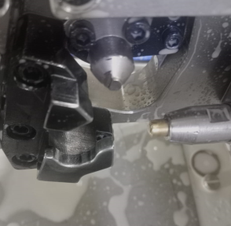
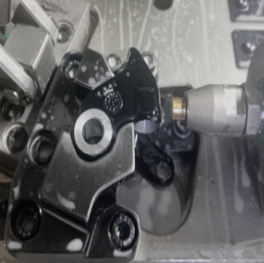
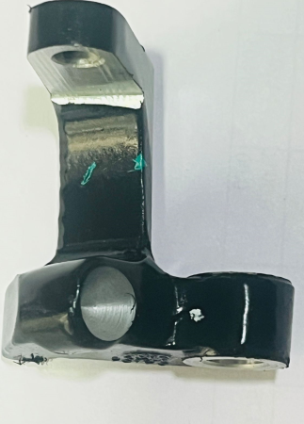
No Provision available for resting parting line part

Slide 13
As discussed with fixture manufacturer we will provide groove to the resting area to avoid parting line resting .

Slide 14
Thank You
Format No.:QLQL_FMT_007 Rev-00 Effective Date:29-09-2022

