Slide 1
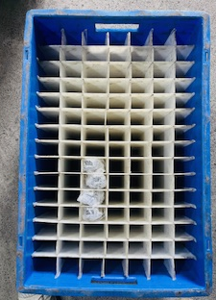
Partion bins with bubble bag implemented for the material movement.

