Slide 1
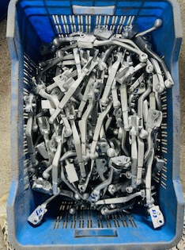
For the material movement jumbo bins used,material contact to each other casused dent mark.

