Slide 1
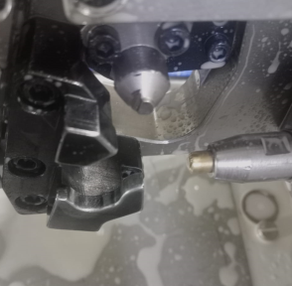
No Provision available for resting parting line part

