Slide 1
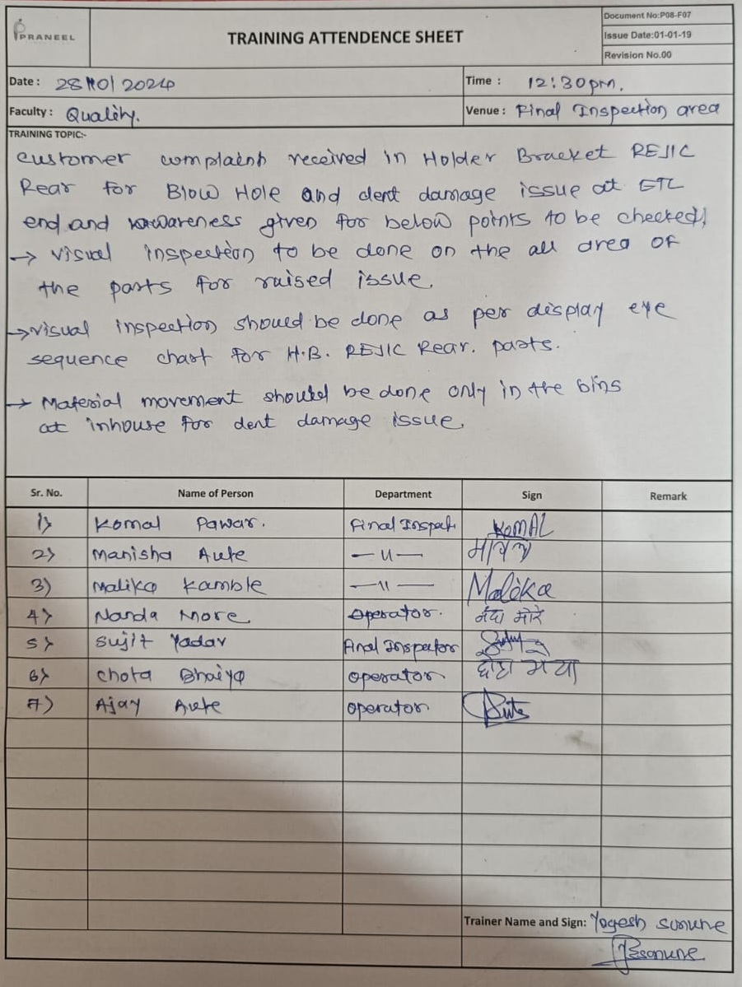
Evidences
1.Eye Sequence Chart after
2.Training Record.

