Slide 1
MAP ALLOYS
Analysis report and Action plan for Leakage issue in Integral Caliper Body-raw.

Slide 2
Problem Analysis and Corrective Action Report
Corrective Action / 8D Report
On
Leakage observed in Integral Caliper body Raw.
Date: -24.10.2024.

Slide 3
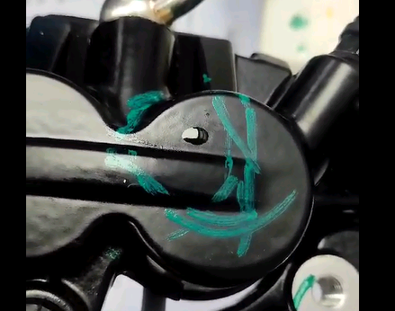
D1 : CFT for Problem Solving
Sr. No. | Name | Department | Designation
1 | Mr. S.K Dash | Operation | Operation Head
2 | Mr. Manish Kolte | Quality | Quality Head
3 | Mr.Rajesh Pandey | Quality | Assist. Manager
4 | Mr. Moreshwar Patil | Quality | Quality Engineer
5 | Mr. Bhaskar Madape | Production | Production Incharge
6 | Mr.Anil Dhange | Die Maint. | Die Maint. Incharge
D2 : Complaint Details:
Problem Definition : |  | Leakage observed in caliper body raw | Defect Photo
Part No./Name | : | Calliper Body Raw
Customer/Location | : | ETL/ Auramgabad
Advik Plant Name / No. | : | K-226/2 ,Waluj MIDC, Sambhajinagar
Complaint Date / Time | : | 24.10.2024
Rejection Qty | : | 1 no.
Repeated / New | : | repeated
Reported By | : | Mr. Raviraj Gaikward
Attended By | : | Mr.Navnath G
Closing Date (Target) | : | In-Process.
Leakage

Slide 4
D3 : Interim / Containment Action
Sr. No. | Containment Area / Location | Date | Available Qty. | Segregation Qty | OK Qty. | NG Qty. | Dispatch / Remarks
1 | Customer End
2 | Warehouse
3 | Plant Dispatch Area
4 | Final Inspection & Assembly Line
5 | Machine Shop
6 | Incoming Insp.
7 | Receipt Store
8 | Supplier End At Final inspection.
9 | At Production stage (Please Specify)
10 | Other Location (Please Specify)
Interim / Containment Actions Closure - Date: Time: Shift:

Slide 5
Process Flow Information
  Receipt of raw material
Incoming inspection of
AC2A Alloy
Incoming raw material inspection(Sand)
Storage of raw material.
Degassing (if DI not ok)
Holding molten metal in holding chamber
Melt treatment inside chamber and at holding chamber
Continuous charging and melting
DI and Spectro Check
N2 Lance Degassing
Die preparation & Die loading
Sand core
Fettling/Grinding
Runner/Riser Cutting
Decoring
Casting
Heat Treatment
Heat Number punching & shot blasting.
Transfer to Inspection & Final inspection
Packing
Note: Fill Red Color in process Block where defect is occurred.

Slide 6
D4 : Root Cause Analysis: Ishikawa Diagram
Man
Machine
Method
Unskilled Operator
Machine Jerk and Vibration
Pouring delay
Excess metal filling time.
Short pouring
Machine parameters are not ok
No smooth Feeding of metal in cavity.
New Operator
Less metal temp.
Less venting
Less die coat application
Leakage issue in Integral Caliper body Raw.
Chemical composition not ok
Spectro not Calibrated.
Low illumination level (Rec: 600 min lux)
Wrong Grade material use.
Inspection frequency not defined.
Material
Measurement
Environment

Slide 7
D4 : Validation of Probable Causes:
Sr. No. | Area/Condition | Probable Cause | Validation | Observation (Significant/ Non-Significant)
1 | Man | Unskilled Operator | Operator is skilled . | Non-Significant
 | Man | New Operator | Operator working from last 1.6 years | Non-Significant
2 | Machine | Machine jerk and vibration | No jerk and vibration in machine | Non-Significant
 |  | Machine parameters are not ok | Machine parameters like solidification | Non-Significant
 |  | Less Venting | Less gas pass from the cavity. | Non-Significant
3 | Method | Pouring delay by operator | No Pouring delay by Operator | Non-Significant
 |  | Short poring | No short pouring | Non-Significant
 |  | Less metal temp | Metal temperature found 718C | Non-Significant
 |  | Less die coat application | Die coat application found Ok | Non-Significant
 |  | Excess metal filling time | No excess metal filling time . | Non - Significant
 |  | No smooth Feeding of metal in cavity at leak area. | No smooth flow of metal due to pouring cup depth excess . | Significant
4 | Material | Chemical composition not ok. | Chemical composition found Ok | Non-Significant
5 | Measurement | Spectro machine not calibrated | Spectro machine calibrated. | Non-Significant
6 | Environment | Low illumination level (Rec: 600 min lux) | Lux level checked found - 760 | Non-Significant

Slide 8
D4 : Why-Why Analysis for Occurrence:
Cause(s) → | Cause1 | Cause 2 (As Applicable)
Why- Why | Leakage after machining
Why 1 | Metal turbulence in cavity at leak area
Why 2 | No smooth flow of molten metal in cavity.
Why 3 | Pouring cup depth excess than required.
Why 4
Why 5
Final Root Cause | Pouring cup depth excess than required.

Slide 9
D4 : Why-Why Analysis for Outflow :
Cause(s) → | Cause1 | Cause 2 (As Applicable)
Why- Why | Leakage observed after machining during HP lest.
Why 1 | Blow hole open after machining.
Why 2 | Machining facility not available at our end.
Why 3
Why 4
Why 5
Final Root Cause | Machining facility not available at our end.

Slide 10
D5 : Corrective Actions (Occurrence & Outflow)
1. Occurrence :
Sr. No. | Action to be taken | Resp. | Target Date | Status | Remarks
1. | Pouring cup depth decrease and slop provided for smooth flow of metal in cavity. | Mr. Anil Dhande / P.N.Patil. | 25.10.2024 | Completed. | Lot is to be produce.
2. Outflow:
Sr. No. | Action to be taken | Resp. | Target Date | Status | Remarks
1. | Quality Alert displayed. Training has been provided to the inspector. | Mr. Navnath G | 11.09.2024 | Completed | Ok

Slide 11
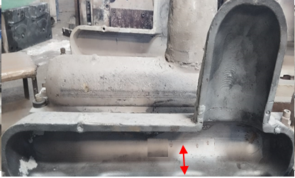
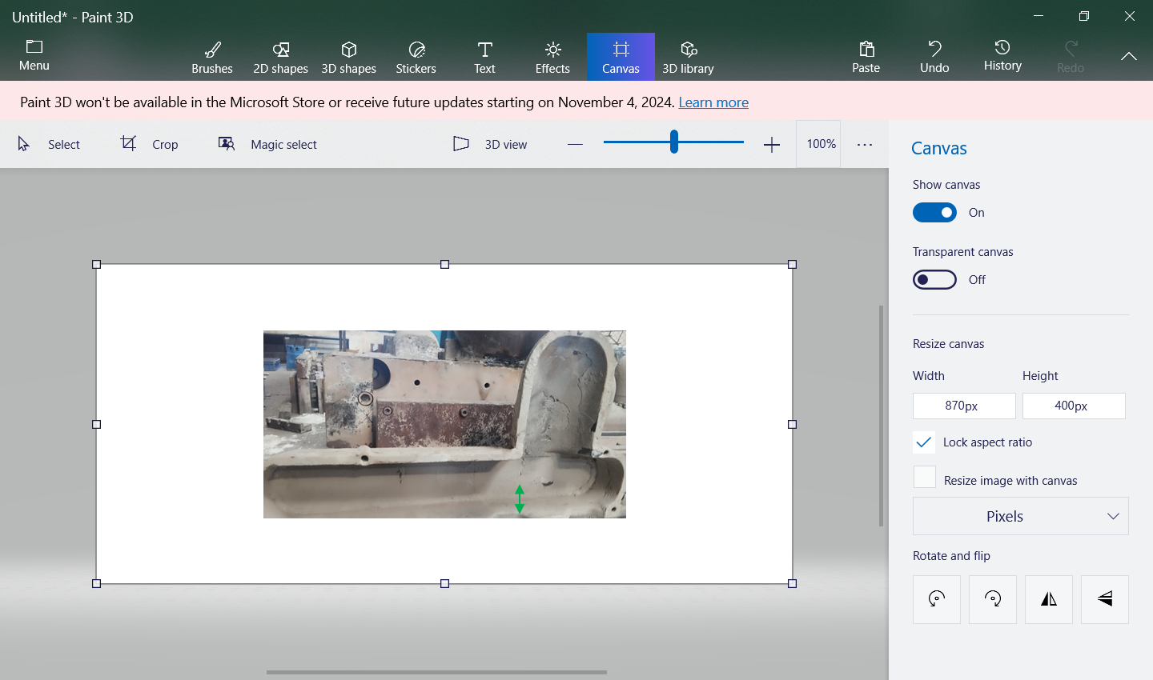
D6 : Verification of Corrective Actions
Sr. No. | Action taken | Verified By | Verification Date | Status | Remarks
1. | Pouring cup depth decrease and slop provided for smooth flow of metal in cavity. | Rajesh Pandey | 25.10.2024. | Completed
Pouring cup depth decreases from 45mm to 32 mm for smooth pouring.
Before Correction
After Correction
Before correction pouring cup depth was 45 mm
After correction pouring cup depth was 32 mm
Note: Please attach evidences here. Insert evidences as objects.

Slide 12
D7(A) : Preventive Actions
Sr. No. | Action taken | Resp. | Target Date | Status | Remarks
1. | we will update in design of pouring cup. | Mr. Rajesh Pandey | 15.11.2024 | Completed.
Horizontal Deployment :
Sr. No. | Product Scope | Resp. | Impletn. Date | Status | Remark

Slide 13
D7(B) : Standardization / Documents Updation
Sr. No. | Document Description | Put “#” on Applicable | Sr. No. | Document Description | Put “#” on Applicable
1. | Quality Alert |  | 8. | Work Instructions
2. | One Point Lesson (OPL) | # | 9. | Inspection Std. / Reports
3. | PFMEA / PQCS 2 |  | 10. | Packing Standard
4. | Control Plan |  | 11. | Process Flow Chart / PQCS 1
5. | Poka Yoke Verification checklist |  | 12. | Drawings
6. | JH Checklist |  | 13. | Gauge / Jig / Fixture Drawings
7. | PM Checklist |  | 14. | Fixture Calibration Plan
Please Specify (if other, excluding above listed documents)
Sr. No. | Document Description | Put “#” on Applicable | Sr. No. | Document Description | Put “#” on Applicable
1. | Update in design. | # | 3.
2. |  |  | 4.
Note: Please put “ # ” mark for applicable / changed documents

Slide 14
Thank you

