Slide 1
MAP ALLOYS
Analysis report and Action plan for Blow hole issue in Caliper Body-raw-REAR REML J1C.

Slide 2
Process Flow Information
  Receipt of raw material
Incoming inspection of
AC2A Alloy
Incoming raw material inspection(Sand)
Storage of raw material.
Degassing (if DI not ok)
Holding molten metal in holding chamber
Melt treatment inside chamber and at holding chamber
Continuous charging and melting
DI and Spectro Check
N2 Lance Degassing
Die preparation & Die loading
Sand core
Fettling/Grinding
Runner/Riser Cutting
Decoring
Casting
Heat Treatment
Heat Number punching & shot blasting.
Transfer to Inspection & Final inspection
Packing
Note: Fill Red Color in process Block where defect is occurred.

Slide 3
Root Cause Analysis: Ishikawa Diagram
Man
Machine
Method
Unskilled Operator
Machine Jerk and Vibration
Pouring delay
Excess metal filling time.
Short pouring
Machine parameters are not ok
No smooth Feeding of metal in cavity.
New Operator
Less metal temp.
Less venting
Less die coat application
Leakage issue Caliper body Raw-Rear REML-J1C.
Chemical composition not ok
Spectro not Calibrated.
Low illumination level (Rec: 600 min lux)
Wrong Grade material use.
Inspection frequency not defined.
Material
Measurement
Environment

Slide 4
Validation of Probable Causes:
Sr. No. | Area/Condition | Probable Cause | Validation | Observation (Significant/ Non-Significant)
1 | Man | Unskilled Operator | Operator is skilled . | Non-Significant
 | Man | New Operator | Operator working from last 1.6 years | Non-Significant
2 | Machine | Machine jerk and vibration | No jerk and vibration in machine | Non-Significant
 |  | Machine parameters are not ok | Machine parameters like solidification | Non-Significant
 |  | Less Venting | Less gas pass from the cavity. | Non-Significant
3 | Method | Pouring delay by operator | No Pouring delay by Operator | Non-Significant
 |  | Short poring | No short pouring | Non-Significant
 |  | Less metal temp | Metal temperature found 718C | Non-Significant
 |  | Less die coat application | Die coat application found Ok | Non-Significant
 |  | Excess metal filling time | No excess metal filling time . | Non - Significant
 |  | No smooth Feeding of metal in cavity at leak area. | No smooth flow of metal due to pouring cup depth excess . | Significant
4 | Material | Chemical composition not ok. | Chemical composition found Ok | Non-Significant
5 | Measurement | Spectro machine not calibrated | Spectro machine calibrated. | Non-Significant
6 | Environment | Low illumination level (Rec: 600 min lux) | Lux level checked found - 760 | Non-Significant

Slide 5
Why-Why Analysis for Occurrence:
Cause(s) → | Cause1 | Cause 2 (As Applicable)
Why- Why | Leakage after machining
Why 1 | Metal turbulence in cavity at blow hole area
Why 2 | No smooth flow of molten metal in cavity.
Why 3 | Pouring cup depth excess than required.
Why 4
Why 5
Final Root Cause | Pouring cup depth excess than required.

Slide 6
Why-Why Analysis for Outflow :
Cause(s) → | Cause1 | Cause 2 (As Applicable)
Why- Why | Blow hole observed after machining
Why 1 | Internal defects open after machining.
Why 2 | Machining facility not available at our end.
Why 3
Why 4
Why 5
Final Root Cause | Machining facility not available at our end.

Slide 7
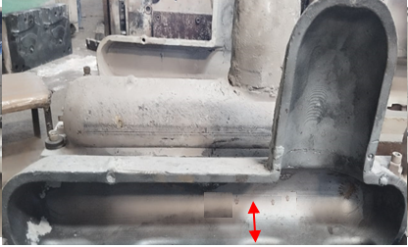
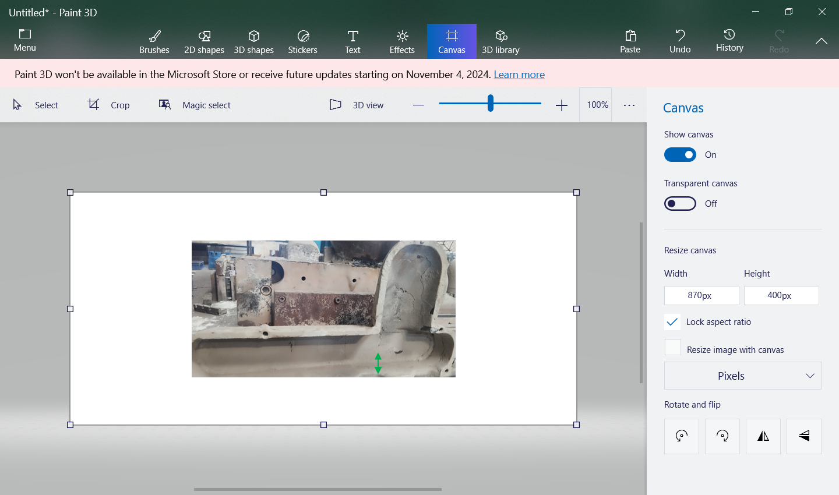
Verification of Corrective Actions
Sr. No. | Action taken | Verified By | Verification Date | Status | Remarks
1. | Pouring cup depth decrease and slop provided for smooth flow of metal in cavity. | Rajesh Pandey | 25.10.2024. | Completed
Pouring cup depth decreases from 45mm to 32 mm for smooth pouring.
Before Correction
After Correction
Before correction pouring cup depth was 45 mm
After correction pouring cup depth was 32 mm
Note: Please attach evidences here. Insert evidences as objects.

Slide 8
Preventive Actions
Sr. No. | Action taken | Resp. | Target Date | Status | Remarks
1. | we will update in design of pouring cup. | Mr. Rajesh Pandey | 15.11.2024 | Completed.
Horizontal Deployment :
Sr. No. | Product Scope | Resp. | Impletn. Date | Status | Remark

Slide 9
Thank you

