Slide 1
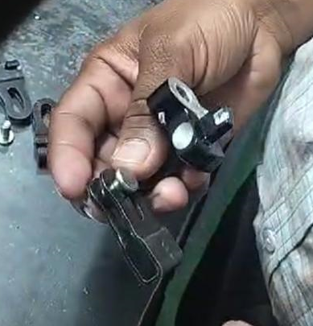
Circlip was implemented for the 4 mm dimension

