Slide 1
Action plan Dt.: 11th Nov 2024

Slide 2
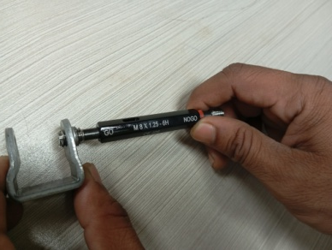
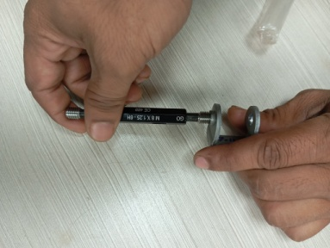
CONDITIONS FOR OCCURRENCE
● Phenomenon:M8 X 1.25 -6h thread GO Tight
Trouble content
・Supplier: M/s Saptagiri Industries
・Model: HMSI
・Parts name: U Type Bracket
・Part No.: 530PE00402
・Date of Occurrence: 06.11.2024
・Qty NG: 01 Nos.
NG Part | OK Part
●Parts Stock check results
Thread GO Tight
Actual: M8X1.25-6h
Thread GO Pass
Actual: M8X1.25-6h
Action
Area | Total Stock | Checked | Checking Method | NG Qty | Status
ETL | 7000 | 7000 | With concentricity gauge & Visual check | 53 | All available stock qty. verified & found OK.
SEPL | 2000 | 2000 | With Concentric PIN Gauge | 05

Slide 3
UNDERSTANDING OF ACTUAL CONDITION AND CONTROL
Process Flow
Possible defect occurrence area.
Raw Material Inward
Sheet Sharing
Blanking
Two side chamfer
First forming
U forming
Tapping
Chamfer
Extrusion Chamfer
Piercing Second Hole
Piercing first Hole
Cleaning
Final Inspection
Packaging / Storing

Slide 4
UNDERSTANDING OF ACTUAL CONDITION
● Understanding the actual cause – (Factor analysis)
Man
Machine
Minor Dia. of Extrusion Hole 6.70mm
Operator not aware about threaded & its Tightness
First Piercing Hole Dia. 8.15mm
Tapping Fixture Part Mounting plate Thickness is 17.00mm
M8 X 1.25 – 6h
Thread GO Tight
For material storing & movement used gunny bag Press shop to tapping stage
Material as per grade standard
Material Not identified by tagging
Cleaning , Burr Removing is doing above used to go
Method
Material

Slide 5
FACTS VERIFICATION
# | 4M | PROBABLE CAUSES | FACTS VERIFICATION | Jud.
1 | MAN | Operator not aware about threaded & its Tightness | Verify the operators’ awareness about threaded and its Tightness of part, out of 03 operator 01 operator not aware about it Tightness of M8 thread . | ❒
2 | MACHINE | First Piercing Hole Dia. | First Piercing Hole Dia. observe 8.15mm | ❒
 |  | Minor Dia. of Extrusion Hole | Minor Dia. of Extrusion Hole observed 6.70mm | ❒
 |  | Tapping Fixture Part Mounting plate Thickness is 17.00mm | Tapping Fixture Part Mounting plate Thickness observe 17.00mm | ❒
3 | METHOD | For material storing & movement in bins from Press shop to tapping stage | Material storing & movement in bins from Press shop to tapping stage . | O
 |  | Material Not identified by tagging | Material identified by tagging | O
 |  | Cleaning , Burr Removing is doing above used to go | For Loose Burr Removing process to be need more Straighten | ❒
4 | MATERIAL | As per Standard grade | As per Standard grade | O

Slide 6
ROOT CAUSE ESTABLISHMENT (WHY-WHY ANALYSIS)
● Root cause establishment (Why-Why Analysis)
 | WHY – 1 | WHY- 2 | WHY -3 | WHY-4 | Why-5
Occurrence | M8 X 1.25 – 6H Thread GO Tight | Thread Plug Gauge not easily pass (Tight) | As First Piercing Hole and Extrusion Hole Dia. 8.15, 6.70 mm both at lower tolerance side respectively
Occurrence | M8 X 1.25 – 6H Thread GO Tight | Part incline while tapping operation due to more clearance in-between part’s gap (as per drawing 19.00 mm) and the fixture plate thickness was 17.00 mm | Tapping Fixture Part Mounting Plate thickness less that is 17.00 mm only | It is easy to part loading and unloading
Outflow | M8 X 1.25 – 6H Thread GO Tight | Sample inspection 10: 200
Conclusion
As First Piercing Hole and Extrusion Hole Dia. 8.15, 6.70 mm at lower tolerance respectively
Part incline while tapping operation due to more in-between part’s gap and the fixture.
For Loose Burr Removing, Started cleaning operation (SOP made available)
Sample inspection 10: 200

Slide 7
COUNTERMEASURES
 | Cause | Countermeasure | Tgt. Dt. | Status
Supplier End | <Occurrence > | As First Piercing Hole keep by 8.25 mm instead of 8.15 mm and Extrusion Hole ( Thread minor 6.75 mm instead of 6.70mm ) Tapping Fixture Part Mounting Plate thickness increases by19.00 mm instead of 17.0 mm to avoided more gap in- between parts and fixture For the Die 8.25 mm after that produce 100000 qty. dia. will reduce by 30-40 micron ( It’s a tool life ) then change the tool For the Die 6.76 mm after that produce 100000 qty. dia. will reduce by 30-40 micron ( It’s a tool life ) then change the tool | 09-11-2024 09-11-2024 09-11-2024 | Completed Completed Completed
Supplier / ETL End | <Outflow> | One point lesion display at work place Awareness training given to final inspector for threaded parts inspection Sample inspection frequency increase by 20 : 200 Started Cleaning Operation process (SOP done) | 09-11-2024 09-11-2024 09-11-2024 09-11-2024 | Completed Completed Completed Completed

Slide 8
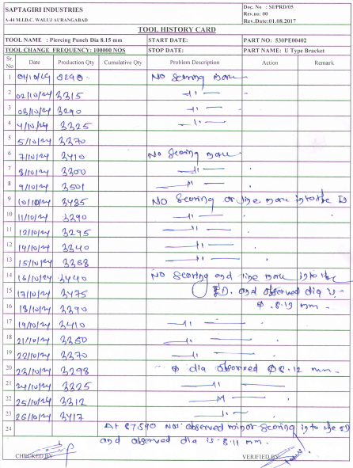
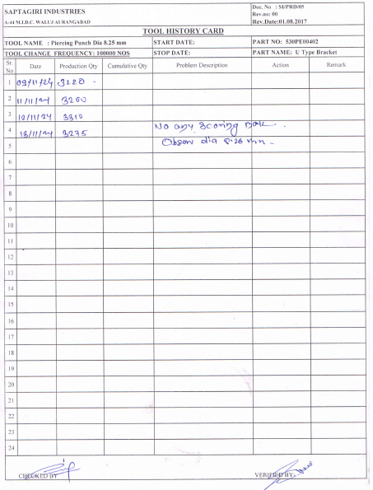
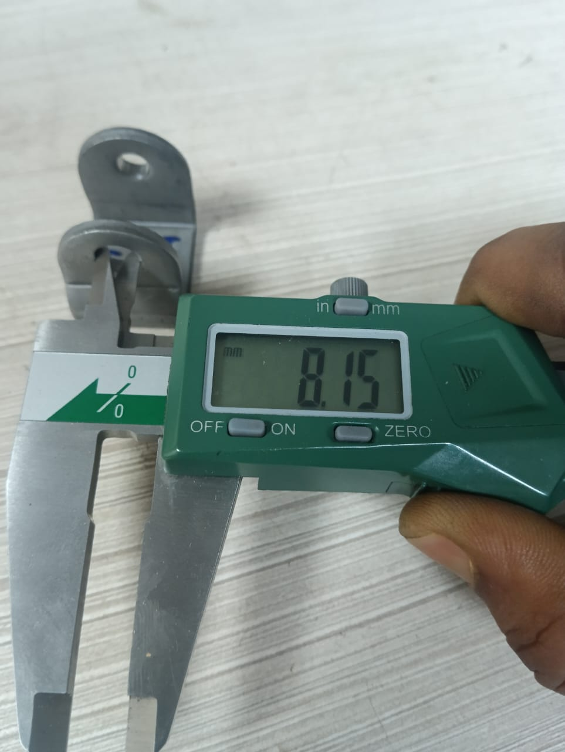
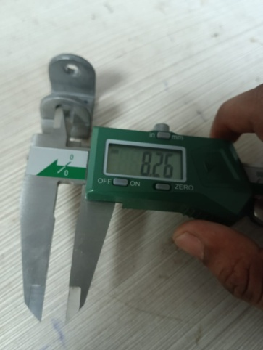
Countermeasure taken
Operation: Piercing
Target date: 09.11.2024 (Implemented)
First Piercing Hole is 8.15mm 8.10~8.15 mm | Size of First Piercing Hole maintain at 8.30 mm. 8.25~8.30 mm
BEFORE
AFTER
.

Slide 9
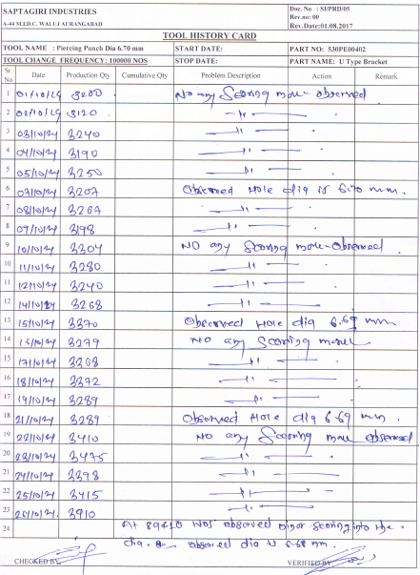
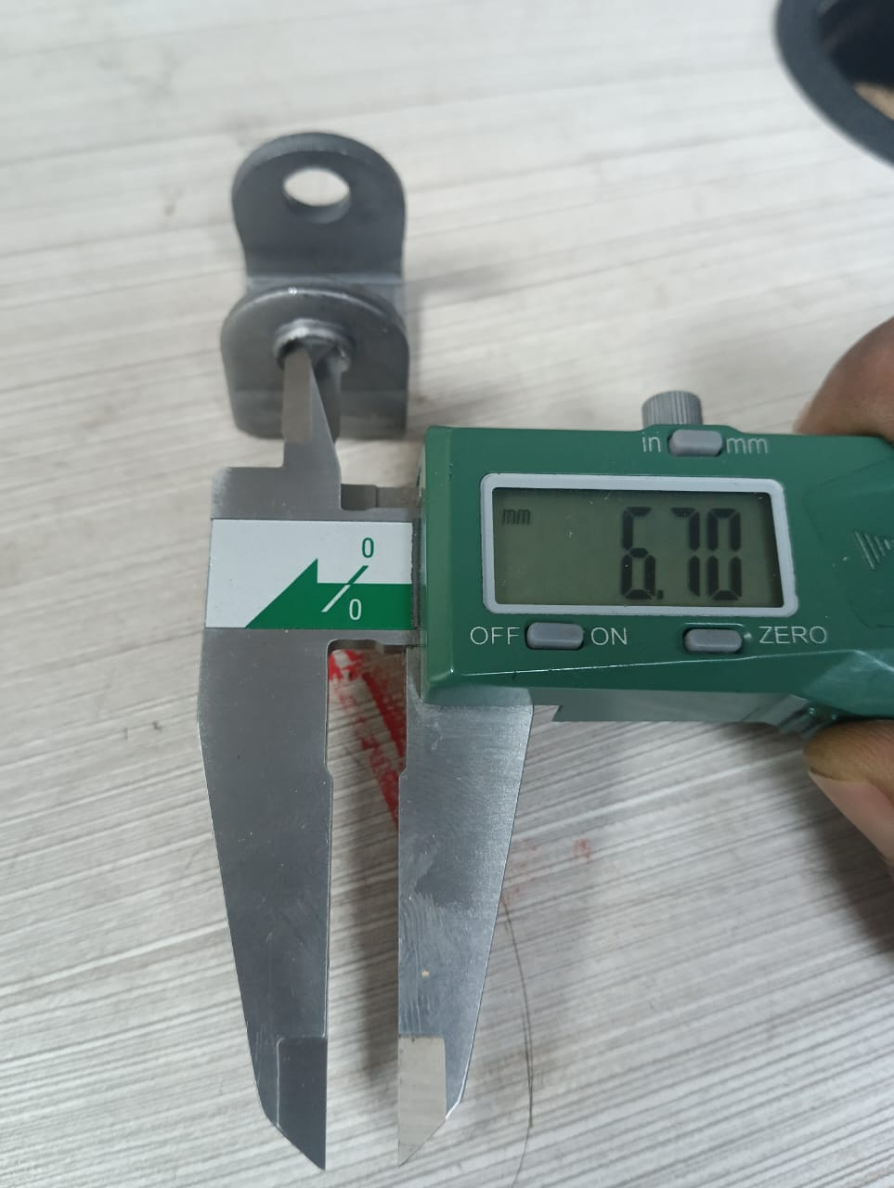
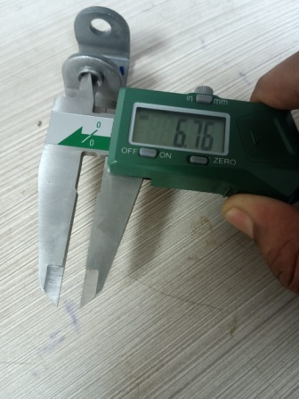
Countermeasure taken
Operation: Piercing-Extrusion
Target date: 09.11.2024 (Implemented)
First Extrusion Piercing Hole is 6.70 mm 6.70~6.75 mm | Size of Extrusion Piercing Hole maintain at 6.76mm 6.75~6.80 mm
AT TAPPING STAGE BEFORE
AT FINAL INSPECTION STAGE AFTER
.

Slide 10
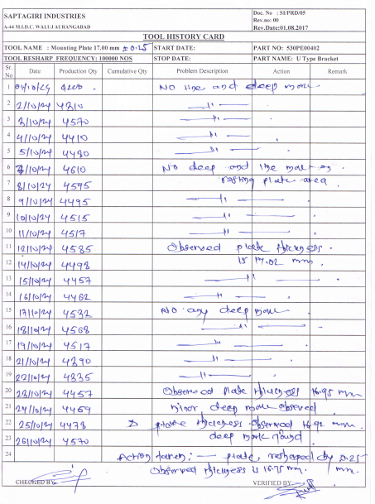
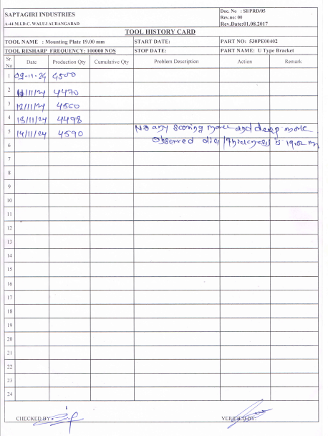
Countermeasure taken
Operation: Tool history card Dim 17 mm
Target date: 09.11.2024 (Implemented)
Tool history card for 17 mm
Tool history card for 19 mm
.

Slide 11
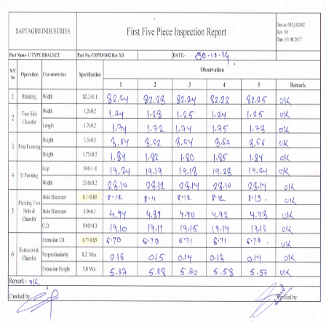
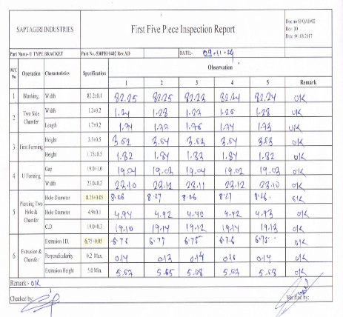
Countermeasure taken
Operation: First piece approval
Target date: 09.11.2024 (Implemented)
First piece approval report before
First piece approval report after
.

Slide 12
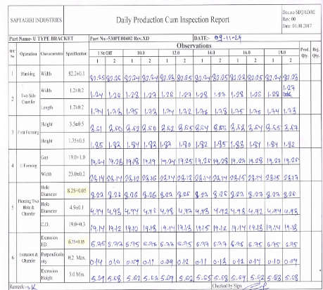
Countermeasure taken
Operation: In process inspection report
Target date: 09.11.2024 (Implemented)
In process inspection report before
In process inspection report after
.

Slide 13
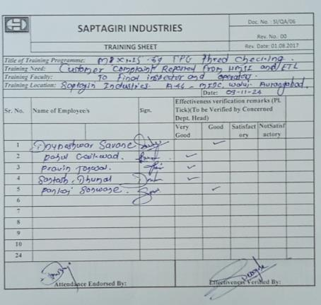
Training record for operator M8 tight thread through TPG
Awareness Training to Operator for M8 tight thread through TPG

Slide 14
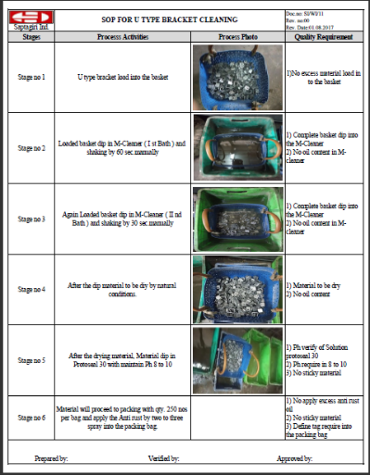
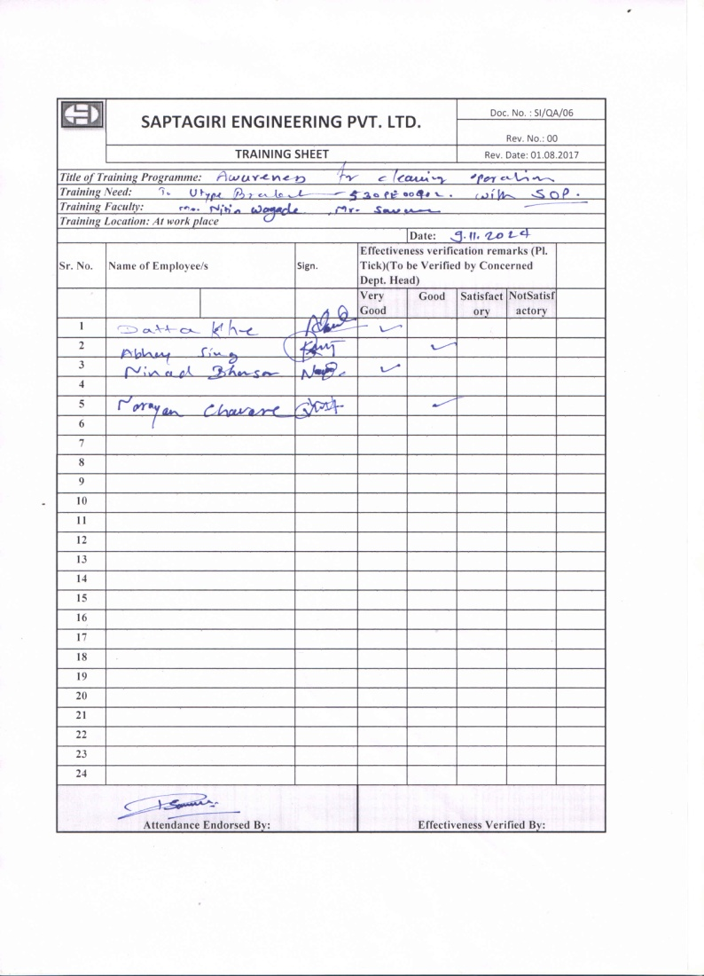
SOP FOR : Part cleaning for the loose burr or chips
SOP for parts Cleaning
Information / Awareness Training to Operator about Cleaning SOP

Slide 15
OPL / Q –Alert FOR : Thread GO Tight M8X1.25-6h

Slide 16
THANK YOU

